Slide 1

Development of the IEA
Overview of membership growth

Slide 2
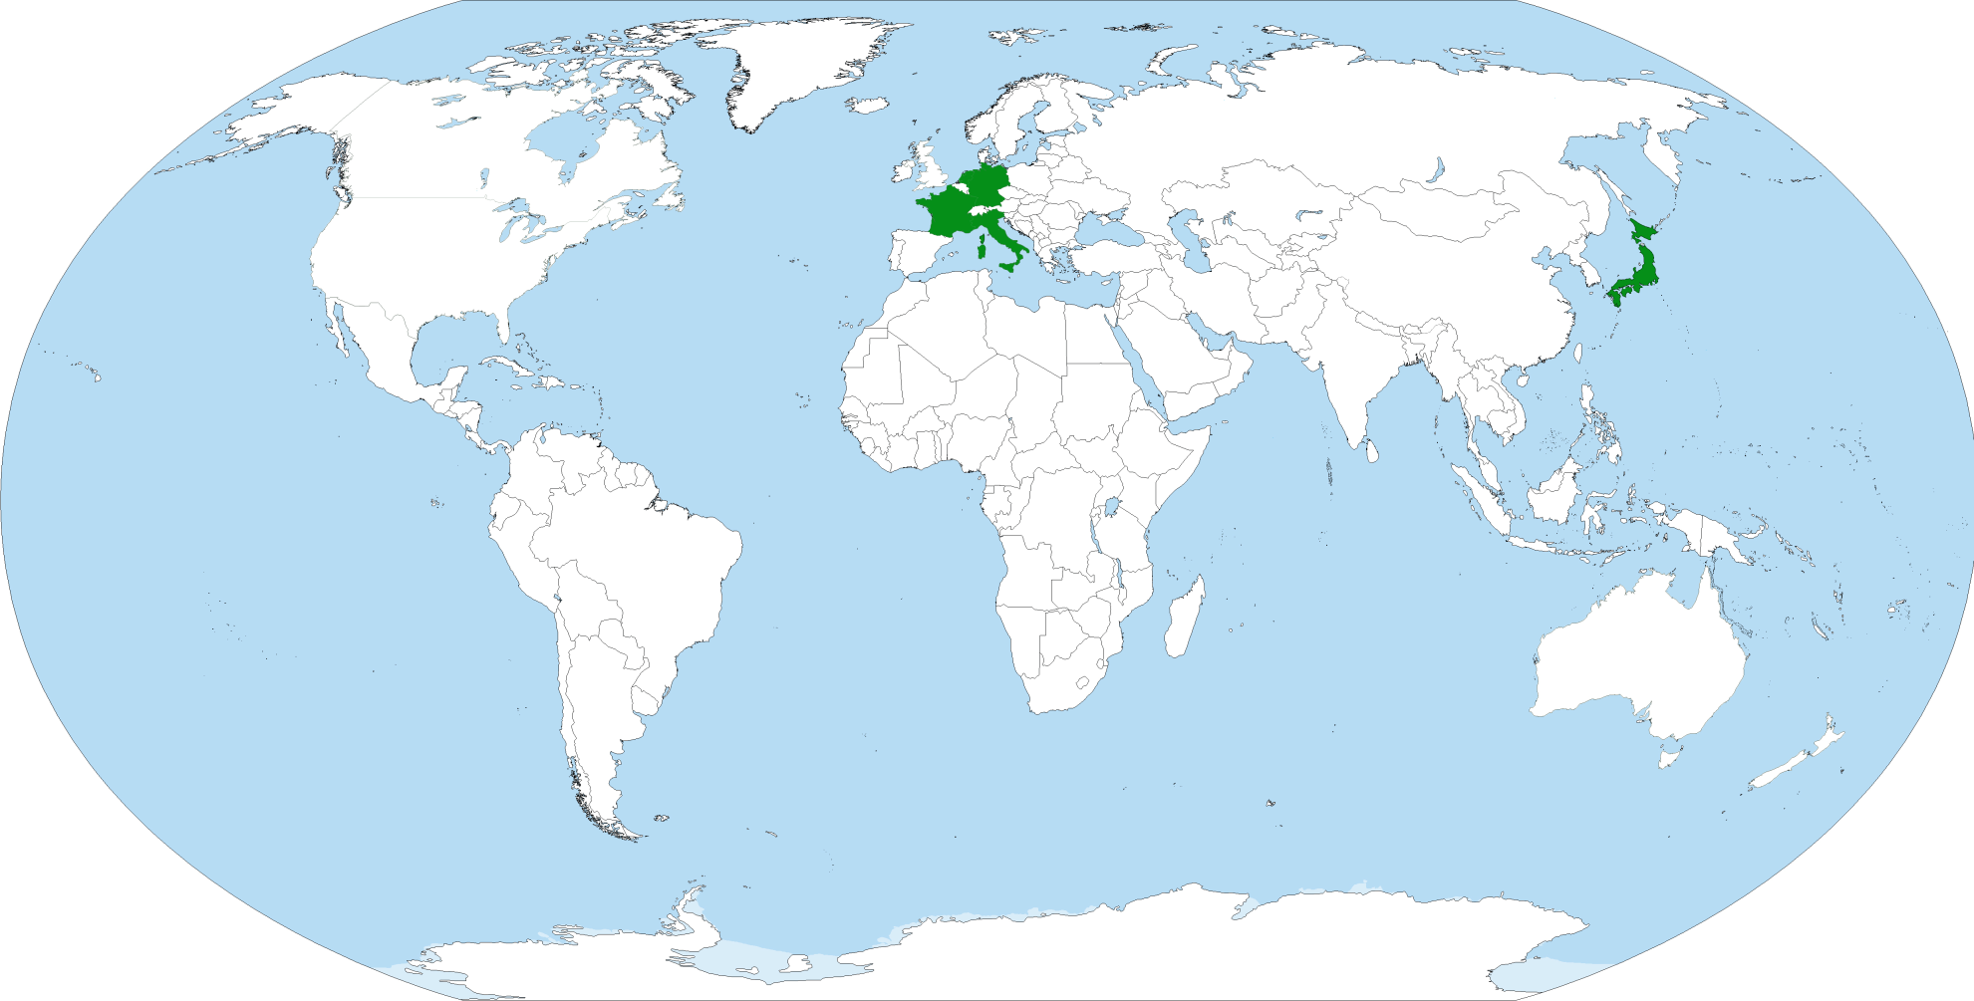
1965

Slide 3
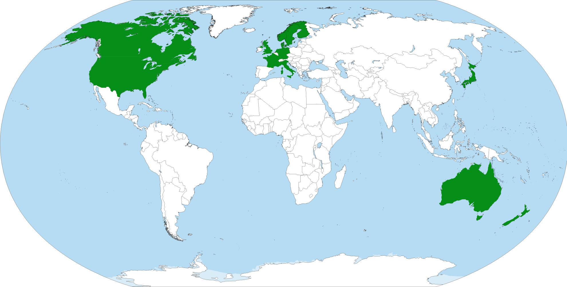
1970

Slide 4
1975

Slide 5
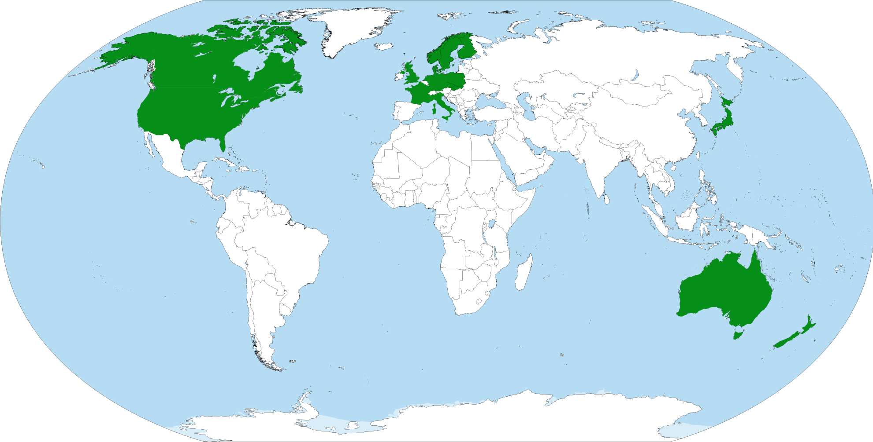
1980

Slide 6
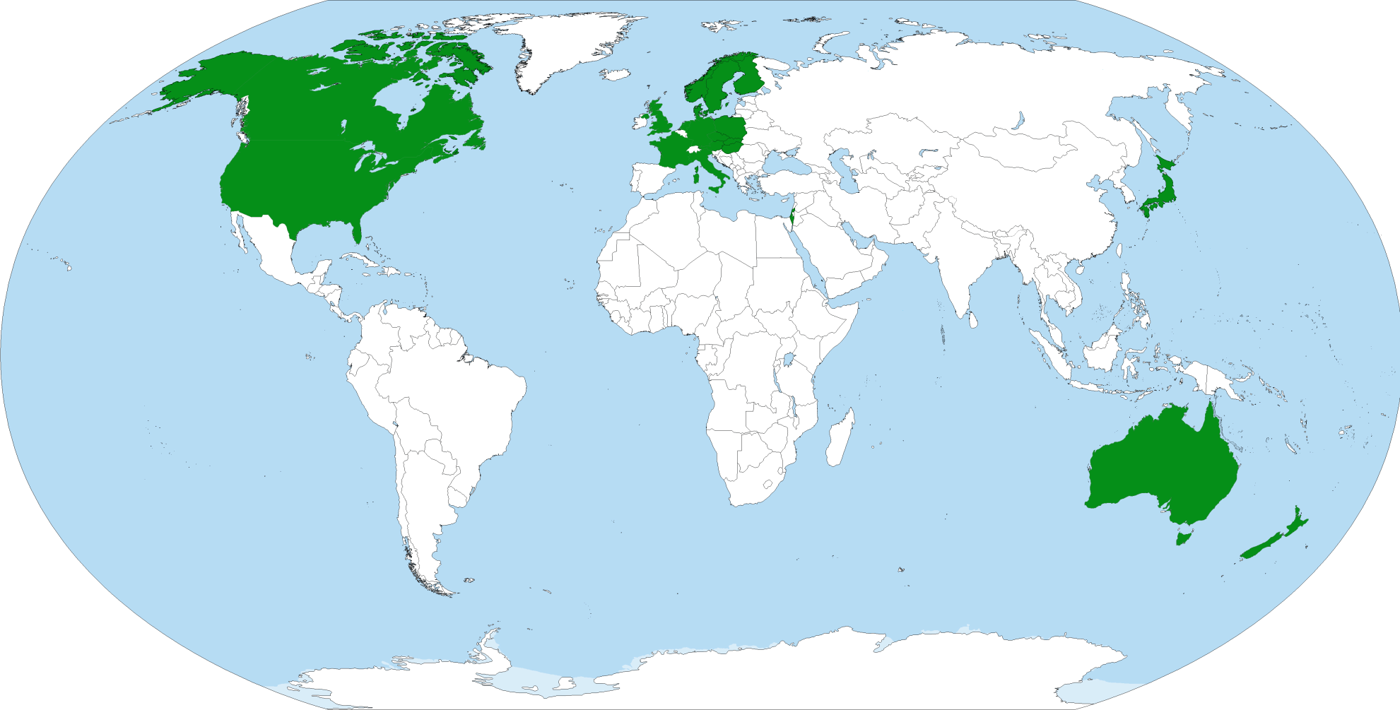
1985

Slide 7

1990

Slide 8
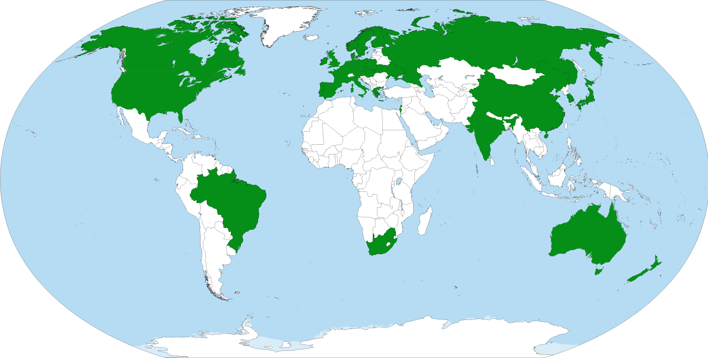
1995

Slide 9

2000

Slide 10
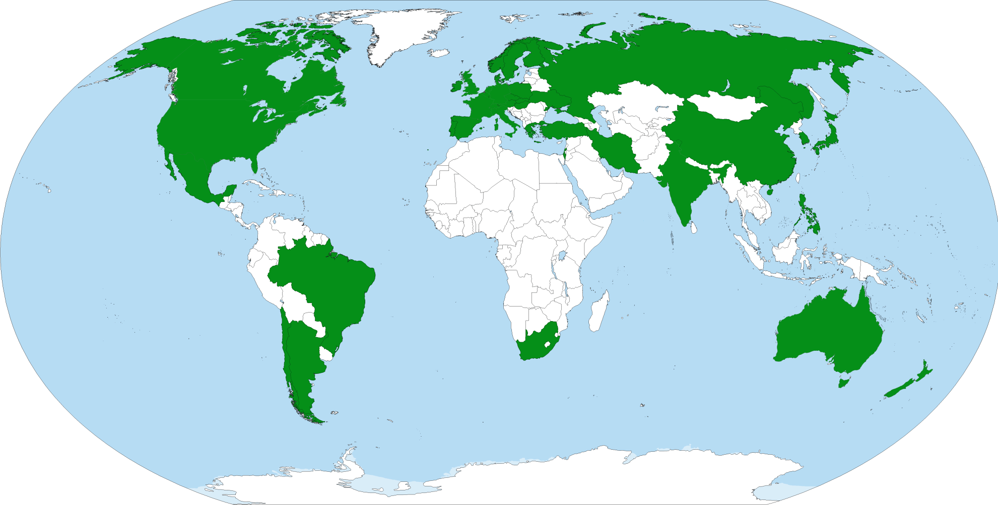
2005

Slide 11
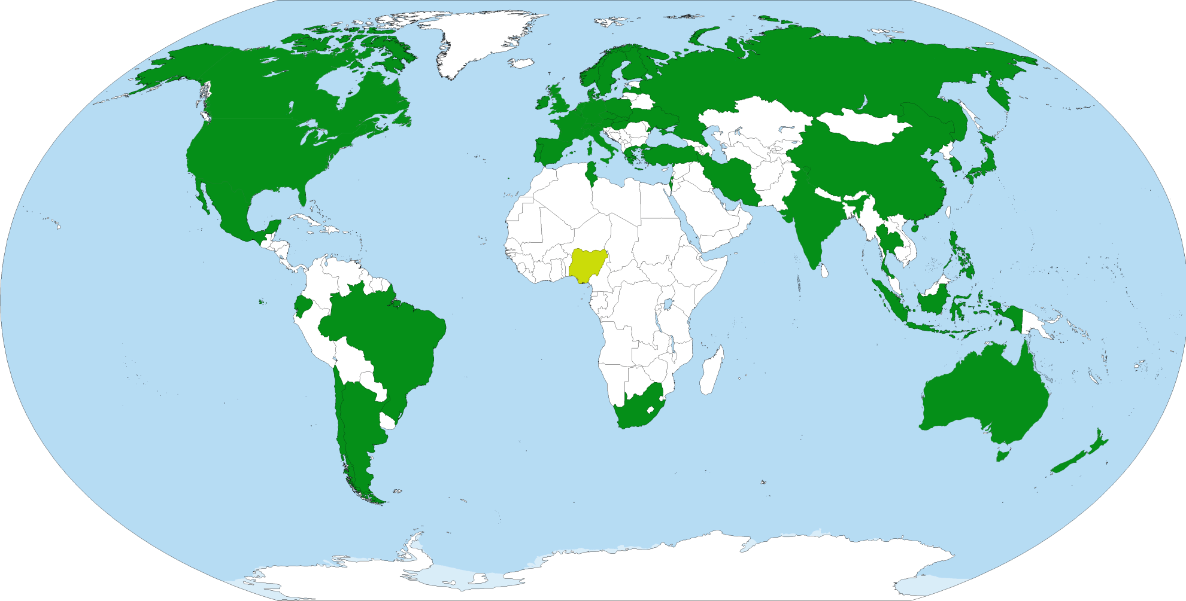
2010

Slide 12
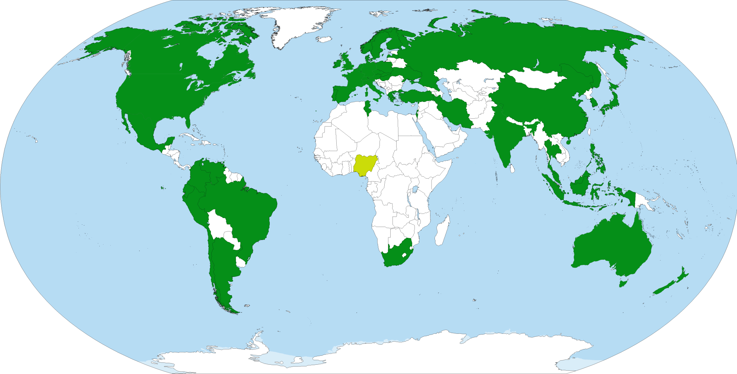
2015

