Slide 1
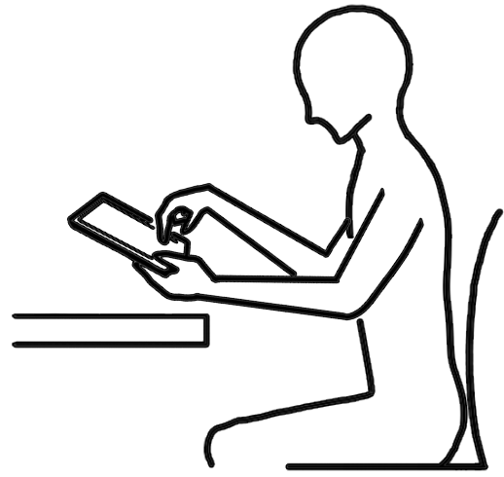



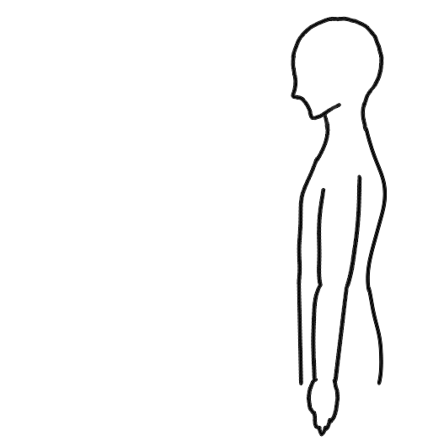
Every
20
minutes
Take a
20
sec. break
Look at an object
20
feet away
+
20 feet away
When using digital devices, take a break every 20 minutes and look at an object at least 20 feet away for at least 20 seconds.

Slide 2

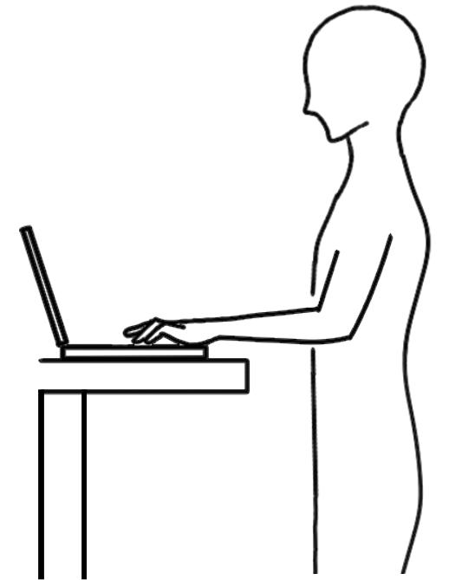
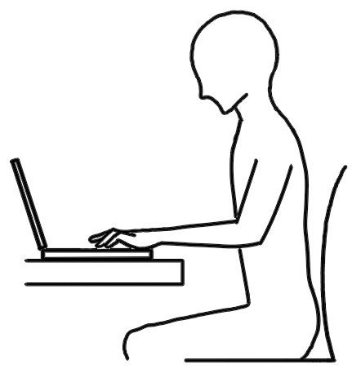
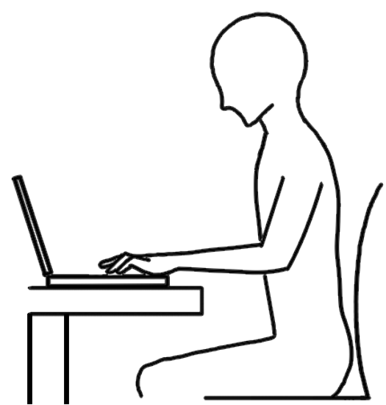

Prolonged sitting
Avoid sitting for a long period of time without taking a break when using digital devices
Alternate between sitting and standing position frequently when using digital devices

Slide 3
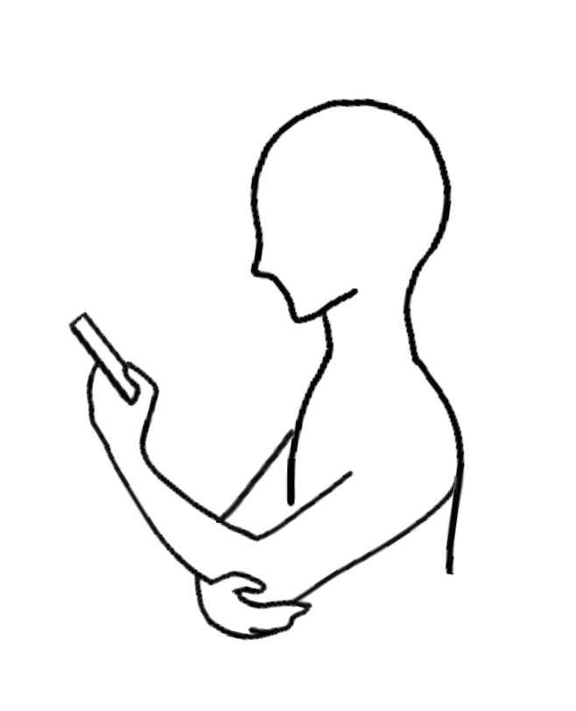
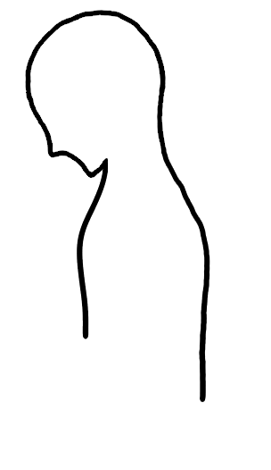



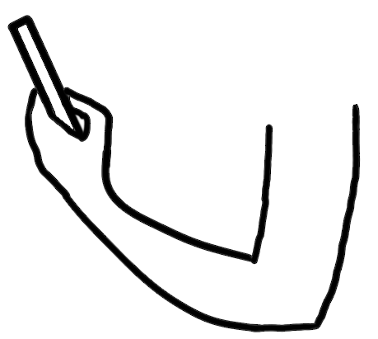
viewing distance:
40cm<
Increases mechanical stress on the shoulder
Decreases mechanical stress on the shoulder
Using the smartphone with one hand causes the head to tilt forward, leading to additional stress on the neck.
Support the arm holding the smartphone with the other hand, and hold your phone up to keep your neck as straight as you can.

Slide 4
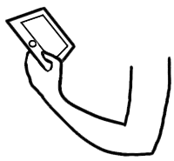
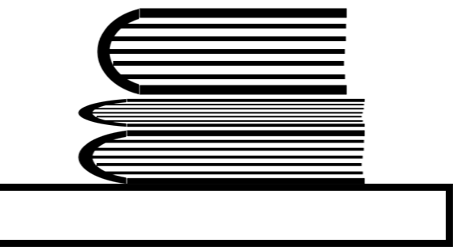
Prolonged screen time on a tablet while holding it with one hand causes the head to tilt forward, leading to additional stress on the neck.
Use a stand/case for tablet/smartphone, and try to raise its height to eye level or slightly below by placing it on a stack of books or magazines on a table.

Slide 5
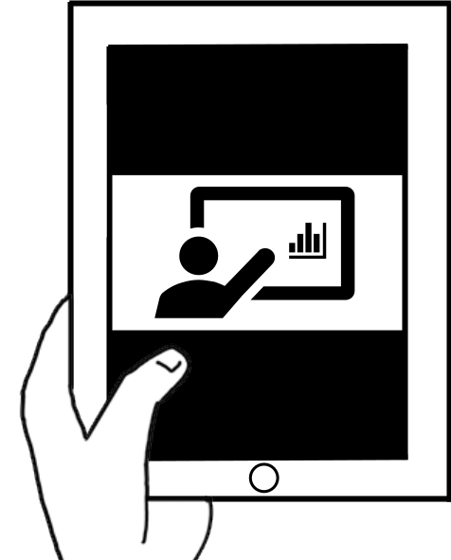
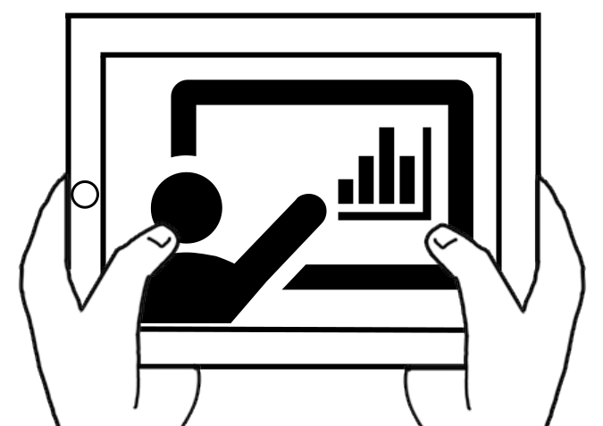
Holding the tablet in portrait style with one hand makes the character size and content appear smaller, resulting in poor visibility.
Rotating your screen to landscape mode can increase the character size and make the content appear larger in many cases.

Slide 6
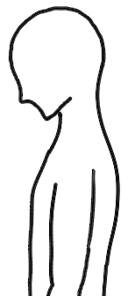
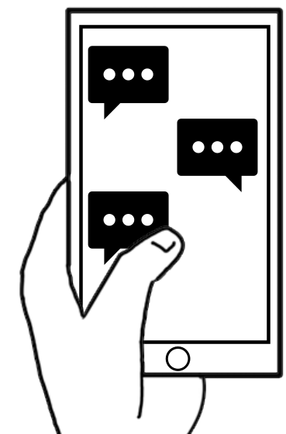

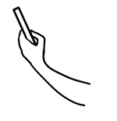
②
Move your head backwards
horizontally
① Pull
your chin
After sending an email or text, STOP once what you are doing.
Put your device on the table...
And stretch and let your shoulders DROP, and let your hands FLOP by your sides. Neck retraction, as shown above, is an effective way of recovering your spine alignment.

Slide 7
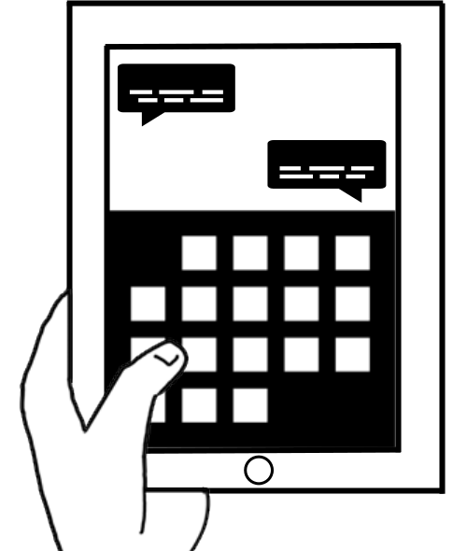
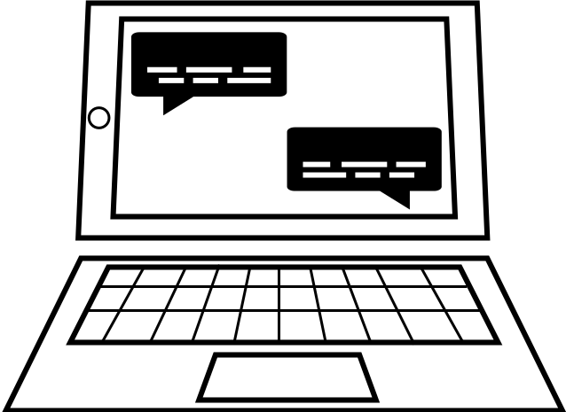
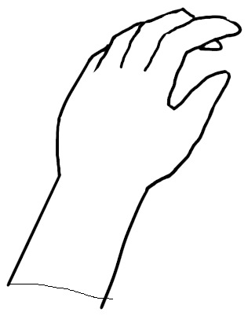
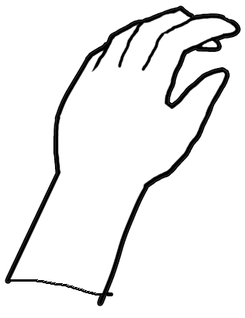
Typing for a long period of time on a tablet/smartphone keyboard in portrait mode causes a constrained posture.
Use a separate input device for typing
when texting via tablet/smartphone for a longer period of time

