Slide 1

An introduction to the

Slide 2
Contents
Section 1: History
Section 2: Mission, goals and strategy
Section 3: Structure
Section 4: Definitions / Understandings of HFE
Section 5: International Collaboration / Partners
Section 6: The business case
Section 7: Education and Professional certification
Section 8: Current activities / Future of HFE application

Slide 3
History

Slide 4
A short history of the IEA
Section 1/8
1949, Ergonomics Research Society (ERS) founded in England
European Productivity Agency (EPA), founded in 1953, initiated a project entitled “Fitting the Task to the Worker”
1959, first meeting of steering (preparatory) committee of the future International Ergonomics Association (IEA)
1961, first meeting of the individual members of IEA’s General Assembly held in Stockholm, Sweden
1967, IEA became an association of federated societies worldwide
2011, IEA became an international not-profit organization based in Switzerland
https://iea.cc/about/introduction/

Slide 5
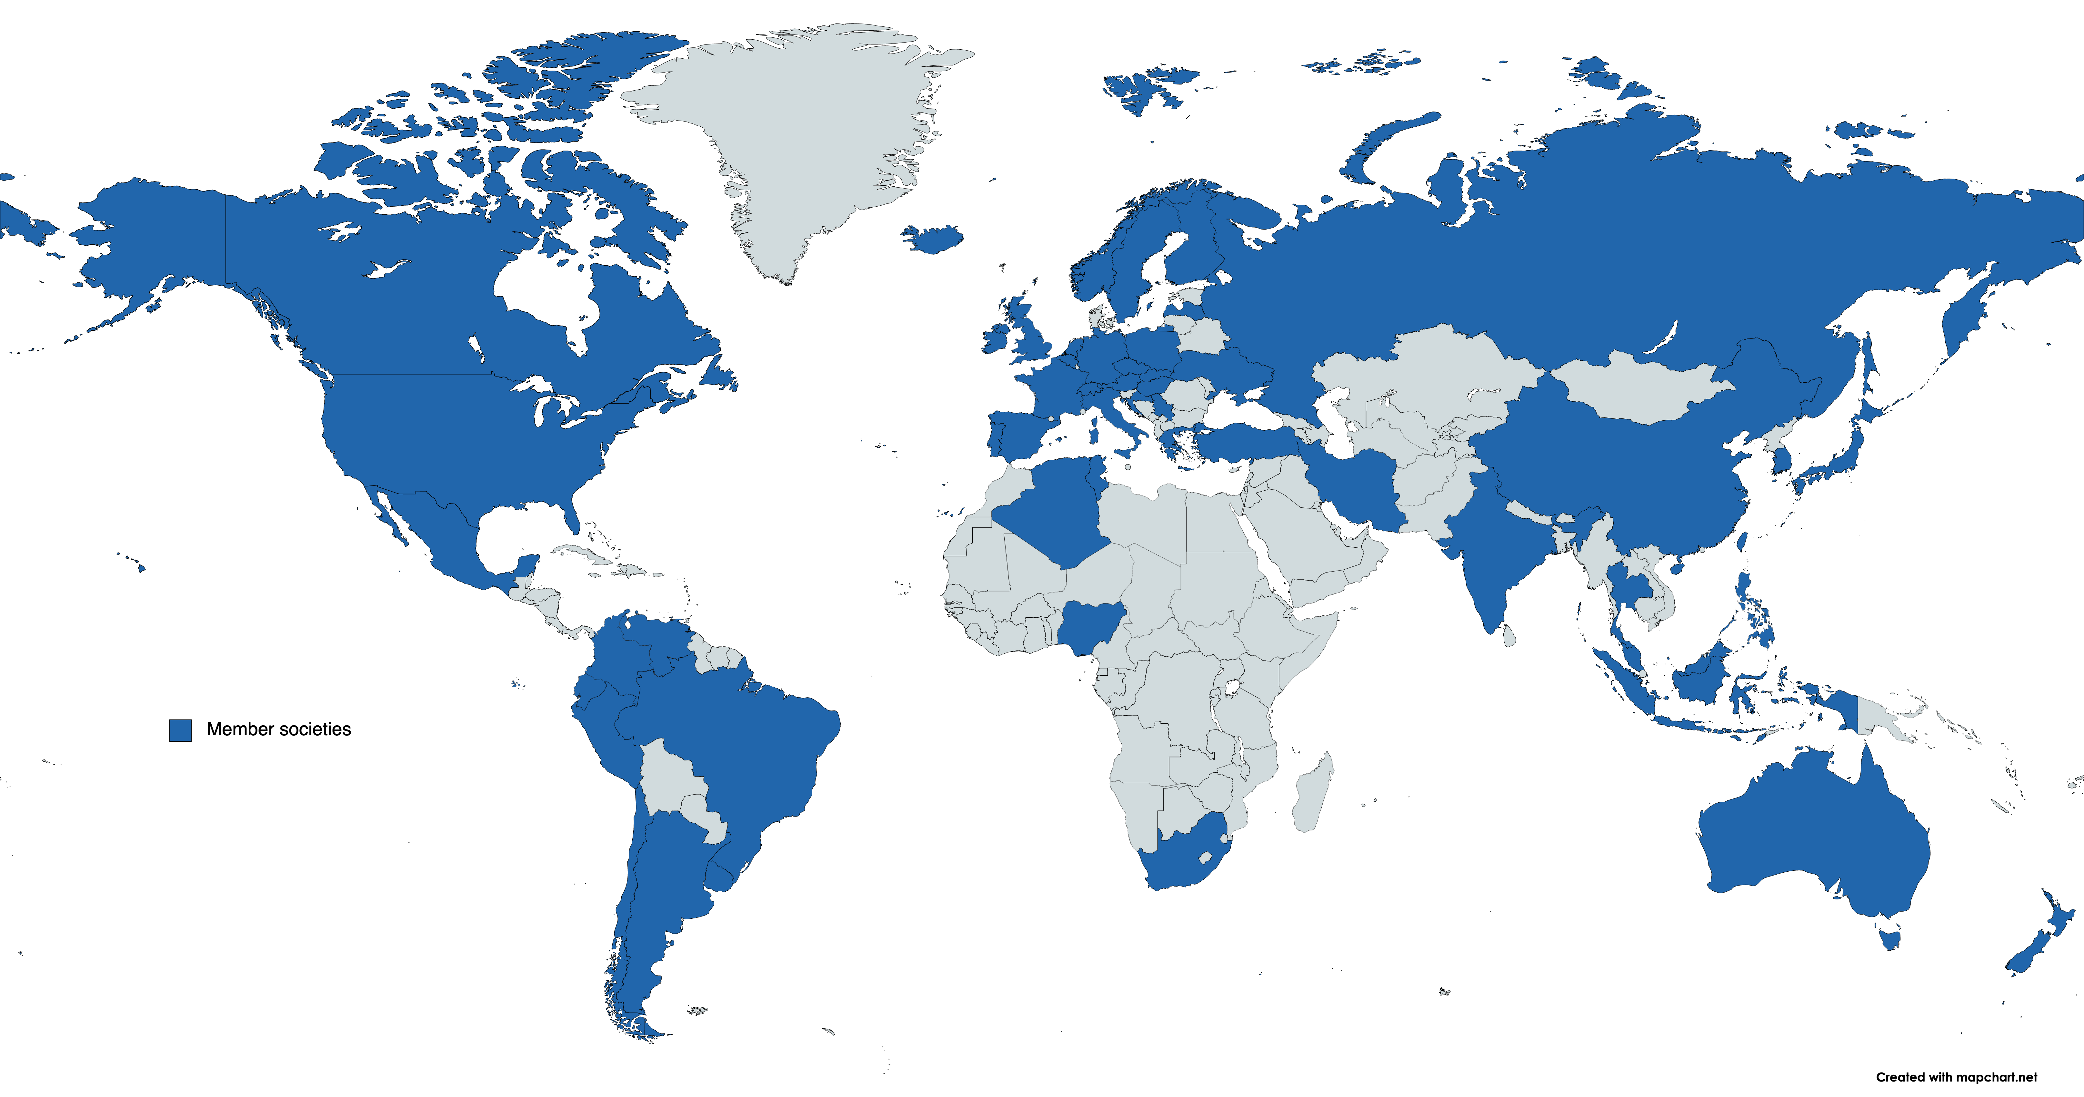
The IEA is An Association of 52 Federated Societies and 2 Affiliated Societies
Section 1/8
Austria
Belgium Croatia
Czech Rep.
Germany
Greece
Hungary
Italy
Ireland
Latvia
Netherland
Poland
Portugal
Serbia
SELF/France
Slovakia
Spain
Switzerland
Ukraine
United Kingdom
Russia
NES
Denmark
Iceland
Finland
Norway
Sweden
China
Taiwan
Hong Kong
Korea
Japan
Canada
USA
The Philippines
Malaysia
Singapore
Indonesia
Turkey
Israel
Iran
Argentina
Brazil
Colombia
Chile
Ecuador
Mexico
Peru
Uruguay
Venezuela
India
Thailand
Algeria
Tunisia
Nigeria
South Africa
Australia
New Zealand
Notes:
Source https://www.mapchart.net/world.html (Maggie)

Slide 6
The IEA has 6 Regional Networks composed of federated members
Section 3/8
Some federated societies represent a region or language group, e.g. NES is a type of regional network, but it has members that are not individually also members of IEA.
Inter Continental
BRICS-Plus (Founded in 2016)
Europe
FEES
IEA EC
Asia
SEANES
Latin America
ULAERGO
Asia
ACED
Africa
Ergo Africa
Asian Council on Ergonomics and Design (ACED)

Slide 7
Mission, goals and strategy

Slide 8
To advance and promote the science and practice of
Human Factors / Ergonomics (HFE) globally.
To expand the scope of HFE application and its contribution to people’s (working) lives.
Section 2/8
IEA Mission
https://iea.cc/about/index.html

Slide 9
Section 2/8
IEA Strategic Policies 2021-2024
Engage internal stakeholders
Collaborate with and reinforce IEA networks
Promote and contribute to HFE science, technology, and practice
Promote and contribute to HFE Education, Certification and Professional Standards
Strengthen relationships with external partners
Reinforce the infrastructure of IEA
Maintain a future focus for HFE

Slide 10
Policy 1 – Engage Stakeholders
Outreach
Local Influential Stakeholders
IEA
Making
projects
Funding
Local IEA Society
IEA Regional Network
Coordination
Contracted project
Various Local Stakeholders
Example: Working with ULAERGO to develop PhD training courses in Colombia/Peru.

Slide 11
Policy 2 – Collaborate with IEA Networks
Europe
FEES
Latin America
ULAERGO*
IEA EC
Asia
SEANES
Africa
Ergo Africa
Asia
ACED
Inter Cont.
BRICS-Plus (Founded in 2016)
Asian Council on Ergonomics and Design (ACED)
*2019 - CERTIFICADO DE EXISTENCIA Y REPRESENTACION LEGAL DE FUNDACION UNION LATINOAMERICANA DE ERGONOMIA

Slide 12
Policy 3 – Promote and contribute to HFE science, technology, and practice
IEA as information source for
cutting-edge HFE
HFE related to cutting-edge technologies
Cutting-edge HFE
Support networks,
Member societies, Technical
Committees
New Technical Committees -
Ad hoc committee
on Future of Work
Reach out to other discipline groups and partner organisations

Slide 13
Structure

Slide 14
Section 3/8
Governing body = IEA Council: composed of representatives of all federated societies, elects officers and approves policy
Elected officers
President
Shaded areas
= members of executive committee Green boxes
= External partners
Grey boxes
= Some examples of responsibilities
Financial management
Archives / Website content
Council member administration
VP/Secretary
General
VP/Treasurer
Sponsors
Banks / Tax authorities
Webinar administration
Office Administrator
Past President
Standing committees* (Established by Council vote, Chairs appointed by President)
Awards
Ad hoc positions/groups
committees (Established and appointed by President)
PS & E
STP
ID
CPR
DP
Annual IEA/Tsinghua & IEA/Kingfar Awatds , Annual Fellowship Awards, Triennial Awards.
Strategy and Implementation (P2DT)
Support of university
programs / HFE research
Technical Committees (>25)
Coordination and project development with federated societies and regional Networks
IEA NewsBriefs
Congress
Guidelines
Social Media platforms
Future of Work
Website Education Map
IEA Congress
Scientific Program
Liaison with
Congress Hosts
Early Career Community
Next Triennial
Congress OC Chair
Endorsement of certification bodies
Endorsement of events and publications
Support non-member HFE societies
Outreach and Partnerships
International Standards for HFE
Non-voting members
Networks
Sustaining
members
ITC/ Website admin.
Website hosts
*Key to Standing Committees:
PS&E = Professional Standards and Education
STP = Science, Technology and Practice
ID = International Development
CPR = Communication and Public Relations
DP = Development and Promotion
WHO
ICOH
ISQua
SEANES/ACED
Corporate
ILO
IOHA
INCOSE
BRICSplus
Legally necessary position
ErgoAfrica
Individual
ISO
FPE
IISE/AES
FEES
University
Swiss Director
(currently vpsg)
ULAERGO
Notes:
Here is a rough draft of the IEA Structure, activities, and liaisons. We have 5 Standing Committees – Professional Standards/Education, Science, Technology and Practice, International Development, Communications and Public Relations, and Development and Promotions. As you can see, each Standing Committee has multiple areas of responsibility and associated activities.

Slide 15
The IEA Executive Committee
Governing body = IEA Council
Composed of representatives of all federated societies, elects officers and approves policy
Elected officers
President
VP/Secretary
General
VP/Treasurer
Ad hoc positions/groups
committees (Established and appointed by President)
Office Administrator
Strategy and Implementation
Standing committees* (Established by Council vote, Chairs appointed by President)
Future of Work
PS & E
Professional Standards and Education
STP
Science, Technology and Practice
ID
International Development
CPR
Communication and Public Relations
DP
Development and
Promotion
Awards
Next Triennial
Congress OC Chair
International Standards
ITC/ Website admin.
Legally necessary position
Swiss Director
(currently vpsg)
Notes:
Here is a rough draft of the IEA Structure, activities, and liaisons. We have 5 Standing Committees – Professional Standards/Education, Science, Technology and Practice, International Development, Communications and Public Relations, and Development and Promotions. As you can see, each Standing Committee has multiple areas of responsibility and associated activities.

Slide 16
Current IEA Executive Structure
Section 3/8
4 Elected officers
Office Administrator
President
Vice President / Secretary General
1 Swiss Director
Vice President / Treasurer
Legally necessary position
(currently vpsg)
Past President
5 Standing committees
(Established by Council vote, Chairs appointed by President)
PS&E = Professional Standards and Education
STP = Science, Technology and Practice
ID = International Development
CPR = Communication and Public Relations
DP = Development and Promotion
5 ad hoc positions/committees (Established and appointed by President)
Strategy and Implementation (P2DT)
Future of Work
Next Triennial Congress OC Chair
International Standards for HFE
ITC/ Website admin.
Notes:
Here is a rough draft of the IEA Structure, activities, and liaisons. We have 5 Standing Committees – Professional Standards/Education, Science, Technology and Practice, International Development, Communications and Public Relations, and Development and Promotions. As you can see, each Standing Committee has multiple areas of responsibility and associated activities.

Slide 17
The IEA Standing committees
(Established by Council vote, Chairs appointed by President)
PS & E
Professional Standards and Education
STP
Science, Technology and Practice
ID
International Development
CPR
Communication and Public Relations
DP
Development and Promotion
Awards
Support of university
programs
Technical Committees
Coordination IEA regional Networks
IEA NewsBriefs
Congress
Guidelines
IEA Fellowships
Website Education Map
Social Media platforms
Annual awards
IEA Congress
Scientific Program
Support non-member HFE societies
Liaison with
Congress Hosts
Early Career Community
Triennial Awards
Endorsement of certification bodies
Endorsement of events and publications
Outreach and Partnerships
WHO
ICOH
ISQua
ILO
IOHA
INCOSE
ISO
FPE
IISE/AES
Notes:
Here is a rough draft of the IEA Structure, activities, and liaisons. We have 5 Standing Committees – Professional Standards/Education, Science, Technology and Practice, International Development, Communications and Public Relations, and Development and Promotions. As you can see, each Standing Committee has multiple areas of responsibility and associated activities.

Slide 18
The IEA has 26 Technical Committees
(interest groups)
Section 8/8
Activity Theories for Work Analysis and Design
Aerospace HFE
Affective Design
Aging
Agriculture
Anthropometry
Auditory Ergonomics
Building and Construction
Digital Human Modeling and Simulation
Ergonomics for Children and Educational Environments
Ergonomics in Advanced Imaging New
Ergonomics in Design
Ergonomics in Design for All (EinDfA) New
Ergonomics in Manufacturing
Gender and Work
Healthcare Ergonomics
Human Factors and Sustainable Development
Human Factors in Robotics New
Mining
Musculoskeletal Disorders
Organizational Design and Management
Process Control
Psychophysiology in Ergonomics
Safety & Health
Slips, Trips and Falls
Transport Ergonomics and Human Factors (TEHF)
Visual Ergonomics
Work With Computing Systems – WWCS
Ergonomics in Informal work sector New

Slide 19
Definitions and Understandings of
Human Factors / Ergonomics
Section 4/8

Slide 20
HFE is a Design Activity focused on Systems
Section 4/8
Ergonomics is the scientific discipline concerned with…
Science: …the understanding of interactions among humans and other elements of a system, and…
Practice: …the profession that applies theory, principles, data and methods to design in order…
Goal: …to optimize human well-being and overall system performance
Cf. https://iea.cc/whats/index.html

Slide 21
Section 4/8
High quality HFE combines disciplines..
Organizational Issues
Cognitive Issues
Physical Issues
Other Issues: Technical, cultural, environmental….
Real World
Problem

Slide 22
..and stakeholders.
It considers and engages stakeholders at all levels
Section 4/8
System Influencers
System Decision Makers
System Experts
System Actors
Cf. Jan Dul et al, Future of Ergonomics Report

Slide 23

Section 4/8
Some issues that plague us all:
No uniform understanding of what ergonomics is about.
No universal acceptance that ergonomics and human factors (engineering) are one and the same thing.
The tools and methods that are used by HFE practitioners are not always validated.
The title “ergonomist” is not officially protected in most countries.
Solutions:
Encourage practitioners to get certified / upgrade education
Encourage practitioners to identify with profession and use their title
Only use validated tools and methods where possible. Be honest.
Encourage national societies to establish certification systems
Reach out to system decision makers.

Slide 24
International Collaboration
and Partners

Slide 25
See: Future of Ergonomics – Dul, et al, 2012
Global Stakeholders
              The IEA maintains official
              Non-State Actor status with the World Health Organization (WHO)
              registered NGO of the International Labour Organization (ILO).
              Category A Liaison with International Standards Organization (ISO) for ISO/TC159 – “Ergonomics”
H
WHO, ILO, ISO
IEA
High Quality HFE
Other Influential Stakeholders

Slide 26
Section 6/8
IEA International Collaboration
World Health Organization (WHO) - official Non-State Actor status
International Labour Organization (ILO) affiliated Non-Government Organisation
International Standards Organization (ISO) – Category A Liaison with ISO/TC159 – “Ergonomics”
This allows us to
propose activities,
participate in/contribute to meetings on HFE relevant items,
collaborate on products e.g. publications
comment on papers and policy

Slide 27
Collaboration with Partner Organisations
The IEA has exchanged Memoranda of Understanding (MOUs) which establish and support collaboration with the following organisations:
International Commission on Occupational Health (ICOH)
International Occupational Hygienists Association (IOHA)
The International Society for Quality in Health Care (ISQua)
Foundation for Professional Ergonomics
International Council on Systems Engineering (INCOSE)
IISE Applied Ergonomics Society
International Society of Pharmacovigilance (ISoP)

Slide 28
Section 6/8
IEA Partner organisations
The IEA cooperates with other international bodies with common or similar goals. e.g. Memoranda of Understanding with
International Commission on Occupational Health (ICOH)
International Occupational Hygienists Association (IOHA)
The International Society for Quality in Health Care (ISQua)
International Council on Systems Engineering (INCOSE)
Also some other ergonomics networks.
This allows us to
synergise our efforts
promote understanding of our profession
benefit from external expertise network
Under development: partnerships with universities

Slide 29
Strategic design?
  IEA works with local stakeholders to build knowledge and capacity
Greenhaigh model (2004)
Notes:
Strategic Design:
Incorporating how technology/knowledge is effectively diffused literature into the approach adopted
A second important consideration of the long term strategy developed for supporting knowledge of HFE and growth in quality education programs was in acknowledging how to effectively promote the diffusion of innovation. The work of Greenhalgh (2004) shown in Figure 2 is of particular important in framing the participatory approach undertaken by the standing committee.
In other words, a key component of the approach adopted by the international development committee was to ensure relevant stakeholders are involved in building capacity with a focus on the negotiated diffusion and transfer (bidirectional) of knowledge. This allows the IEA to develop a better understanding of the contextual constraints on societies and for societies to gain insights into potential areas and mechanisms of growth. This is obviously a long term plan as “helping it happen” takes time but supports sustainable development through both social and technical mechanisms (i.e. takes a socio-technical systems approach to HFE growth).

Slide 30
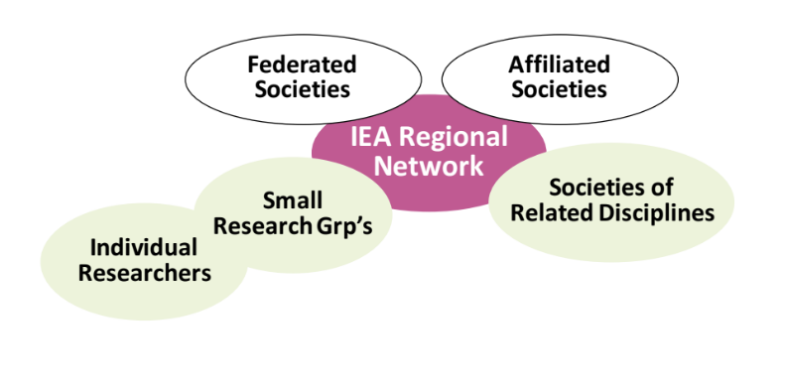
Strategic design?
Local Stakeholders Create Networks, Communities of Practice, Systems of Influence
“Change begins as local actions spring up simultaneously in many different areas. If these changes remain disconnected, nothing happens beyond each locale. However, when they become connected, local actions can emerge as a powerful system with influence at a more global or comprehensive level.” Wheatley and Frieze (2006)
Stage 1: Networks
– Discovering shared purpose
Stage 2: Communities of practice
– Developing new practices
Stage 3: Systems of influence
– New practices become the norm
Notes:
Strategic Design:
. Stakeholders, Emergence and networks:
HFE has long advocated for acknowledging the importance of emergence. Furthermore, the Dul et al. (2012) paper promoted the building of closer relationships with stakeholders. The concept of emergence is particularly important from a stakeholder perspective, as it is through stakeholders that change (i.e. development) can occur. This is best reflected in the work of Wheatley and Frieze (2006):
“Change begins as local actions spring up simultaneously in many different areas. If these changes remain disconnected, nothing happens beyond each locale. However, when they become connected, local actions can emerge as a powerful system with influence at a more global or comprehensive level.”
Therefore, it is through emergence that local changes can materialize as global systems of influence, this is of obvious relevance to growth in HFE at local, regional and global levels. Building networks between stakeholders at the various levels (see General Framework Model for details) was therefore a key strategic aspect of the design of the development activities. There are typically three stages recognized within such an approach:
Stage 1: Networks – Discovering shared purpose
Stage 2: Communities of practice – Developing new practices
Stage 3: Systems of influence – New practices become the norm
To achieve these within a 3-year period is obviously difficult and ambitious, and as such are part of the long term approach adopted by the IEA development standing committee for sustainable growth rather than short term success. The international development plan was therefore aligned with that of the IEA and advocated by the IEA president (see Figure 3)
rtant consideration of the long term strategy developed for supporting knowledge of HFE and growth in quality education programs was in acknowledging how to effectively promote the diffusion of innovation. The work of Greenhalgh (2004) shown in Figure 2 is of particular important in framing the participatory approach undertaken by the standing committee.
In other words, a key component of the approach adopted by the international development committee was to ensure relevant stakeholders are involved in building capacity with a focus on the negotiated diffusion and transfer (bidirectional) of knowledge. This allows the IEA to develop a better understanding of the contextual constraints on societies and for societies to gain insights into potential areas and mechanisms of growth. This is obviously a long term plan as “helping it happen” takes time but supports sustainable development through both social and technical mechanisms (i.e. takes a socio-technical systems approach to HFE growth).

Slide 31
Sustaining Members
The IEA encourages sustaining membership to link up with companies, national and regional organisations and universities. Sustaining membership gives recognition to these organisations for their support of HFE.
ELSEVIER Publishers
TeamScape LLC
Kingfar International Beijing
Tsinghua University
Korea Occupational Health and Safety Agency
Office Ergonomics Research Committee
SURA ARL – Occupational Risk Insurance Company, South America
Treston – Workspaces for happier workfaces
Universidad del Valle/Facultad de Salud (College of Health)

Slide 32
The business case

Slide 33
Successful business requires high quality HFE...
Different types of work arrangements
      Traditional organizations
      Informal (‘gig’) economy and non-regulated work
    Technological advances
      Robotics and automation
      Internet-based work
      High quality HFE is critical for human-centered, sustainable work systems

Slide 34
…High quality HFE Contributes to Successful Business
Design
(Practice)
Business:
Profitable
Sustainable
Organization functions
Staff Motivation
Human Performance
High quality HFE Products, Services, …
Technology
Knowledge
of Human System Interactions
(Science)
Application Areas

Slide 35

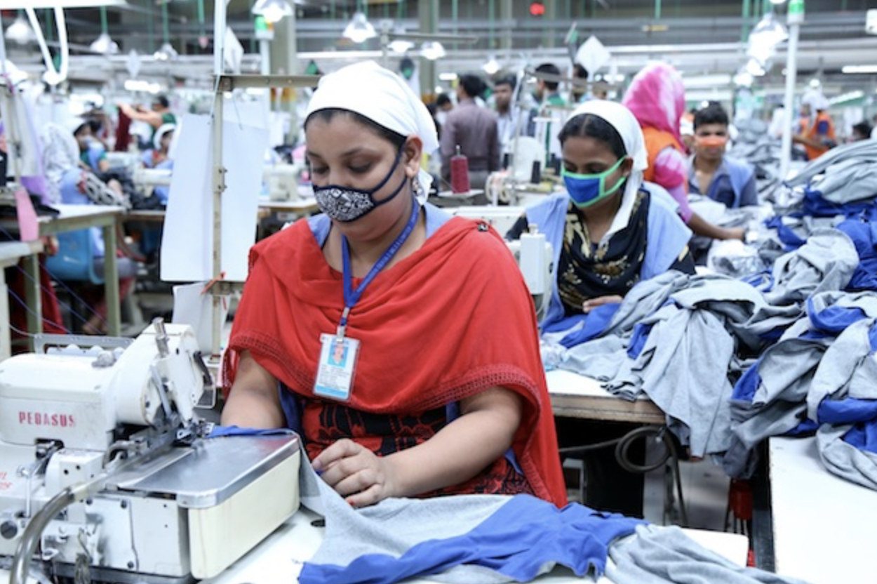
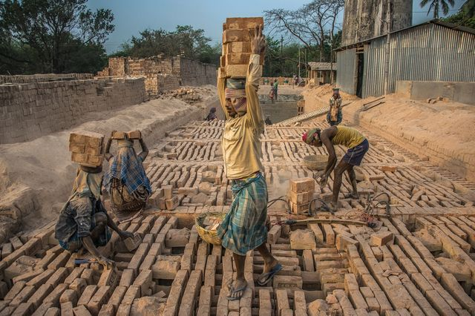

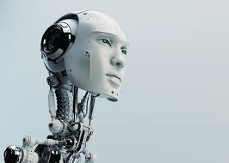
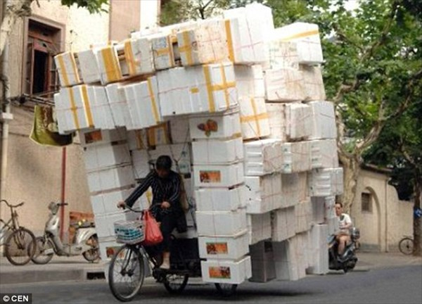
Importance of HFE Today
Realities – constant change, increasing mechanization, increasing information technology and robotics, globalization, large disparities, growing informal/unregulated work sector
Ever new demands on humans, need for increasing performance in changing world

Slide 36

Successful business requires high quality HFE...
Section 7/8
      HFE is critical for sustainable work systems, in terms of
      - reliability
      - efficiency
      - quality control
Ergonomics in a Nutshell (3 Part series)
https://ergonomics.org.uk/resource/giving-your-business-the-human-factors-edge.html

Slide 37
Educational and Professional Certification

Slide 38
Education and Certification
Students
HFE as major
HFE as minor
IEA University Networks
e.g., Training programs
Promotion of HFE Education
Balanced in terms of areas of disciplines
Accreditation Guidelines
Professionals
Professors
Engineers/Scientists
Regulators
Collaboration with networks and existing certification bodies
Country Certification
Country Certification
Regional Certification
Bodies
IEA endorsement
Balanced member societies

Slide 39
Section 5/8
Why IEA promotes certification (1)
Many people call themselves ergonomists but people working in the field with no relevant scientific training, or restricted approach, may cause damage to our profession.
Benefits of professional certification to clients
Certification offers a guarantee of professional quality to employers. Peers set the standards and review peer competence. This has advantages in terms of keeping the profession up-to-date. The system is independent of financial interests.
Certification may be legally required (e.g. in occupational health) or part of company rules (Shell, Johnson & Johnson, Airbus,…..etc.
Benefits of professional certification to national societies
It is a sign of the maturity of the profession - Ergonomics is most well-known and accepted in countries where certification has been actively promoted for some decades (UK, France, USA, Japan).
Government regulation of certification may be supportive, but it often comes at a price: It may be confined to one area (occupational health) and generally the standard is low, making it hard to maintain a high level in the profession and severely limiting the effectiveness of the profession.

Slide 40
Section 5/8
Why IEA promotes certification (2)
Benefits of professional certification to government and public administration
There is a win-win situation in that ergonomics assists in promoting public health and other public policies (e.g. good working conditions, improved productivity).
When the professional certification is well-established, it may be officially recognized by government bodies (example of UK Chartered Ergonomists), saving their resources.
Benefits of professional certification to ergonomists
Our professional identity is enhanced.
Certification promotes professional exchange and continual professional development, promoting professional quality.
Privileged access to jobs and contracts, as some large companies only employ certified ergonomists.
Ease of movement between countries. Intercontinental guarantee by IEA endorsement of certification systems

Slide 41
Section 5/8
IEA Requirements for endorsement of certification bodies
Governance requirements
International Standard ISO/IEC 17024:2012 Conformity assessment – General requirements for bodies operating certification of persons (i.e. same as CREE)
PLUS
Quality assurance
IEA Core Competencies = Education and skills
2 years fully independent practice
Code of Conduct
Notes:
Certification bodies have different systems for assessing candidates
Some have more stringent certification criteria than IEA minimal requirements

Slide 42


IEA Awards
Recognise and encourage high quality HFE work
Annual awards:
- IEA Fellowship (service to profession)
Kingfar (early career professionals)
Tsinghua (collaborative education)
Triennial awards:
The IEA Distinguished Service Award
IEA Triennial Outstanding Educators Award
IEA Award for Promotion of Ergonomics in Developing Countries
IEA Triennial Ergonomics Development Award
IEA Human Factors and Ergonomics Prize
IEA/Elsevier John Wilson Award
The IEA President’s Award
K U Smith Student Award

Slide 43
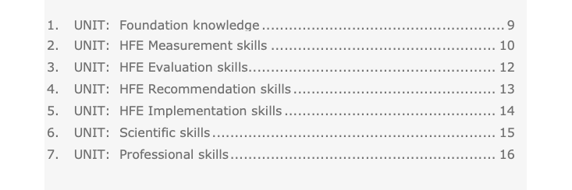
Section 5/8
CORE COMPETENCIES IN HUMAN FACTORS AND ERGONOMICS (HFE) Professional knowledge and skills
27 Elements arranged into 7 units
Search “Core Competencies” on IEA Website for details.

Slide 44
Current activities

Slide 45
Where are we? Where are we going?
IEA continues to apply and refine its project strategy model
IEA offers:
Knowledge and expertise through local societies and networks
Global connections
Support for educational programs
Support for human-centered high quality HFE through partner organizations

Slide 46
Ever-changing Demands for HFE
Changing Technologies
e.g. ICT, Robotics, Medicine, HFE
Diverse and Changing Demands for HFE, e.g.
Innovative/Advanced HFE Science/Technologies
Low-cost HFE Solutions
Attractive HFE Technologies
Better Training Opportunities - students, lecturers, researchers, practitioners
Quality Management of HFE Practices
…
Changing
Economy
e.g. Global Trading, Industrial Roles
Changing
Work Environment
Design & Management Approaches
Changing
Local Conditions
e.g. Culture, Politics, Economy, Training Opportunities

Slide 47


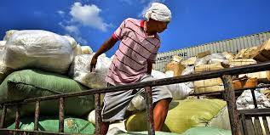

Informal work
Section 8/8
Biggest ”employer” worldwide and growing
Not only in non-industrialised countries (household help, gig workers, Uber, etc.)
Cannot be reached by traditional law and enforcement system

Slide 48

Multiple problems in informal work
Section 8/8
Well-being
MSDs
Poisoning
Fumes
Fire and explosion
Falls
Cuts
Sepsis
…
…
Performance
Inefficient work
Loss of labour
Social friction
…

Slide 49

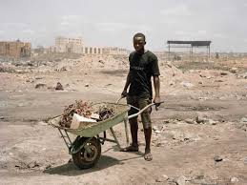
How do we solve this?
Section 8/8
System approach:
Work with authorities
Work with local informal groups
Use networks / participation
Use experiences of others
Education and training
Not just nice-to-have but essential to success!

Slide 50

Emergence – why systems approach is essential
Section 8/8
Characteristic of complex systems:
Unexpected outcomes and effects - 1+1+1=4 (or 5?)
e.g., emergent effect for street vendors in South Africa
Work as planned vs work as actually done
e.g., Swedish studies: female vs male exposures in same jobs
Other examples:
Self driving cars – decades of attempts
MSDs still very prevalent despite decades of “ergonomics”
- good seating vs immobility issues
- lifting training

Slide 51
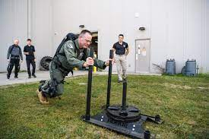
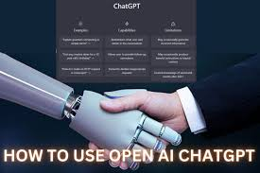
”New” challenges
Section 8/8
Exoskeletons
- Do other tissues get overloaded?
- Do supervisors just expect more work?
ChatGPT and AI
- Producing language vs understanding it - Parrots understand some of what they are saying but AI does not. AI does not understand the difference between true and false. What safeguards do we need?

Slide 52
The future of the HFE profession
Section 8/8
Designing human-technology interfaces cannot be only a physical consideration:
Good HFE includes cognitive, organisational, cultural, environmental and ethical implications.

Slide 53
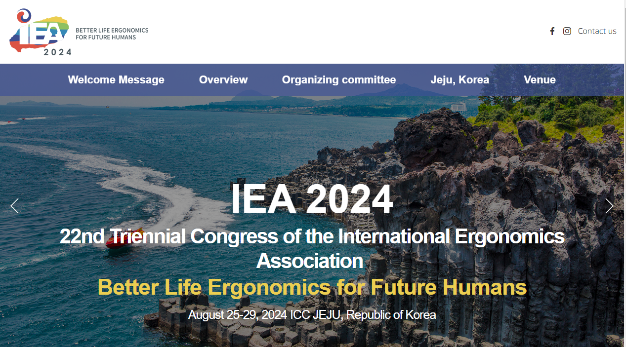
http://iea2024.com/

Slide 54
IEA LINKS OF INTEREST
NewsBriefs (subscribe on IEA website)
IEA Press publications.
IEA YouTube channel (includes recorded IEA webinars).
IEA LinkedIn, Facebook and Twitter pages.

