Slide 1














Florence 26-30 August, 2018
IEA 2018
Final Report
Sara Albolino and Riccardo Tartaglia
Chairs IEA 2018

Slide 2
Some significant numbers (1)
PARTICIPANTS
Total Registered Participants 1576
Participants from Federated societies n. 533
Students n 428 : 176 from LMIC (72 free), 252 from HIC
ATTENDEES BY CONTINENTS
52 %(828) Europe - 12% (193) Italy,
12 % (183) Latin America,
11 % (167) North America,
20 % (315) Asia
2 % (18) Africa
4 % (65) Oceania

Slide 3
Some significant numbers (2)
n. 68 Countries
PARTICIPANTS BY COUNTRY
Algeria 5
American Samoa 2
Argentina 12
Armenia 1
Australia 52
Austria 12
Bangladesh 2
Belgium 29
Bolivia 1
Bosnia-Herzegovina 2
Brazil 92
British India Ocean Territory 1
Bulgaria 2
Canada 42
Chile 19
China 39
Colombia 24
Croatia 1
Czech Rep 3
Denmark 23
Ecuador 4
Estonia 2
Finland 16
France 115
Germany 107
Greece 8
Hong Kong 4
Hungary 3
India 25
Indonesia 3
Iran 14
Iraq 1
Ireland 4
Israel 13
Italy 193
Jamaica 1
Japan 102
Korea South 44
Latvia 3
Lebanon 2
Malaysia 8
Malta 1
Mexico 25
Mongolia 1
Netherlands 48
New Zeland 13
Nigeria 1
Norway 14
Peru 5
Philippines 5
Poland 9
Portugal 18
Romania 1
Russian Federation 5
Saudi Arabia 1
Serbia 1
Singapore 9
Slovenia 4
South Africa 11
Spain 10
Sweden 71
Switzerland 23
Taiwan 46
Turkey 8
United Kingdom 45
United states Minor Outlying Islands 1
USA 122
No nationality 36

Slide 4
Some significant numbers (3)
SCIENTIFIC CONTRIBUTIONS
140 registered special sessions, symposia, workshop
45 Special Session 59 Symposia 36 (registered) Workshop
17 (attivati) Workshop
1689 Accepted Abstracts (860 oral+ 411 poster/video)
Abstracts submitted from 68 different countries
73 (4%) Not accepted

Slide 5

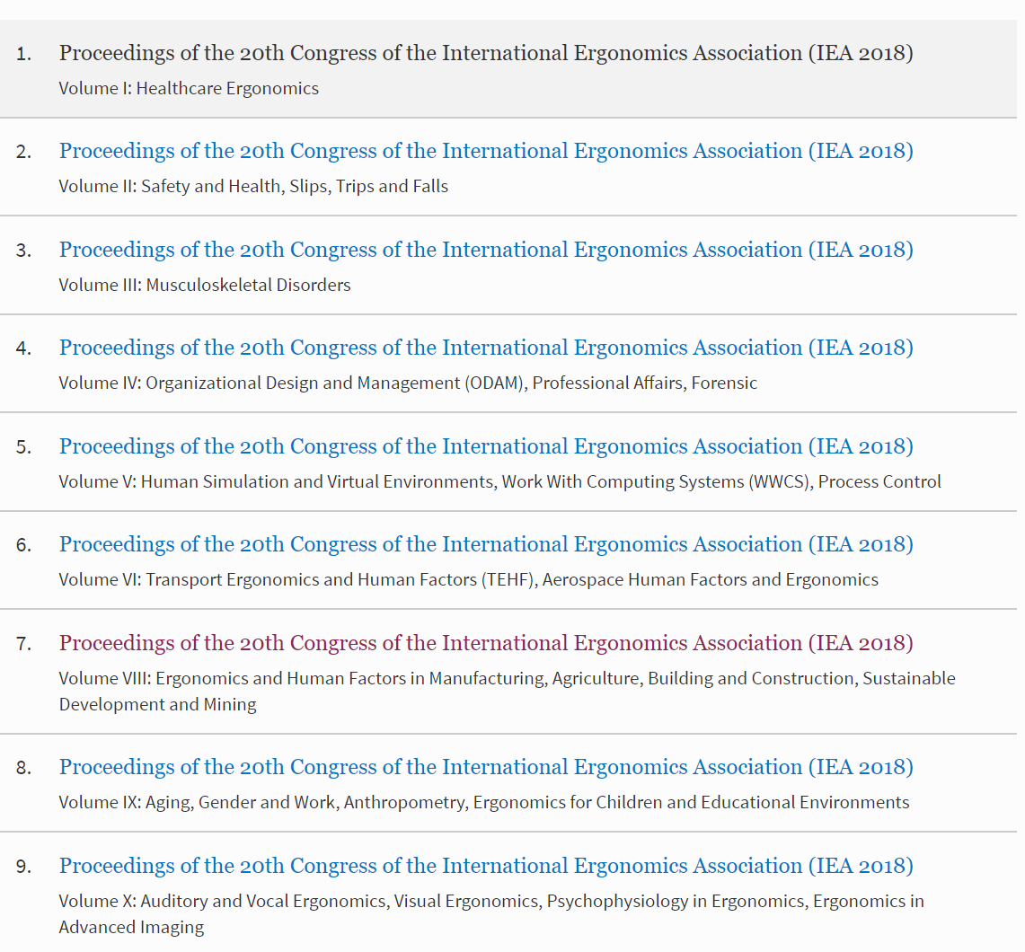

Some significant numbers (4)
PUBLICATIONS
1012 published papers in proceedings

Slide 6
Some significant numbers (5)
Topic | oral presentation | special session | symposia | poster | paper
Ergonomics in Design | 84 | 22 | 18 | 16 | 140
Musculoskeletal Disorders | 42 | 26 |  | 30 | 98
Healthcare Ergonomics | 56 | 7 |  | 32 | 95
Safety & Health | 41 | 14 | 1 | 32 | 88
Organizational Design and Management | 40 | 22 | 11 | 5 | 78
Transport Ergonomics and Human Factors (TEHF | 38 | 2 |  | 16 | 56
Human Factors and Sustainable Development | 20 | 22 |  | 6 | 48
Human Simulation and Virtual Environments | 32 | 3 |  | 5 | 40
Ergonomics in Manufacturing | 28 | 3 |  | 8 | 39
Ergonomics in Design for All | 25 | 5 |  | 7 | 37
Work With Computing Systems - WWCS | 14 | 19 |  | 3 | 36
Activity Theories for Work Analysis and Design | 21 | 9 | 4 | 1 | 35
Aging | 15 | 3 | 1 | 6 | 25
Anthropometry | 17 | 4 |  | 2 | 23
Psychophysiology in Ergonomics | 11 | 7 |  | 4 | 22
Ergonomics for Children and Educational Environments | 18 |  |  | 3 | 21
Gender & Work | 3 | 5 | 7 | 3 | 18
Visual Ergonomics | 14 |  |  | 4 | 18
Building and Construction | 11 |  |  | 6 | 17
Slips, Trips and Falls | 13 |  |  | 1 | 14
Professional Affairs |  | 4 | 7 |  | 11
Affective Design | 10 |  |  |  | 10
Agriculture | 5 |  |  | 4 | 9
Advanced Imaging | 3 |  | 2 | 1 | 6
Auditory and Vocal Ergonomics | 6 |  |  |  | 6
Forensic in Human Factor |  |  |  | 6 | 6
Process control | 5 | 1 |  |  | 6
Aerospace | 5 |  |  |  | 5
Mining | 2 |  |  | 3 | 5
Total | 579 | 178 | 51 | 204 | 1012
Technical domains – committees
with more than
30 papers

Slide 7
Some significant numbers (6)
Economics at glance (provisional)
Total costs of the conference € 849.943,90
Total revenue of the conference € 853.408,21
Revenue from sponsors € 194.390,00
Revenue from registrations € 659.018,21
Income from registrations for IEA € 22.035,00
(801 full registration - € 20.025) – (134 reduced fee - € 2.010)
(Students, reduced fees, and free registrations – they are a cost for IEA2018)
Profit for IEA TBD according to the final budget
Seed fund for IEA 30.000 $
Total income for SIE € 8.814,00

Slide 8
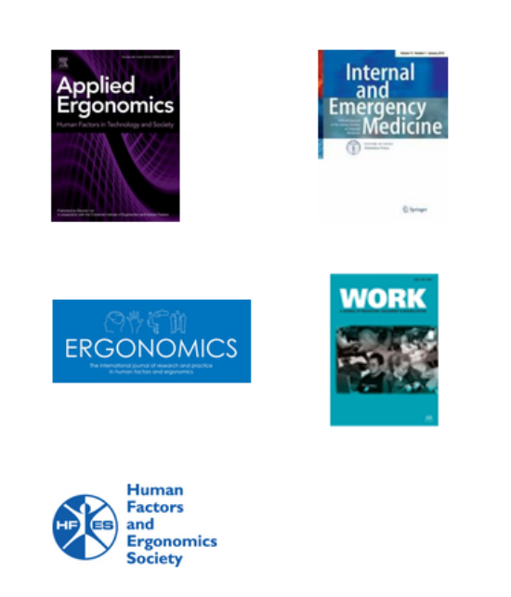
Publication Plan
Special issues with selected contributions and peer review
Ergonomics Journal (IF 1.81)
Applied Ergonomics Journal (IF 2.43)
Journal of Human Factors (IF 2.37)
Journal of Internal and Emergency
Medicine (IF 2.45)
Work (IF 0.40)

Slide 9
The IEA2018 Journey

Slide 10
Dissemination IEA 2018 - events
  2018
  Human Factors and Ergonomics in Health Care (USA)
  SwissErgo 20 years Day in Switzerland
  2017
  ISQua's 34th International Conference
  Human Factors and Ergonomics Society Annual Meeting (USA)
  Human Factors & Ergonomics Society of Australia conference. Sustainable Ergonomics
  49° CONGRESS SIBioC - Laboratory Medicine and clinical practice: from present to the future
  52° Congrès de la SELF. Présent et futur de l'Ergonomie
  7° Congreso Internacional de Ergonomia y Psicologia Aplicada
  7°Congreso Internacional de Ergonomia “Encuentro Iberoamericano de Ergonomia” and seminars in Latin America
  13° Ergonomics Society of South Africa Conference (ESSA2017) and ErgoAfrica Conference
  HFESS Seminar in Singapore and ULAERGO seminar in Chile and in Argentina
  Brussels FEES ETUI Joint meeting
  GfA Annual Congress in Germany
  ACED Conference in Japan
  AHFE Conference

Slide 11
Reviewers from TCs (1)
TC | response | solution found | abtracts
Activity Theories for Work Analysis and Design | support |  | 49
Aerospace HFE | support |  | 22
Affective Design | no support | other experts of the field | 15
Aging | support |  | 39
Agriculture | no support | other experts of the field | 15
Anthropometry | support |  | 30
Auditory Ergonomics | no support | TC Anthropometry | 12
Building and Construction | support |  | 24
Ergonomics for Children and Educational Environments | no support | other experts of the field | 51
Ergonomics in Advanced Imaging | no support | other experts of the field | 9
Ergonomics in Design | no support | other experts of the field | 165
Ergonomics in Design for All (EinDfA) | support |  | 56
Ergonomics in Manufacturing | no support | other experts of the field | 65
Gender and Work | support |  | 45
Healthcare Ergonomics | support |  | 153

Slide 12
Reviewers from TCs (2)
Human Factors and Sustainable Development | support |  | 56
Human Simulation and Virtual Environments | support |  | 58
Mining | no support | other experts of the field | 1
Musculoskeletal Disorders | support |  | 205
Organizational Design and Management | support |  | 103
Process Control (Emeritus) | no support | other experts of the field | 10
Psychophysiology in Ergonomics | no support | other experts of the field | 33
Safety & Health | no support | TC Healthcare Ergonomics | 144
Slips, Trips and Falls | support |  | 33
Transport Ergonomics and Human Factors (TEHF) | no support | TC ODAM | 79
Visual Ergonomics | support |  | 33
Work With Computing Systems - WWCS | support |  | 34

Slide 13
Reviewers from TCs (3)
topic | referees (mostly choosen by TC) | status activity
1.Activity Theories for Work Analysis and Design | 6
2.Aerospace Human Factors and Ergonomics | 3
3.Affective Design | 8
4.Aging | 10
5.Agricolture | 1
6.Anthropometry | 15
7.Auditory and Vocal Ergonomics | 4
8.Building and Construction | 4
9.Ergonomics for Children and Educational Environments | 4 | TC inactive
10.Ergonomics in Advanced Imaging | 7 | TC inactive
11.Ergonomics in Design | 20 | TC inactive
12.Ergonomics in Design for All | 9
13.Ergonomics in Manufacturing | 5
14.Gender and Work | 3
15.Healthcare Ergonomics | 42
16.Human Factors and Sustainable Development | 15
17.Human Simulation and Virtual Environments | 42
18.Mining | 2 | TC inactive
19.Musculoskeletal Disorders | 17
20.Organizational Design and Management | 71
21.Process Control | 0 | TC inactive
22.Psychophysiology in Ergonomics | 0 | TC inactive
23.Safety & Health | 35 | TC inactive
24.Slips, Trips and Falls | 6
25.Transport Ergonomics and Human Factors (TEHF) | 53 | TC inactive
26.Visual Ergonomics | 6
27.Work With Computing Systems - WWCS | 11
results | 399 | One third of TC were inactive

Slide 14
Special policies for promotion
Special offer for the federated societies:
Every 10 people registered one is free
Special prices for accommodation for LMIC
Free registration and accomodation for students from LMCI who submit an abstract (77)

Slide 15
Concept for IEA program
TOPICS Productive Sectors and Services
Manufacturing
ICT
Robotics
Aerospace
Agriculture
Healthcare
Building and Construction
Mining
Transport
Automotive
Military and Security
Architecture
Banking and insurance
Advanced Imaging
Sports Entertainment and Leisure
Fashion
Education and Training
Cultural Heritage and Tourism
Urban and Rural Planning
HFE Domains
HFE Domains
HFE Domains

Slide 16




















Sponsors
Ad hoc initiatives with companies for creating a relationship and retention

Slide 17
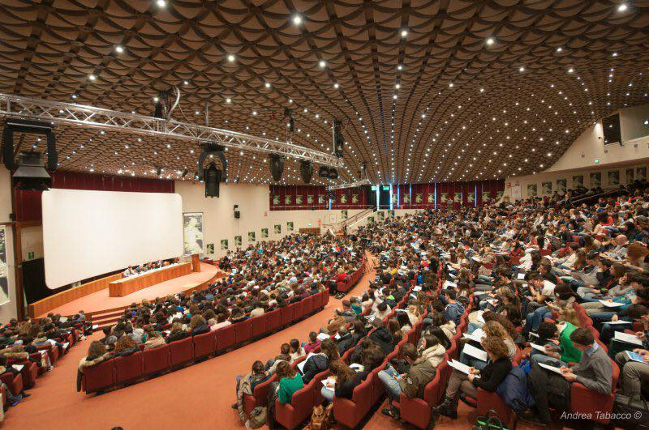
Program Highlights
2 plenary sessions for day: keynote speakers and discussant
Artese Show
Ergonomics in the future world
Visual abstracts
Ergonomics stories

Slide 18
Plenary sessions Keynote speakers
DAY1 | DAY1 – 26/08 afternoon Healthcare Ergonomics CARAYON PASCALE - comments by WESTBROOK J. Innovation in healthcare BRAITHWAITE JEFFREY - comments by: COSTA GIOVANNI
DAY2 - 27/08 morning Agriculture ABRAHAO ROBERTO FUNES – comments by Rosecrance John Sustainability and Ecology THATCHER ANDREW – comments by Pierre Falzon | DAY2 - 27/08 afternoon Cognitive Design KIRSH DAVID– comments by: PACI DALO’ ROBERTO Manufacturing OCCHIPINTI ENRICO – comments by: ROSAL GUSTAVO
DAY3 – 28/08 morning Resilience HOLLNAGEL ERIK – comments by: CHIALASTRI ANTONIO Aerospace KHOLI SAMIR - comments by: CHIALASTRI ANTONIO | DAY3 – 28/08 afternoon Design JENKINS DANIEL – comments by: HIGNETT SUE Interaction design CHAPMAN LORRAINE– comments by: PERLA GIANNI
DAY4 – 29/08 morning Quality in healthcare PETER LACHMAN– comments by: FRANCESCO VENNERI Defence and pace keeping MAJUMDAR DHURJATI– comments by: TODD ANDREW | DAY4 – 29/08 afternoon Art and Museums Patrizia Asproni Manufacturing STRIANO – comments by: COLOMBNI DANIELA
DAY5 – 30/08 morning HFE WALDEMAR KARWOSWSKY – comments by: BOY GUY Robotics BERGAMASCO MASSIMO – comments by: Patrizia Marti

Slide 19
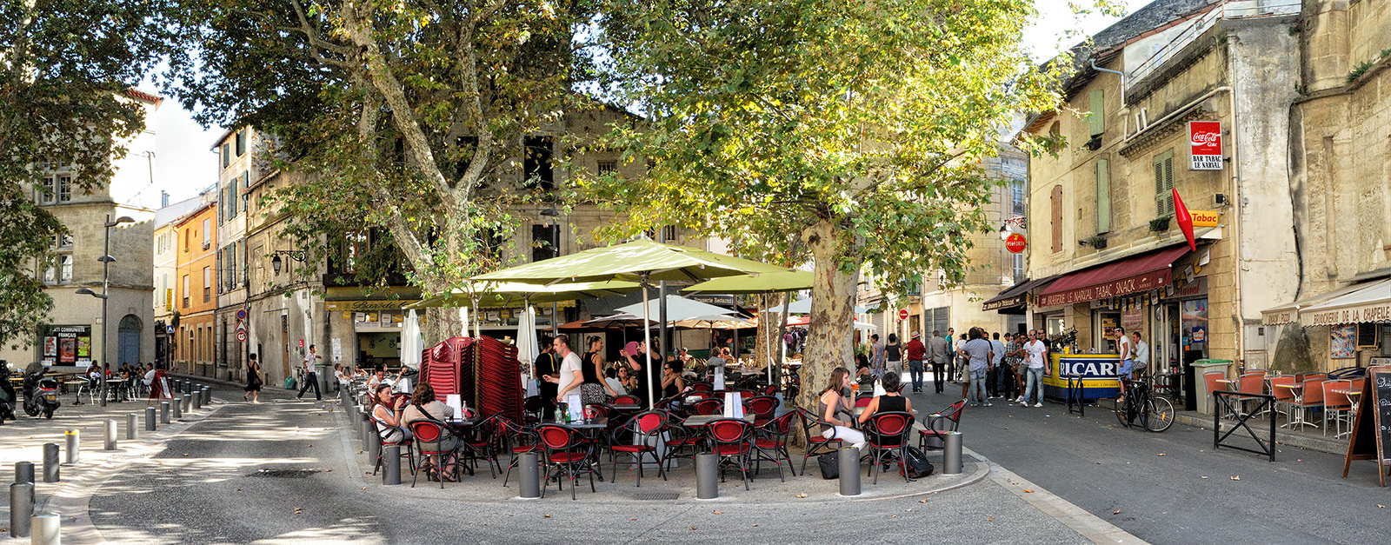
Special Content:
ergonomics in the future world
ERGONOMICS IN THE FUTURE WORLD: Challenges and Opportunities for the HFE Practitioner & Researcher in Cultural Contexts Worldwide”
This track is meant to be used by the federation of national societies and regional networks (FEES – ULAERGO – ERGOAFRICA – SEANES – BRICS - ACED, etc) to embrace a common cultural ground in order to elicit the state of the art of ergonomics and to inform the closing session “future of human factors and ergonomics”
Each one of the 17 clusters (see attached file) will have a liaison person appointed by the national societies
  Each cluster of national societies is asked to discuss and to answer the following questions:
  What are the most promising opportunities for RESEARCH & DEVELOPMENT in HFE?
  What is needed to make HFE PRACTICE more actionable/operational on the field level?
  What are the needs to be included in HFE initial & professional TRAINING?
  What is the contribution of HFE to the future of work?
www.iea2018.org

Slide 20
Innovative Session:
ergonomics in the future world
ERGONOMICS IN THE FUTURE WORLD: Challenges and Opportunities for the HFE Practitioner & Researcher in Cultural Contexts Worldwide
Network of societies Leading Cluster of Societies Partecipating
FEES | Cluster north mediterranean countries
 | Cluster French speaking countries
 | Cluster English speaking European countries
 | Cluster German speaking countries
 | Eastern Europe countries
NORDIC ERGONOMICS AND HUMAN FACTORS SOCIETY and LATVIA | Cluster\EU Nordic and Baltic Sea
AHFE +ACE | Cluster\ NA
Australia and New Zealand | Cluster \ Southern Cross
SEANES/ACED/ Asia | Cluster \ ASIA-SEANES\ ACED
ULAERGO | Cluster Latin cultures/ ULAERGO
BRICS + | cluster \BRICS
ERGOAFRICA | cluster AFRICA
www.iea2018.org

Slide 21

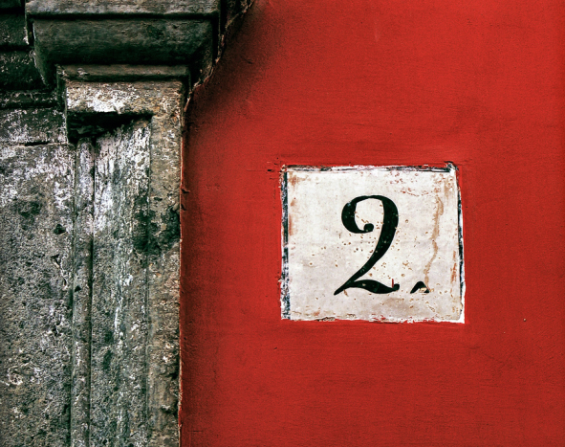
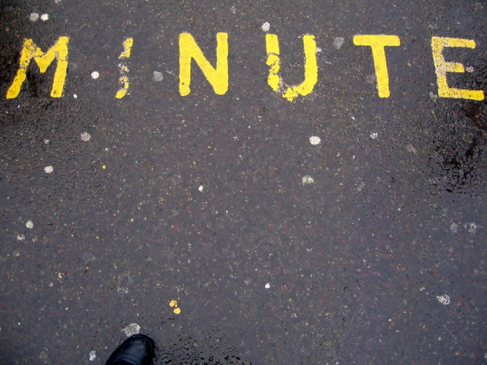
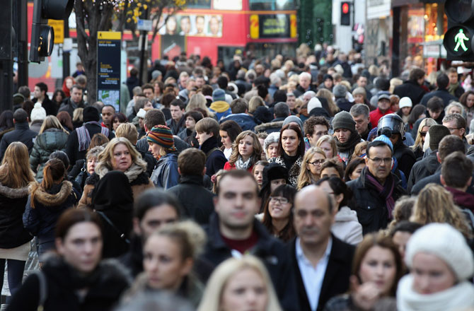
Special Content:
Video abstracts
Video Abstract
N. 40 Visual abstract
How does your research look like from «the field»?
Research seen from the user perspective
Video showing the effect/reaction/need of your research
www.iea2018.org

Slide 22
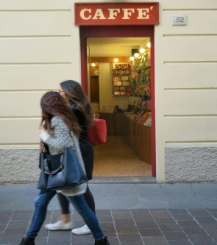

Special Content:
Human factor stories
Special session coordinated by Ernst
Stories and History of Human Factors
HFE
An Attempt To Study The Evolution Of French-speaking Ergonomics
Ergonomics at 60
Montessori discover of ergonomics
Ergonomics and design in Brazil: The ergonomic concept of Itiro Iida
Technological constraints related to the practice of parathetism launches: Performance and Prevention of Work related musculoskeletal disorder.
www.iea2018.org

Slide 23
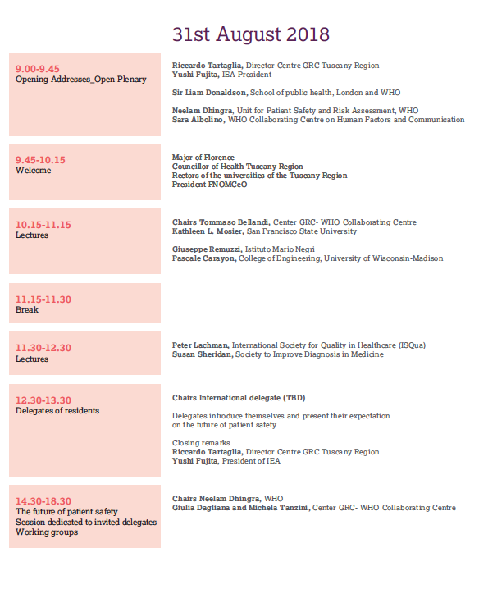

Special Content:
WHO CC-IEA event

Slide 24
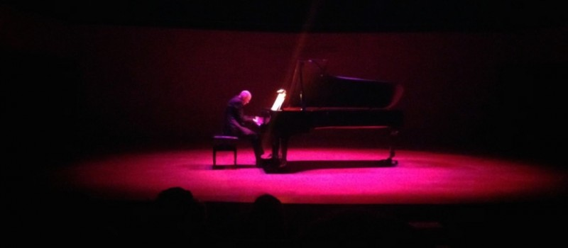
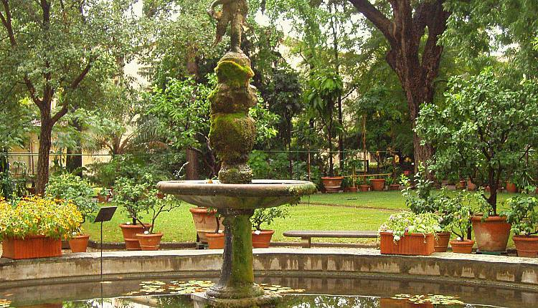

Opening session with Multi-sensorial show: music, light and perfum by Antonio Artese piano player
Social dinner in Botanic Garden and after dancing with an Italian band
Social tours and special tourist experiences
SOCIAL PROGRAM

Slide 25
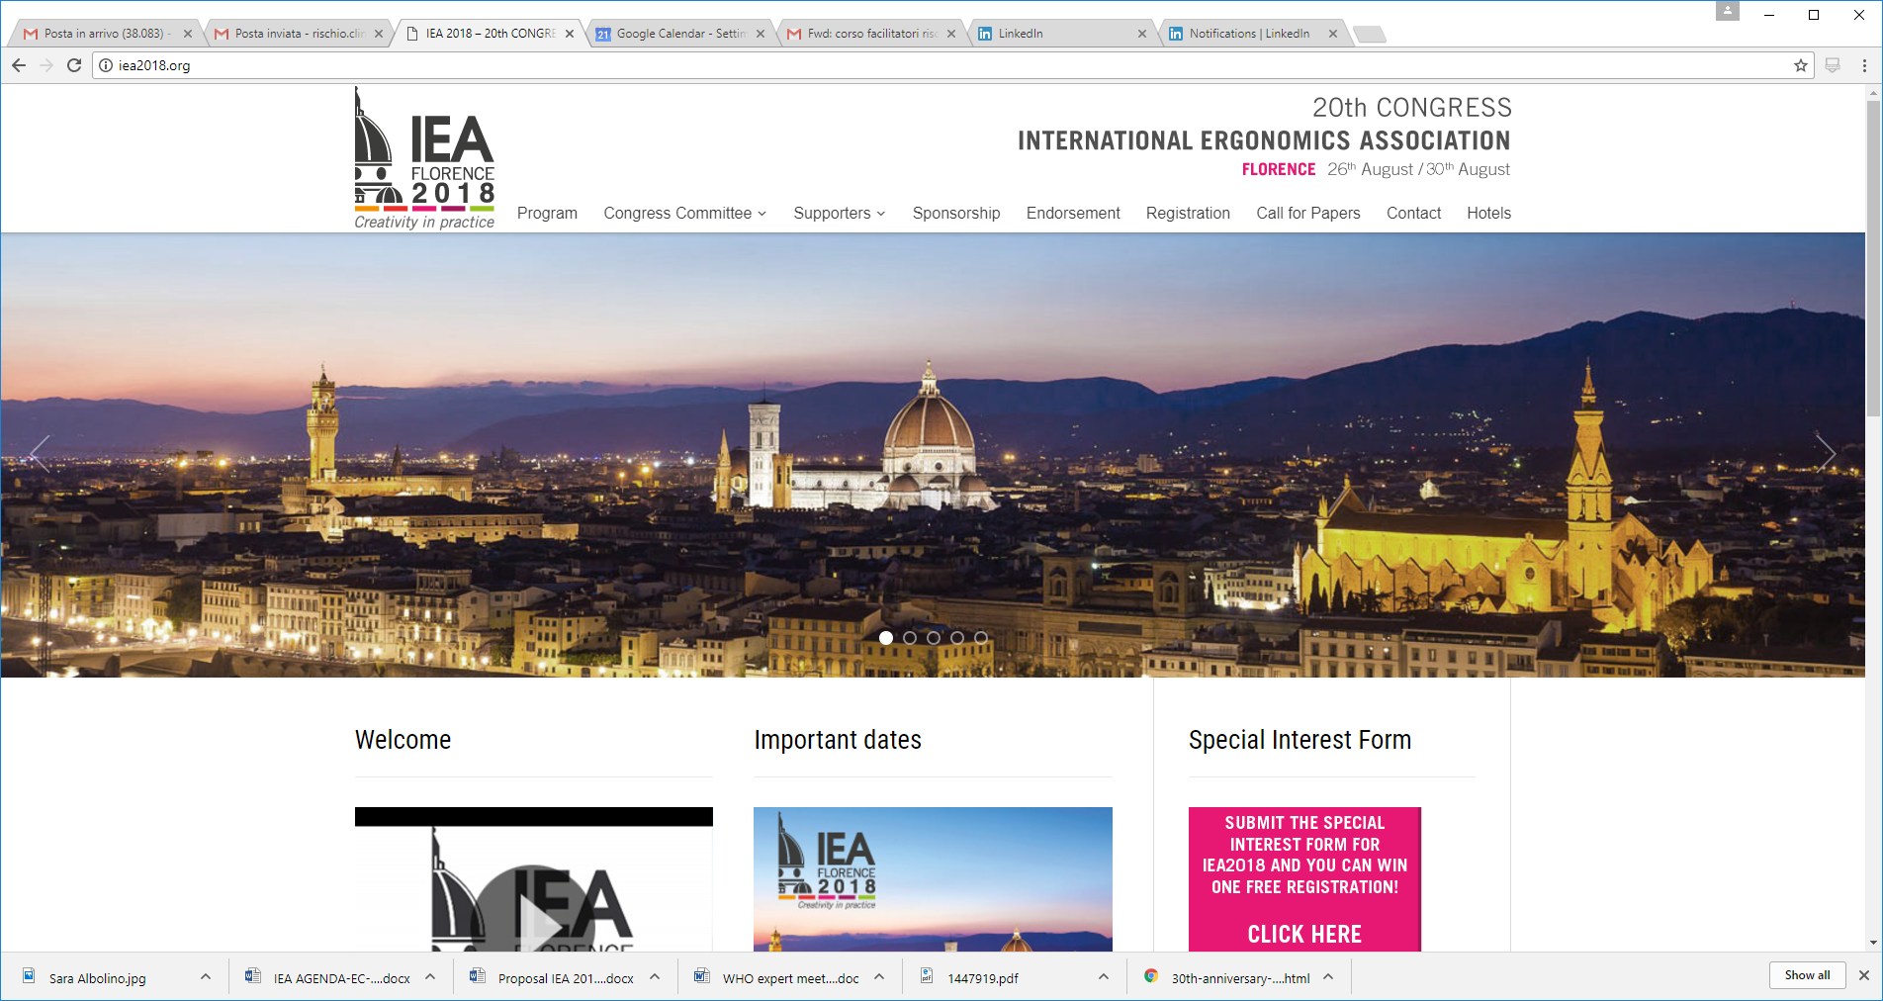
SOCIAL MEDIA
NOT ENOUGH GOOD FROM THE ERGONOMIC POINT OF VIEW

Slide 26
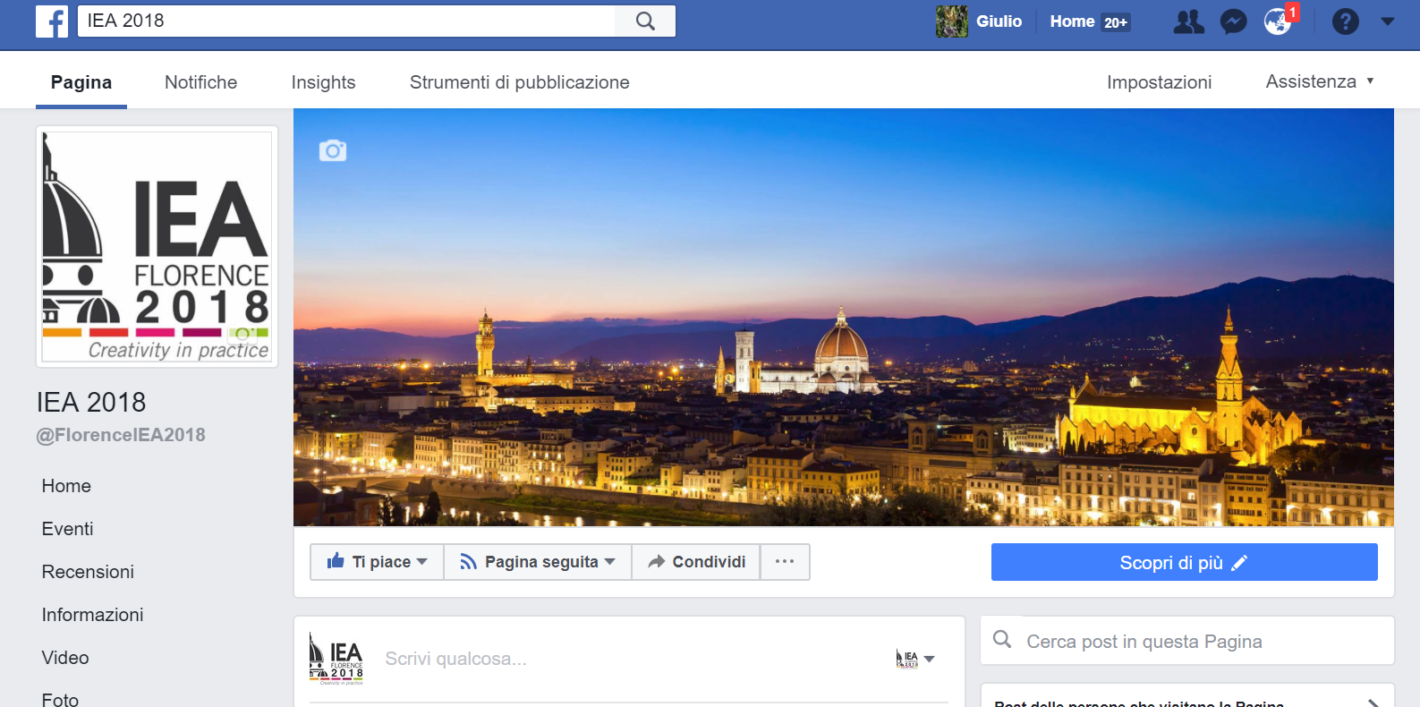


Facebook:@FlorenceIEA2018
IEA 2018
Active

Slide 27
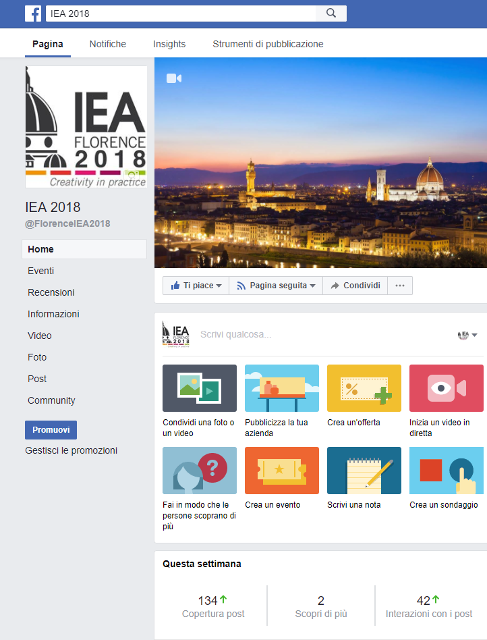
Use the Facebook page to amplify
The information produced by
the main web site
www.iea2018.org
Registered participants
Key note info
Promotional video
Updates on program
Updates on events

Slide 28
Remarks
The interactions with the IEA 2018 facebook page increased constantly. The first peak was registred after the post on number of abstract submitted
The most followed post was the conference program scoring 1200 views
The post regarding the opening cerimony had 470 views

Slide 29
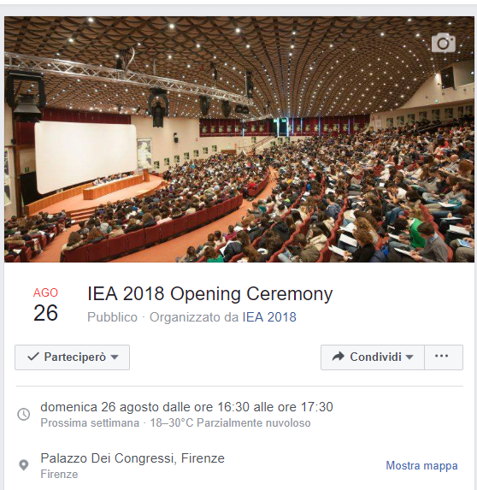
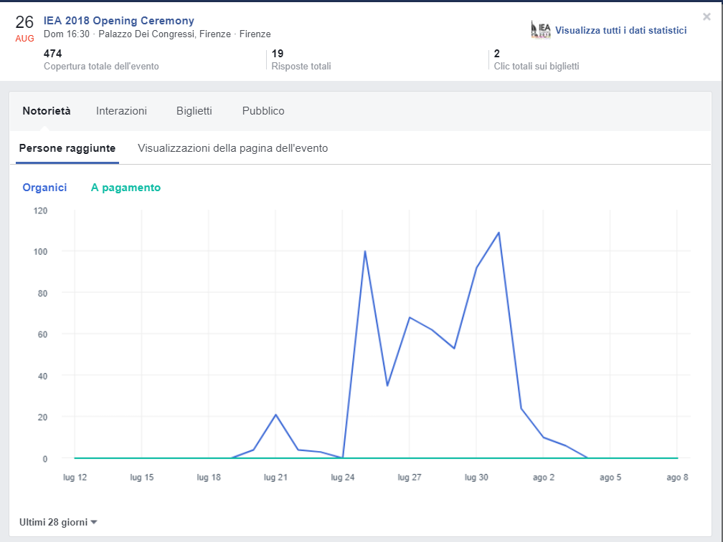
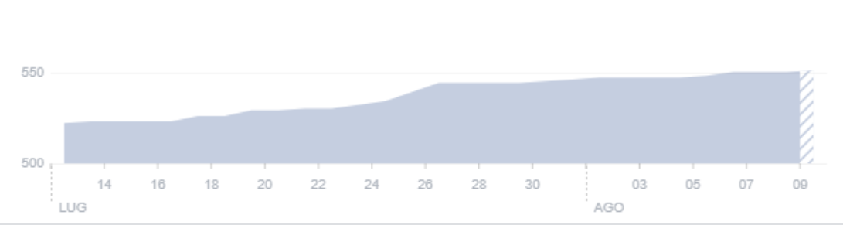
Continous Growth of Page Follower
On 1° of August launch of EVENTS section
470
Views: Opening cereminony event
605
Page follower
16.08.18

Slide 30
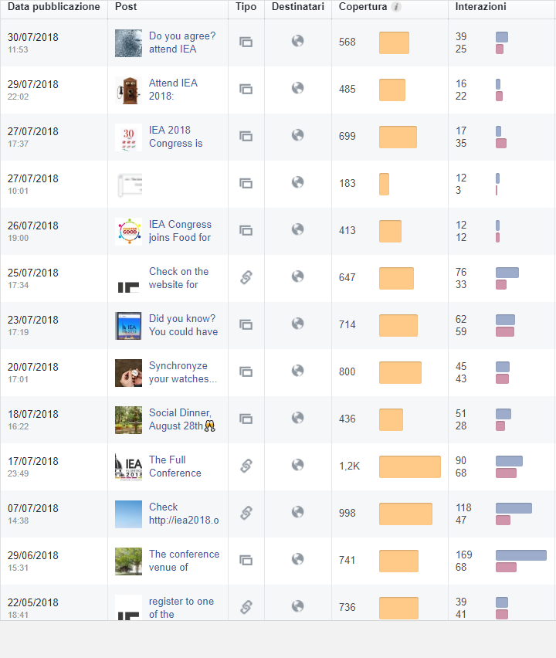
Facebook: Most Followed Posts
Launch of
conference APP
700
800
Countdown «30 days to opening»
Publication of
conference program
1200

Slide 31
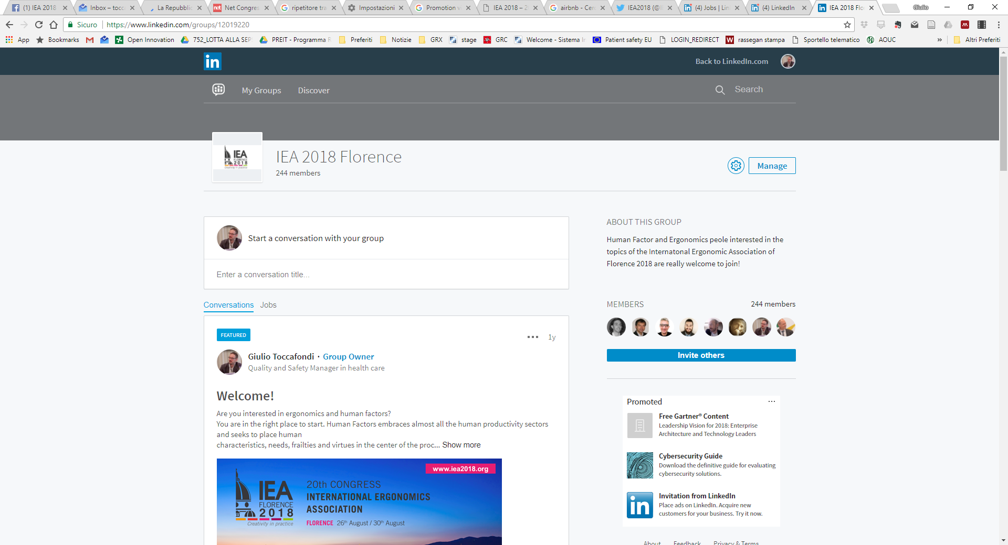
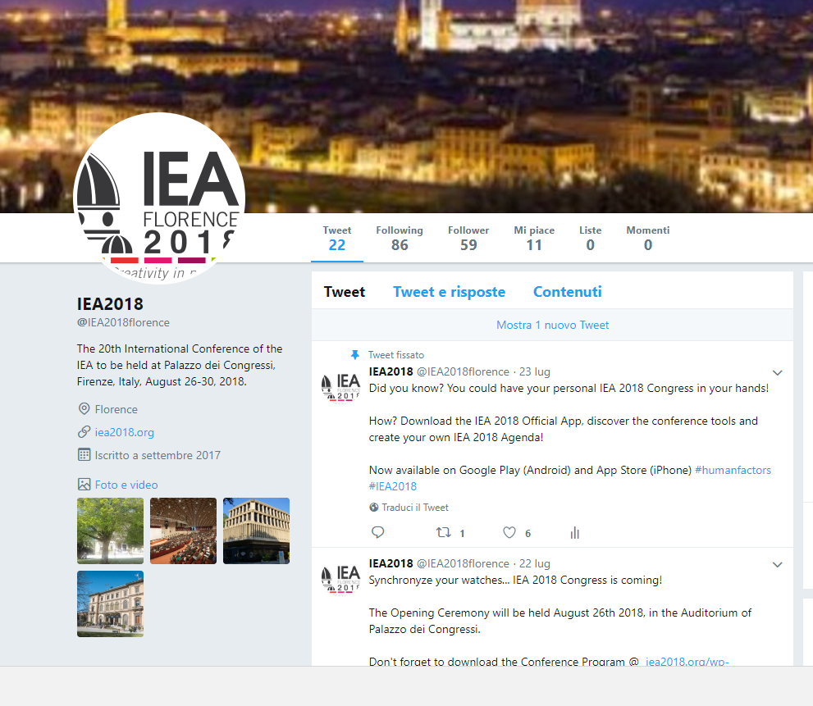
Linked-in and Twitter
Linked in Now 320 members
+ 70 members in the last 3 months
Twitter account active
Good interaction 60 followers

Slide 32
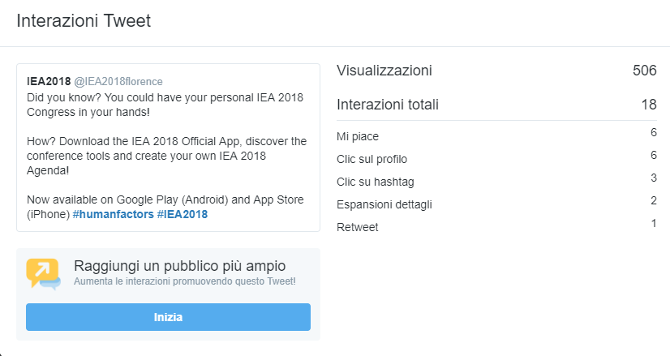
Twitter
followers
506
Launch of
conference APP
700

Slide 33
Lessons learned
Preserve the knowledge on the Triennal Congress for next editions: consolidate a conference format with a permanent committee
Create a Council of companies advisors (to mantain also after the Conference, consolidate the relationship with sponsors)
Define A new strategy for attracting sponsors for the Triennal Congress: difficulties in finding companies interested in such a general event.
The multidisciplinarity is an added value for developing the knowledges but it is a limit for the sponsors’ attraction
Establish a permanent collaboration with an editor for papers publication: conference is an opportunity and not a cost for an editor

Slide 34
Lessons learned
Dissemination by promoting the conference in other IEA events around the globe and creating collaboration with other federated societies is crucial for global participation
Role of the technical committees should be reinforced and structured
Use the conference as an opportunity for promoting HFE in your own country and reinforce the local society (new members from participants thanks to specific registration policies
Official language: simultanous translation can favourite participation
Social media are strategic
Define the added value for attending the conference by target for the promotion plan

Slide 35
Lessons learned
Website: it is necessary to consider the ergonomic aspect from the very beginning of its construction
Ad-hoc solutions with clear basic rules for attracting participants: being inclusive but respect the organizational procedures (deadlines, special requests)
Organize side events on specific technical domains to attract sponsors with a specific interest in a professional community
Plan Special issues in journals form other scientific domains in order to disseminate the HFE knowledge in other fields
Provide the organization with an Organizing Secretariat and a team from the federated society or from an organization affiliated to the society that can guarantee continuity and stability
Participants’ Mailing list has to be of IEA property
Emphasize the multidisciplinarity of the Conference through the program and topics

Slide 36

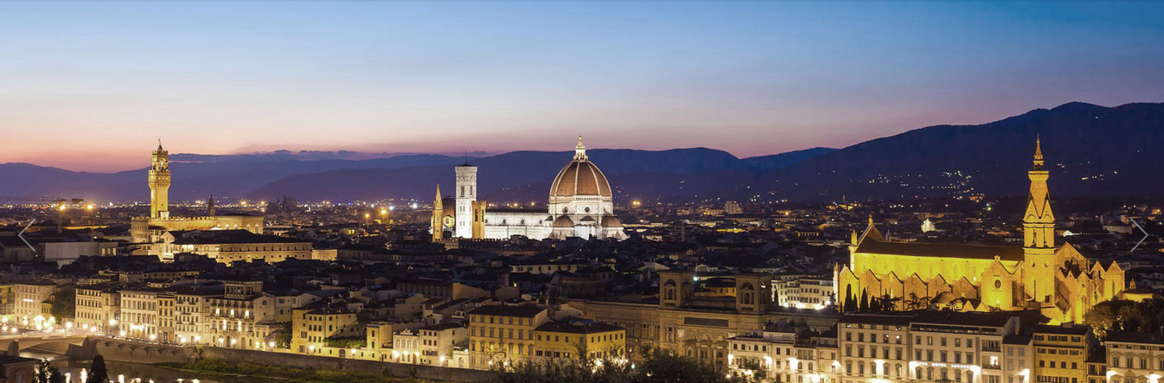

Thanks for your Attention!
26 – 30 August 2018

