Slide 1
IEA2027 update
Ben Peachey
28 March 2025

Slide 2
Progress to date
        Ambition document reviewed by CIEHF and IEA leadership
        Marketing email sent to IEA2024 delegates > 300 signed up to marketing list
        Early drafts of MOU and seed funding agreements reviewed by IEA and CIEHF
        Event company appointed
        CIEHF trustees approved creation of trading company for event in Feb 2025
        Site visits to venues completed in early March 2025
        Next priorities:
          Set up company and open bank accounts
          Sign agreements with IEA and obtain seed funding
          Venue and date confirmation
          Budget development
          Work on sponsor packages

Slide 3
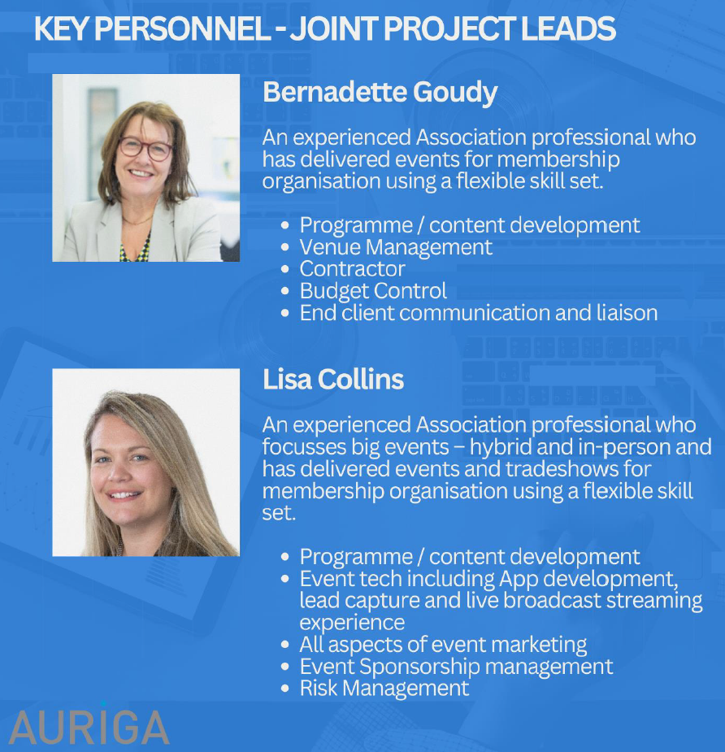
Event organisers

Slide 4
Input requested from IEA EC – the event
Target audiences
  Are all key stakeholder audiences covered?
  Do you have contacts/leads in organisations that we should engage?
Event format
  Feedback on content formats (see next slide)

Slide 5
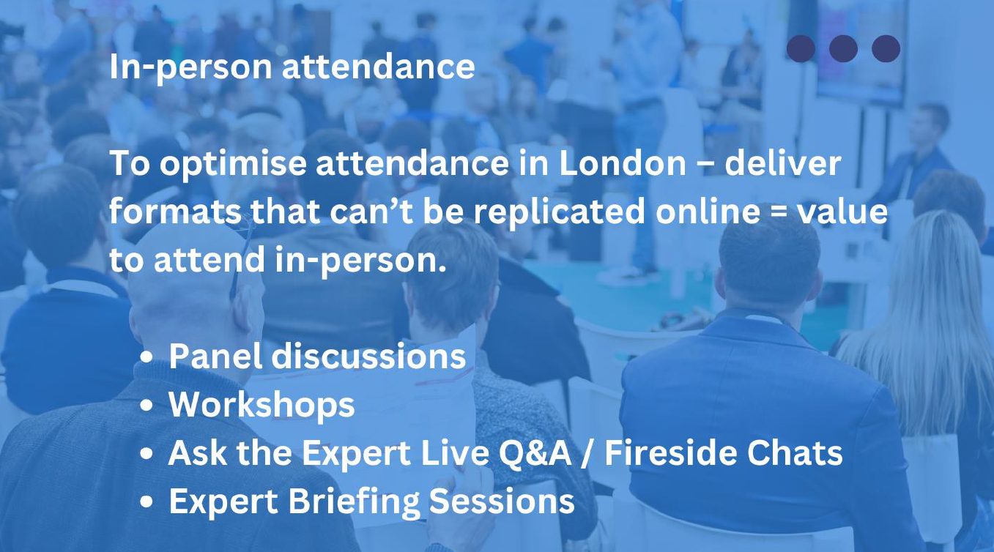
Content formats

Slide 6
Delegate Experience
Before the Event
  Clear understanding of the overall programme and what’s on offer
  Ease of registration and payment
  Confirmation of Registration and Venue sent promptly
  Queries answered promptly by email

Slide 7
Delegate Experience
At the Event
  Welcoming and friendly atmosphere
  Self registration to print delegate badge – speeds up delegate transitions
  ‘Here to Help’ delegate supporters wearing bright T-Shirts
Promote community (inclusive, relevant topics, every opinion counts)
  Topics appeal across the range of delegates
  Opportunity to give feedback throughout the event via QR code

Slide 8
Presentation Formats - Opportunities
Plenary Presentation. Format: speakers are front on stage
Interactive Workshops. Format: Facilitated sessions focused on hands-on learning or skill development.
Panel Discussions. Format: A moderated conversation among 3-5 experts representing diverse perspectives on a single topic.
Fireside Chats. Format: Intimate, one-on-one or two-person conversations, often involving a moderator and a guest speaker.
Roundtable Discussions. Format: Small-group discussions facilitated by a moderator, with participants sitting around a table (physical or virtual).
Lightning Talks. Format: Short, focused presentations of 5-10 minutes on a specific topic or idea.

Slide 9
Presentation Formats - Opportunities
Interactive Demonstrations. Format: Live or recorded demonstrations showcasing tools, technologies, or workflows, often with audience participation.
Debates. Format: Structured debates where opposing viewpoints are presented on controversial or emerging topics.
Peer-Led Discussions. Format: Informal sessions where attendees lead discussions on topics of mutual interest.
Poster Presentations. Format: Academic or research posters displayed digitally or physically, with scheduled time for authors to present.
Think Tanks. Format: Small groups collaborate to solve a real-world challenge or develop actionable strategies.

Slide 10
Input requested from IEA EC – stakeholder input
Technical committee role
  How do we best engage technical committees?
International advisory group
  Intention is to recruit a regionally-representative group of Council members to help drive global buy-in to the event: is this worthwhile?
Side events
  See list in Ambition document – others to add?

Slide 11
Input requested from IEA EC – event preparation
Do you have any feedback on other sections in ambition document:
  Marketing & Promotion
  Event logistics
  Content planning & management
  Post-event activities

Slide 12
Thank you
28 March 2025

