Slide 1

Main projects of Vice-President Secretary General
Improve IEA internal stakeholder communications
Improve process efficiency
Enhance operating procedures (OPs)
EC meeting: March 28-29, 2025 Aachen
Presenter: Nancy Black

Slide 2
Improve IEA internal stakeholder communications
Value-add
Alignment with IEA Goals
Involvement + Perceived value
To develop more effective communication with and collaboration between federated societies.
1. Engage Stakeholders
Stakeholder Needs to be met
Project outline including status
Networking
Information sharing
New gatherings between Council meetings …Feb 20, 2025 ✓
Notes:
P^2DT is a process for helping systematic HFE project design. Various HFE methods or tools can be integrated into P^DT to conduct specific steps of the process.
P^2DT assumes participatory design approaches. The benefits of adopting participatory approaches are discussed later.
P^2DT is designed to be applicable to any HFE-related projects in various work places such as healthcare, office work space and environment, process plant, aviation,…

Slide 3
Improve IEA internal stakeholder communications Who, involved & how?
Group | Group’s role* | Group benefit | Individual | Individual’s role* | Individual benefit
IEA Council | Participants, idea generation, sharing (A) | Enhance bonds; learning | IEA President | Chair (E) | Value-creation
IEA Officers | Create opportunities (D) | Value creation | VPSG | Scheduler (I) | Communic-ation
Executive Committee | Facilitators | A / I | Administra-tor | Communicator (group lists) | Database
Sustaining Members | Participants, sharing (A) | Involve-ment
*Categories: Actor/ Expert/ Decider/ Influencer

Slide 4
Enhance communications: stakeholders and their relationships
From To | Officers | EC | Council | Sustaining Members | Non-council
Officers | Discuss | Test-population | Request comm. | Suggest opport. | Needs. Practices
EC | Present; suggest. | Discuss at EC meetings | Feedback-suggest. |  | TC Input
Council | Propose opportunities | Support | Discuss needs | Suggest (interested) | Needs from IEA
Sustaining Members | Invited | Listen. Learn | Network |  | Historical, business interests
Non-council | Communicate |  |  |  | Platforms
Notes:
Coupled with the understanding of stakeholder benefits (Step 6), the understanding the relations among stakeholders is critically important for developing promotional strategies.
It will form a basis for specifying subprojects: The underlying consideration is to develop a set of projects which do not conflict in each project. For instance, develop a science-oriented HFE project and a more application-oriented HFE project: The science-oriented HFE project is designed to contribute to the development of HFE science, while the application-oriented HFE project is designed to provide practical benefits. They together achieve a high-quality HFE project. Others may include promotion projects for influential stakeholders (i.e., system influencers).

Slide 5
Improve process efficiency
Value-add
Alignment with IEA Goals
Limited secretariat and volunteer hours available
6. Reinforce the infrastructure of the Association
7. Maintain future focus
Stakeholder Needs to be met
Project outline including status
Timely, transparent, value-added supports
Ambassador reports ✓
Automated certificates (prog) ➔
Streamline communications
- platforms; exchange (Forum unused)
Notes:
P^2DT is a process for helping systematic HFE project design. Various HFE methods or tools can be integrated into P^DT to conduct specific steps of the process.
P^2DT assumes participatory design approaches. The benefits of adopting participatory approaches are discussed later.
P^2DT is designed to be applicable to any HFE-related projects in various work places such as healthcare, office work space and environment, process plant, aviation,…

Slide 6
Improve processes - stakeholders involved & how?
Group | Group’s role* | Group benefit | Individual | Individual’s role* | Individual benefit
IEA Council | Suggestors (I, D) | Value | IEA President | Chair (E) | Value-creation
IEA Officers | Creation of supports; facilitators (A, I) | Value creation | VPSG | Scheduler (I) | Communic-ation
Executive Committee | Suggestors (A, E) | Efficiency | VPTreas | Budget oversight (I)
Admin support | Implementation; quality control (A,E) | Efficiency | Administra-tor | Communicator (group lists) A,E | Database
*Categories: Actor/ Expert/ Decider/ Influencer

Slide 7
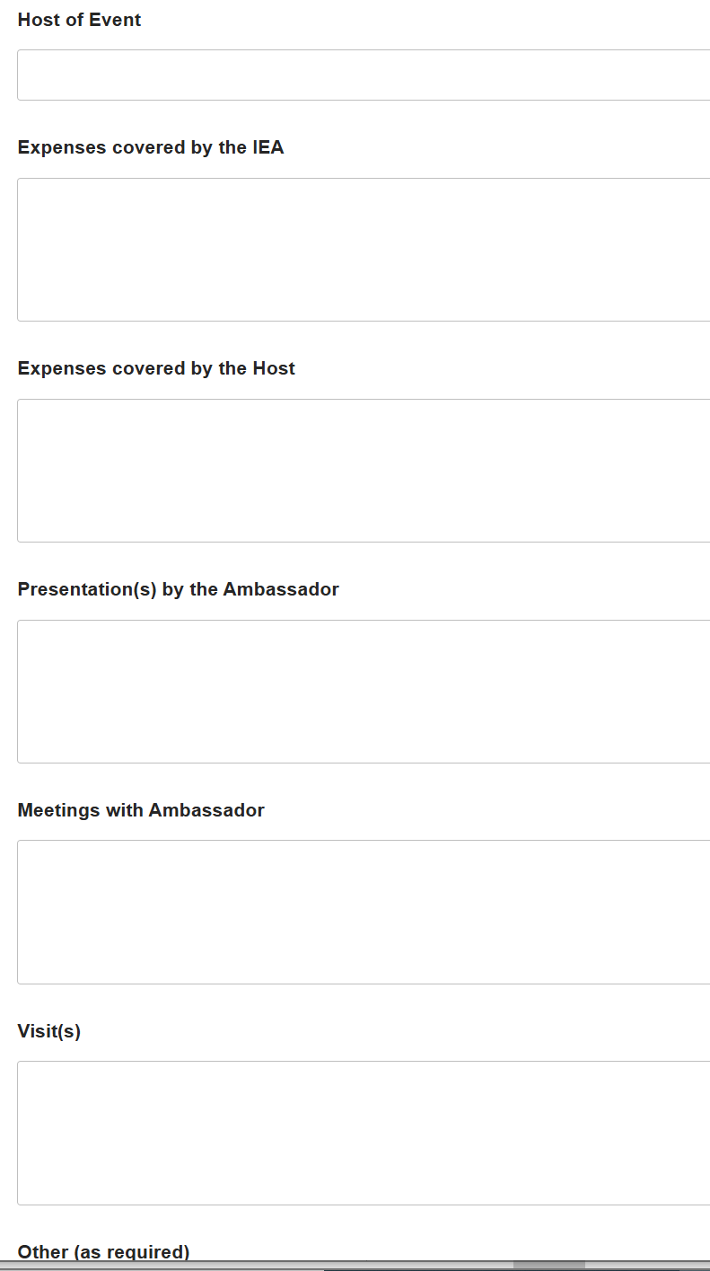
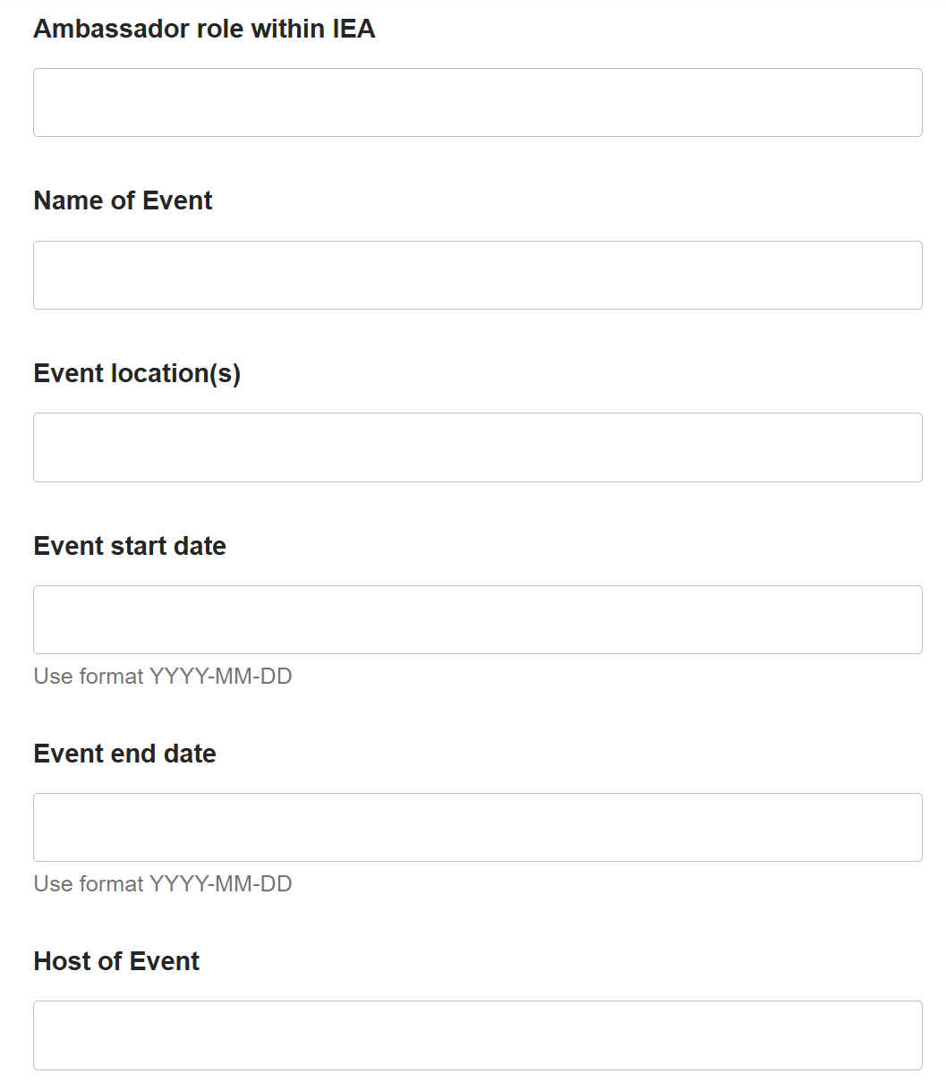
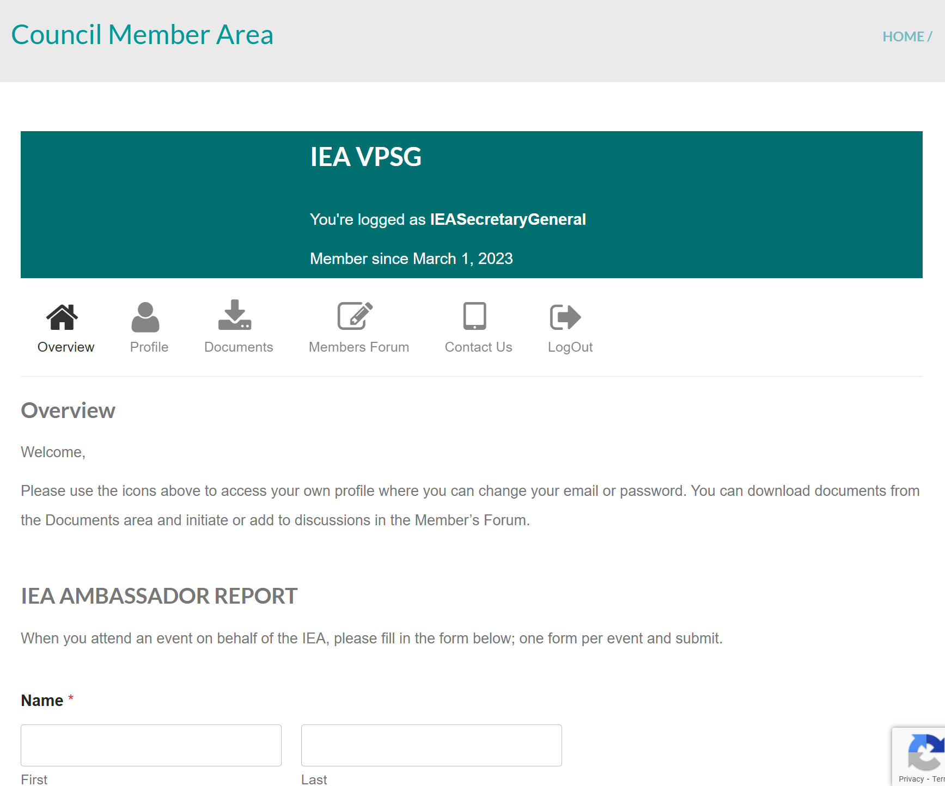
Ambassador report: iea.cc → Member area
Improve processes

Slide 8
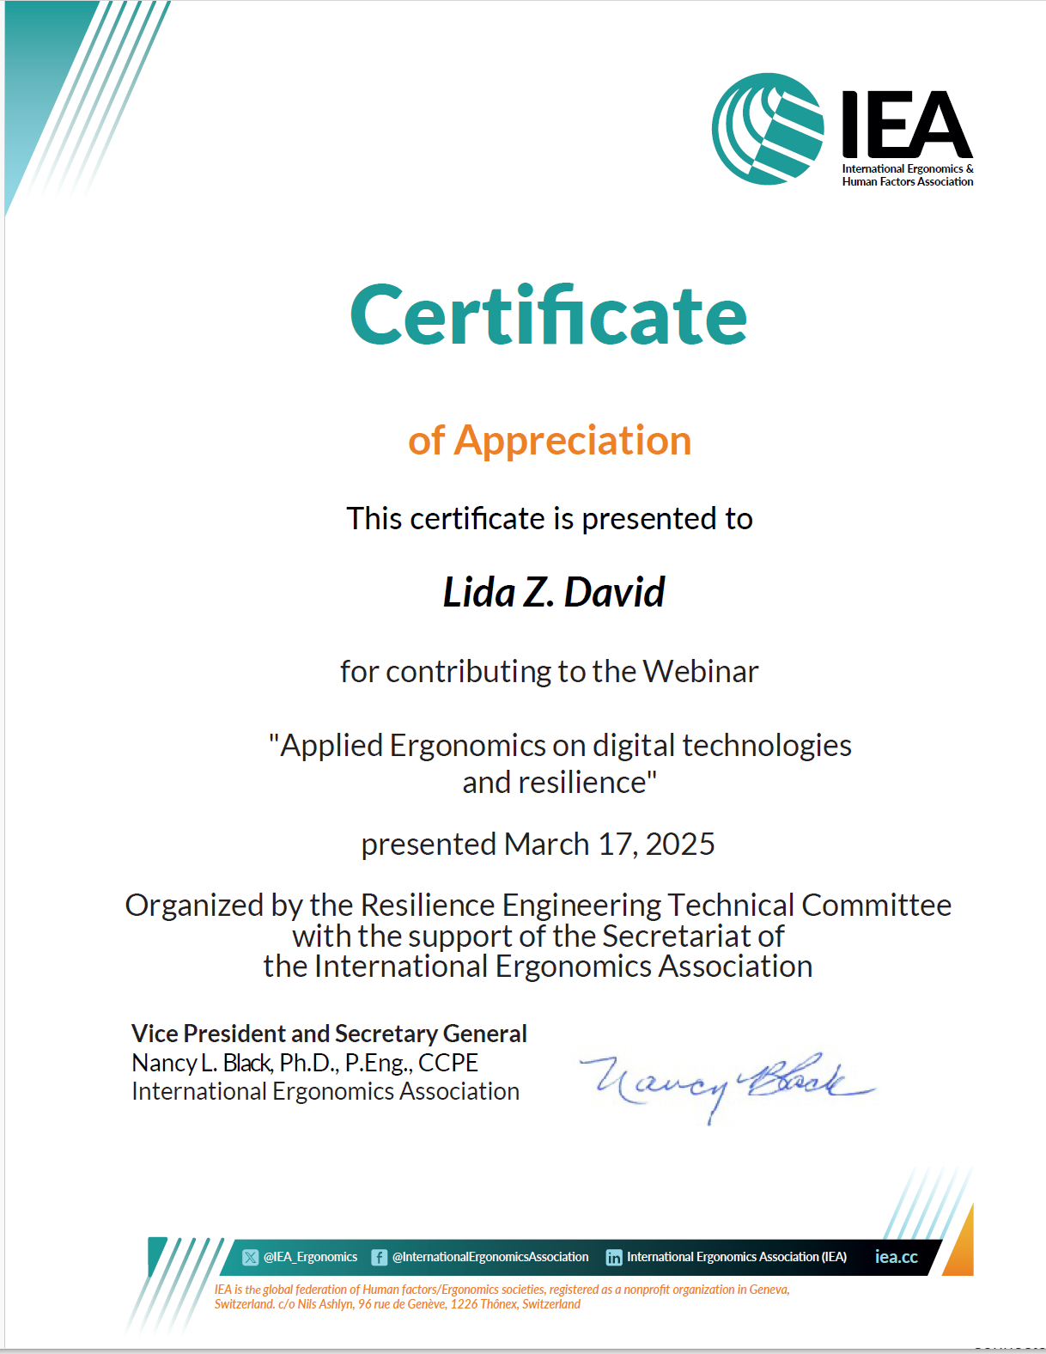
Webinar Certificate Production
Improve processes
Programmed support
https://ergengresearch.shinyapps.io/hfe_certificates_demo/
Variable fields
  TC recognition
    TC members as organizers
Value-added of IEA hosting
  Hosting time limitations

Slide 9
Process efficiency stakeholder relationships
From To | VPSG | Admin. | Officers | Executive Committee | Other (external) groups
VPSP | Reflect | Suggest | Suggest | Suggest | Suggest
Admin | Consult | Reflect | Suggest | Suggest | Suggest
Officers | Suggest | Discuss | Discuss | Suggest | Discuss
Executive Committee | Discuss | Inform | Discuss | Reflect | Discuss
Other (external) groups | Discuss | Discuss | Discuss | Discuss | Share best practices
Notes:
Coupled with the understanding of stakeholder benefits (Step 6), the understanding the relations among stakeholders is critically important for developing promotional strategies.
It will form a basis for specifying subprojects: The underlying consideration is to develop a set of projects which do not conflict in each project. For instance, develop a science-oriented HFE project and a more application-oriented HFE project: The science-oriented HFE project is designed to contribute to the development of HFE science, while the application-oriented HFE project is designed to provide practical benefits. They together achieve a high-quality HFE project. Others may include promotion projects for influential stakeholders (i.e., system influencers).

Slide 10
Enhance Operating Procedures
Value-add
Alignment with IEA Goals
Facilitate value-added elements
…effective communication with and collaboration between FS.
Engage Stakeholders
Reinforce the infrastructure of the Association
Maintain future focus
Stakeholder Needs to be met
Project outline including status
Succession support;
Responsible resources use
OP21: Financial support for IEA Presentations (non-officer) (prop.)
+ Review by EC members+
Notes:
P^2DT is a process for helping systematic HFE project design. Various HFE methods or tools can be integrated into P^DT to conduct specific steps of the process.
P^2DT assumes participatory design approaches. The benefits of adopting participatory approaches are discussed later.
P^2DT is designed to be applicable to any HFE-related projects in various work places such as healthcare, office work space and environment, process plant, aviation,…

Slide 11
Operating Procedure - stakeholders involved & how?
Group | Group’s role* | Group benefit | Individual | Individual’s role* | Individual benefit
IEA Officers | Propose, Oversee, Review (A,E,I) | Value-add | VPSG | Propose (A,E) | Responsive value
 |  |  | President | Strategic alignment (E) | Value-add
Executive Committee | Preliminary approval (A,I) | Value-add | VP Treasurer | Financial sustainability (E) | Value-add
IEA Council | Debate, Final approval (D,I) | Value-add | Admin. | Compilation, publishing (A) | Efficiency
*Categories: Actor/ Expert/ Decider/ Influencer

Slide 12
Operating Procedure 21: Proposal
Financial support of IEA presentations (non-officer) Pt 4.1
Objectives | Asked to present at conferences / gatherings Normally represented by elected officer but… Support limitations ($ - # annually
2. Procedures | 2.1 IEA presentation requested
 | 2.2 communicating request to IEA officers for decision
 | 2.3 Deliberation
 | 2.3 Decision to support
3. Terms of Reference for Funds | Support travel given … volunteer.... follow the IEA Guidelines for travel expenses (2019)

Slide 13
Operating Procedures stakeholders relationships
From To | Officers | Executive Committee | Council | External stakeholders
Officers | Discuss, revise | Suggest | Suggest | Suggest
Executive Committee | Propose, discuss (revise) | Discuss | Suggest | Suggest
Council | Propose, discuss, vote |  | Discuss | Suggest
External stakeholders | Inform | Inform | Inform
Notes:
Coupled with the understanding of stakeholder benefits (Step 6), the understanding the relations among stakeholders is critically important for developing promotional strategies.
It will form a basis for specifying subprojects: The underlying consideration is to develop a set of projects which do not conflict in each project. For instance, develop a science-oriented HFE project and a more application-oriented HFE project: The science-oriented HFE project is designed to contribute to the development of HFE science, while the application-oriented HFE project is designed to provide practical benefits. They together achieve a high-quality HFE project. Others may include promotion projects for influential stakeholders (i.e., system influencers).

Slide 14
Discussion
VPSG@iea.cc

