Slide 1
Main projects of Vice-President Secretary General
Improve IEA internal stakeholder communications
Improve process efficiency
Enhance operating procedures (OPs)
Council meeting: October 28-29, 2025 Beijing
Presenter: Nancy Black

Slide 2
Improve IEA internal stakeholder communications
Value-add
Alignment with IEA Goals
Involvement - Networking
+ Perceived value
To develop more effective communication with FS & collaboration between FS.
1. Engage Stakeholders
Stakeholder Needs to be met
Project outline including status
Value … + Networking
Information sharing
Virtual council gatherings: Feb. – June ✓
Calendar on IEA.cc ✓
Improve online exchanges ➔
Notes:
P^2DT is a process for helping systematic HFE project design. Various HFE methods or tools can be integrated into P^DT to conduct specific steps of the process.
P^2DT assumes participatory design approaches. The benefits of adopting participatory approaches are discussed later.
P^2DT is designed to be applicable to any HFE-related projects in various work places such as healthcare, office work space and environment, process plant, aviation,…

Slide 3
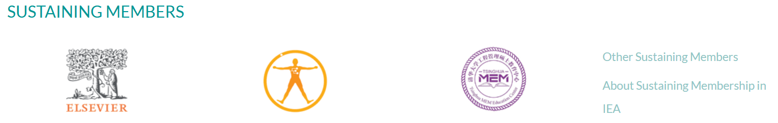
Sustaining Member value
Diamond level
Gold level
Universidad del Valle/Facultad de Salud (College of Health)
HUANUO
TeamScape LLC
BAuA
Minicute
VUBPnet
Individual Sustaining Members
Supporters: David Caple
Contributors: Pascale Carayon; Peter Hoonnaker; Andrew S. Imada; Kazutaka Kogi; Ernst Koningsveld; Johan Molenbroek; David Rempel

Slide 4
Improve process efficiency
Value-add
Alignment with IEA Goals
Limited secretariat and volunteer hours available
6. Reinforce the infrastructure of the Association
7. Maintain future focus
Stakeholder Needs to be met
Project outline including status
Timely, transparent, value-added supports
Ambassador reports ✓
Automated certificates (prog) ➔
Streamline communications
- platforms; exchange (Forum unused)
Notes:
P^2DT is a process for helping systematic HFE project design. Various HFE methods or tools can be integrated into P^DT to conduct specific steps of the process.
P^2DT assumes participatory design approaches. The benefits of adopting participatory approaches are discussed later.
P^2DT is designed to be applicable to any HFE-related projects in various work places such as healthcare, office work space and environment, process plant, aviation,…

Slide 5
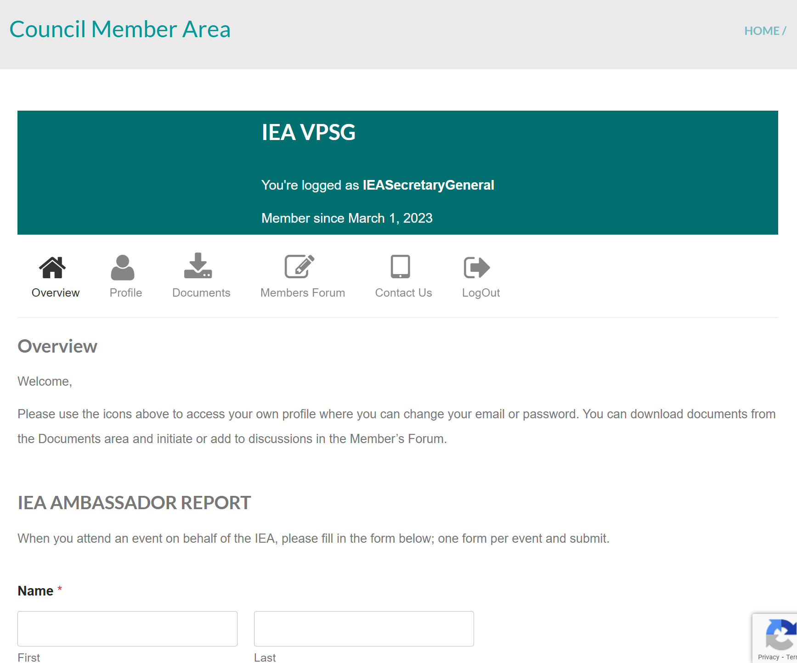
Ambassador report:
Improve processes
iea.cc → Member Login
NewsBriefs
Andrew Thatcher
Nancy Black

Slide 6
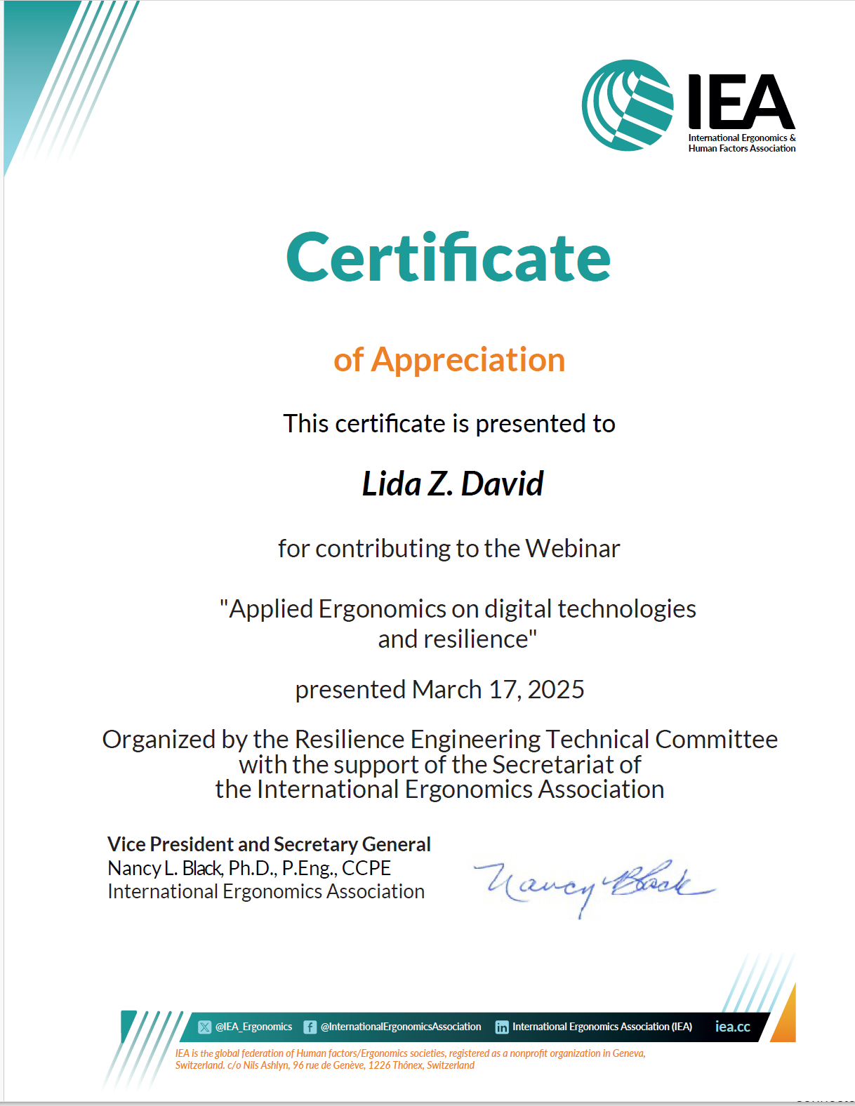
Webinar Certificate Production
Improve processes
Programmed support
https://ergengresearch.shinyapps.io/hfe_certificates_demo/
Variable fields
  TC recognition
    TC members as organizers
Value-added of IEA hosting
  Hosting time limitations

Slide 7
Enhance Operating Procedures
Value-add
Alignment with IEA Goals
Facilitate value-added elements
…effective communication with and collaboration between FS.
Engage Stakeholders
Reinforce the infrastructure of the Association
Maintain future focus
Stakeholder Needs to be met
Project outline including status
Succession support;
Responsible resources use
Policy: Financial support for IEA Presentations (non-officer) ✓
Notes:
P^2DT is a process for helping systematic HFE project design. Various HFE methods or tools can be integrated into P^DT to conduct specific steps of the process.
P^2DT assumes participatory design approaches. The benefits of adopting participatory approaches are discussed later.
P^2DT is designed to be applicable to any HFE-related projects in various work places such as healthcare, office work space and environment, process plant, aviation,…

Slide 8
New Policy:
Financial support of IEA presentations (non-officer)
Objectives | Asked to present at conferences / gatherings Normally represented by elected officer but… Limited support available
2. Procedures | 2.1 Event / Organisation requests IEA presentation
 | 2.2 Communicate request to IEA officers for decision
 | 2.3 Deliberation
 | 2.3 Decision to support
3. Terms of Reference for Funds | Support travel … volunteer.... Follow IEA Guidelines for travel expenses (2019)

Slide 9
Discussion
VPSG@iea.cc

