Slide 1
Treasurer’s Report 2024
IEA VP Treasurer
Thomas Alexander

Slide 2

2024 Assets and Liabilities
Balance Sheet: January 1 – December 31, 2024
Assets |  | Liabilities
Accounts | $ 130,534 | Dues Advanced Received | $ 100
Investment | $ 350,000 | Accounts Payable (incl. accrued expenses) | $ 8,244
Prepaid Expenses | ./. | Earmarked Funds* | $ 39,877
Seed Money Receivable | ./. | Total Liabilities | $ 48,221
 |  | Total Equity | $ 432,313
TOTAL | $ 480,534 | TOTAL | $ 480,534
IEA’s equity increased by USD 12,966
from USD 419,347 on Dec 31, 2023,
to USD 432,313 on Dec 31, 2024,
because of a
successful recruitment,
fixed-term investments at UBS,
payment of capitation fee of ESK.
*funds: Support IEA2024 IDC part.
Notes:
Earmarked Funds:
In 2024, IDC funds of HFES and JES allowed experts from IDC countries an in-person attendance of the IEA 2024 Triennial World Congress supporting the development of Ergonomics and Human Factors in these regions. Before the congress, member and federated societies were informed that one person per society of LMIC and UMIC countries will be supported by an amount of USD 500. 7 (seven) societies responded. The process was managed by the chairperson of the IDC steering committee. At the end of 2024, IEA has still been managing two funds (originally provided by JES and ACE) with a total amount of USD 39,877 for supporting the development of Ergonomics and Human Factors in IDC countries.

Slide 3
2024 Revenues and Expenditures
Revenues |  | Expenditures
FS & AS Membership Dues | $ 45,426 | Meeting | $ 27,438
Sustaining Member Contributions | $ 56,651 | Representation & Outreach | $ 11,344
Capitation Fees | $ 20,440 | Office | $ 30,086
Exchange Rate Gains | $ 0 | Awards Committee | $ 24,783
Interest | $ 13,360 | ID Committee | $ 2,959
Miscellaneous* | $ 479 | PSE Committee | $ 143
 |  | STP Committee | $ 4,464
 |  | CPR Committee | $ 1,142
 |  | Future of Work Com. | $ 2,662
 |  | DP Committee | $ 3,732
 |  | IEA Congress Com. | ./.
 |  | Bank Fees | $ 5,281
 |  | Exchange Rate Losses | $ 584
 |  | Website (Dev, Maint.) | $ 7,500
 |  | Miscellaneous (IEA corporate design)** | $ 1,272
Total Revenues | 136,356 | Total Expenditures | 123,390
Summary of operations |  |  | $ 12,966
$ 38,782
$ 15,102
Notes:
* Miscellaneous revenues includes royalities from Elsevier and released funds for awards operations
** Miscellaneous expenditure is for the new IEA corporate image.

Slide 4
2024 Cash Flow
Summary of operations, Year 2024, up to December 31
Forwarded from 2023 @ 2024 Exchange | $ 122,869
Cash Revenues (+) (includes dues advanced this year, but does not include dues advanced in previous years) | + $ 137,701
Cash Expenses (-) (does not include depreciations, suppliers’ outstanding costs or accrued expenses of this year) | - $ 126,336
Seed moneys sent (-) and received (+) | ./.
Funds disbursed (-) and received (+) | - $ 3,500
Investment Changes | ./.
Exchange rate variation and effects from transfers between accounts, currencies, refunds etc. (USD, CHF)* | - $ 200
Cash Flow | + $ 7,665
Available to be forwarded to 2024 @ 2025 Exchange | + $ 130,534

Slide 5
2024: Expected and final financial results
Revenues | Revenues
FS & AS Membership Dues | $ 43,000 | $ 45,426
Sustaining Member Contributions | $ 55,000 | $ 56,651
Capitation Fee | $ 0 | $ 20,440
Exchange Rate Gains | $ 0 | $ 0
Interest | $ 17,000 | $ 13,360
Miscellaneous |  | $ 479
Total Revenues | $ 115,000 | $ 136,356
Expenditures | Revenues
Meeting, representation and outreach | $ 34,000 | $ 38,782
Office | $ 22,000 | $ 30,086
Awards & Awards Committee | $ 20,000 | $ 24,783
Standing and ad-hoc committees* | $ 20,000 | $ 15,102
Website maintenance (regular contract) | $ 7,500 | $ 7,500
Bank fees |  | $ 5,281
Exchange rate losses |  | $ 584
Miscellaneous |  | $ 1,272
Total Expenditures | $ 103,500 | $ 123,390
expected final
Summary of Operations | $ 11,500 | $ 12,966
expected final

Slide 6
Auditors’ Report
IEA VP Treasurer
Thomas Alexander

Slide 7
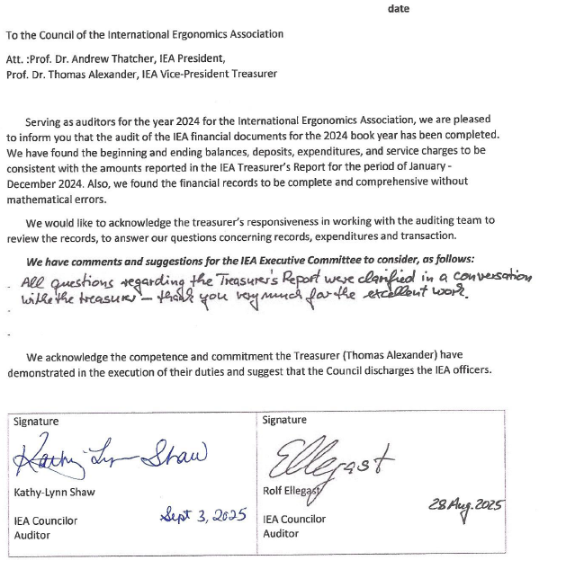
…the audit of the IEA financial the 2024 book year has been completed.
…
All questions regarding the Treasurer’s Report were clarified in a conversation with the treasurer – thank you very much for the excellent work.
We acknowledge the competent and commitment the Treasurer has demonstrated in the execution of his duties and suggest that the Council discharges the IEA officers.
Kathy-Lynn Shaw, Rolf Ellegast

Slide 8
Interim Report 2025 and Forecast
IEA VP Treasurer
Thomas Alexander

Slide 9
2025 Assets and Liabilities
IEA’s equity increased by USD 90,043
from USD 432,313 on Dec 31, 2023,
to USD 522,356 on Sept 12, 2025,
because of a
successful recruitment,
reduced meeting and ambassador costs,
1st payment of ILO project
surplus of IEA2024 (IDC-fund, $ 3,033)
MOST PAYMENTS FOR SERVICES ARE
STILL DUE.
Balance Sheet: January 1 – September 12, 2025
Assets |  | Liabilities
Accounts | $ 175,666 | Dues Advanced Received | $ 400
Investment | $ 350,000 | Accounts Payable (incl. accrued expenses) | $ 0
Prepaid Expenses | ./. | Earmarked Funds | $ 42,910
Seed Money Receivable | $ 40,000 | Total Liabilities | $ 43,310
 |  | Total Equity | $ 522,356
TOTAL | $ 565,666 | TOTAL | $ 565,666

Slide 10
2025 Revenues and Expenditures
2025 P&L Statement to September 12
Revenues |  | Expenditures
FS & AS Membership Dues | $ 43,251 | Meeting | $ 5,806
Sustaining Member Contributions | $ 58,719 | Representation & Outreach | $ 4,265
Capitation Fees | $ 0 | Office | $ 14,563
Exchange Rate Gains | $ 0 | Awards Committee | $ 1,369
Interest | $ 15,238 | ID Committee | $ 1,622
Miscellaneous* | $ 5,335 | PSE Committee | $ 0
 |  | STP Committee | $ 1,235
 |  | CPR Committee | $ 0
 |  | DP Committee | $ 0
 |  | IEA Congress Com. | $ 241
 |  | Bank Fees | $ 2,659
 |  | Exchange Rate Losses | $ 5
 |  | Website (Dev, Maint.) | $ 0
 |  | Miscellaneous** | $ 735
Total Revenues | 122,543 | Total Expenditures | 32,500
Summary of operations |  |  | $ 90,043
$ 10,071
$ 4,467

Slide 11
2025 Cash Flow
Summary of operations, Year 2025, up to September 12
Forwarded from 2024 @ 2025 Exchange | $ 130,534
Cash Revenues (+) (includes dues advanced this year, but does not include dues advanced in previous years) | + $ 125,001
Cash Expenses (-) (does not include depreciations, suppliers’ outstanding costs or accrued expenses of this year) | - $ 83,303
Seed moneys sent (-) and received (+) | ./.
Funds disbursed (-) and received (+) | + $ 3,033
Investment Changes | ./.
Exchange rate variation and effects from transfers between accounts, currencies, refunds etc. (USD, CHF)* | 401
Cash Flow | + $ 45,132
Available to be forwarded between before and after September 12, 2025 | + $ 175,666

Slide 12
2025 Forecast
2025 P&L Forecast 2025
Revenues |  | Expenditures
FS & AS Membership Dues | $ 45,000 | Meetings, Representation & Outreach | $ 14,000
Sustaining Member Contributions | $ 60,000 | Awards Committee | $ 36,000
Capitation Fees | $ 0 | Office | $ 38,000
Exchange Rate Gains | $ 0 | Standing and ad-hoc committees | $ 10,000
Interest | $ 15,000 | Website (Dev, Maint.) | $ 5,500
Misc. – ILO Project | $ 5,500 | Bank Fees | $ 3,500
 |  | Misc. – ILO Core Team Travel Reimb. | $ 5,000
 |  | Misc. – TC HFiR Open Access Publication | $ 10,000
Total Revenues | 125,500 | Total Expenditures | 112,000
Summary of operations |  |  | $ 13,500

