Slide 1



www.ulaergo.org
Council Meeting IEA
26/10 /2025

Slide 2
Situation of Ergonomics in
Latin America

Slide 3


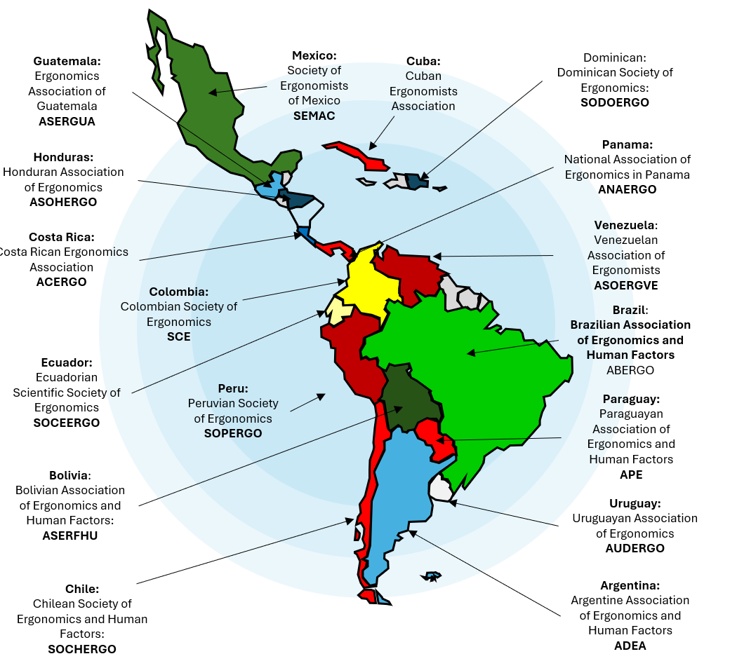
Ergonomics grows in Latin America
October 2025
4.434
Ergonomics specialists in 18 countries
295
HF/E Related Regulations in 18 countries
5%
58%
of HF/E specialists are from the area of architecture, design and engineering
2.308
Specialists in HF/E associated with the 17 associations and societies that make up ULAERGO
75%
ULAERGO countries have approved standards ISO
530
HF/E specialists are certified in Argentina, Brazil, Chile and Mexico
9 de 16
countries have training centers in HF/E

Slide 4
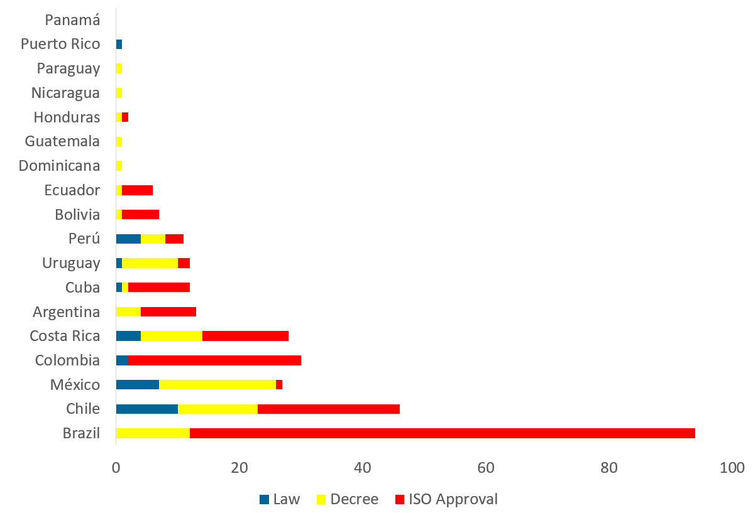
Latin American E/FH Regulations
Distribution of type of regulation, law, decree and ISO approved standard
295 reulations in 18 countries
10% law
27% decrees and regulations
62.8% ISO standards approved

Slide 5
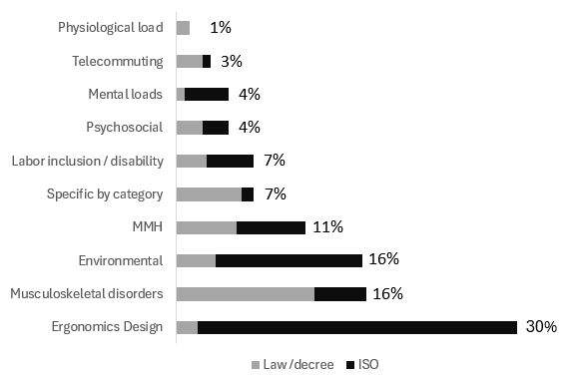
Latin American E/FH Regulations by Subject

Slide 6
2. Initiatives to promote HF/E

Slide 7
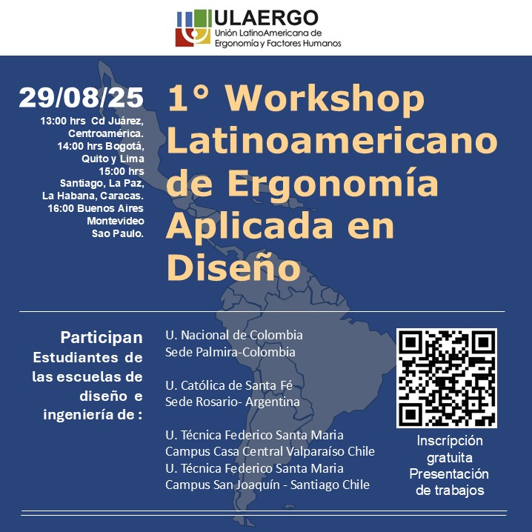
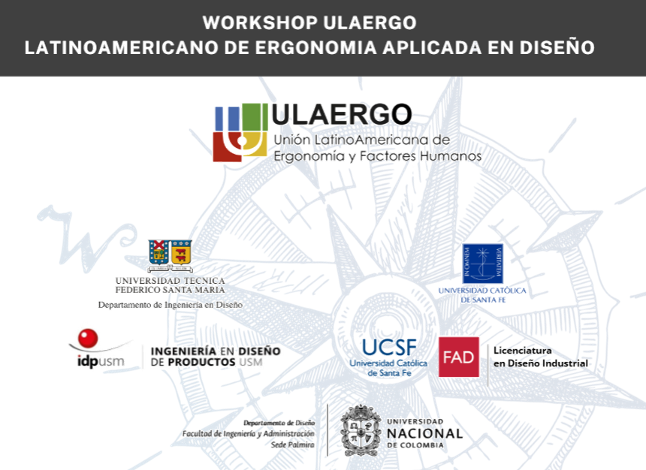
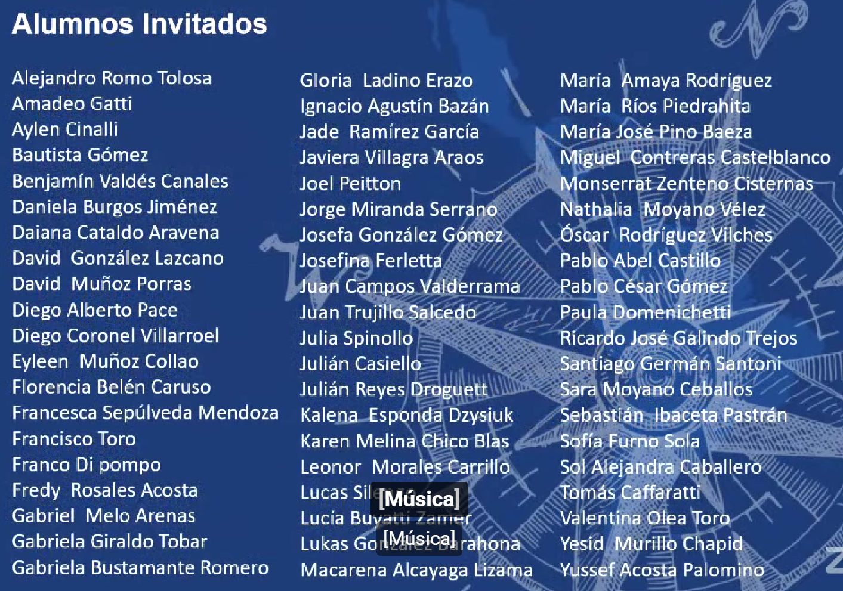
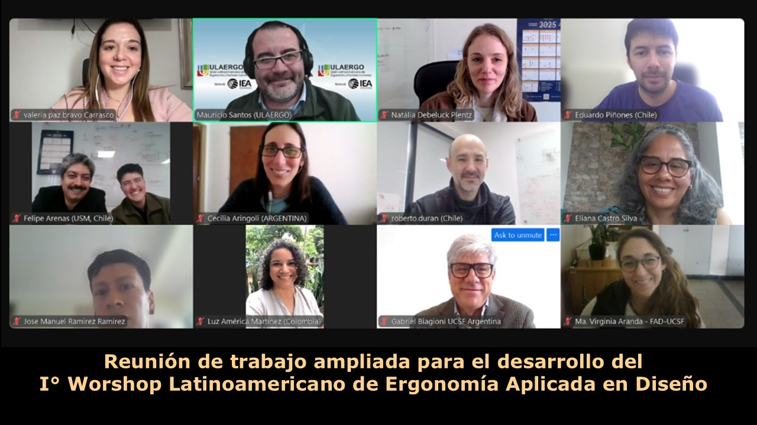
First Latin American workshop on applied HF/E in design.
60 undergraduate students from 3 countries participated.
Jose Orlando was on the evaluation commission
https://www.youtube.com/watch?v=HCQjB6GS95o&t=5060s

Slide 8
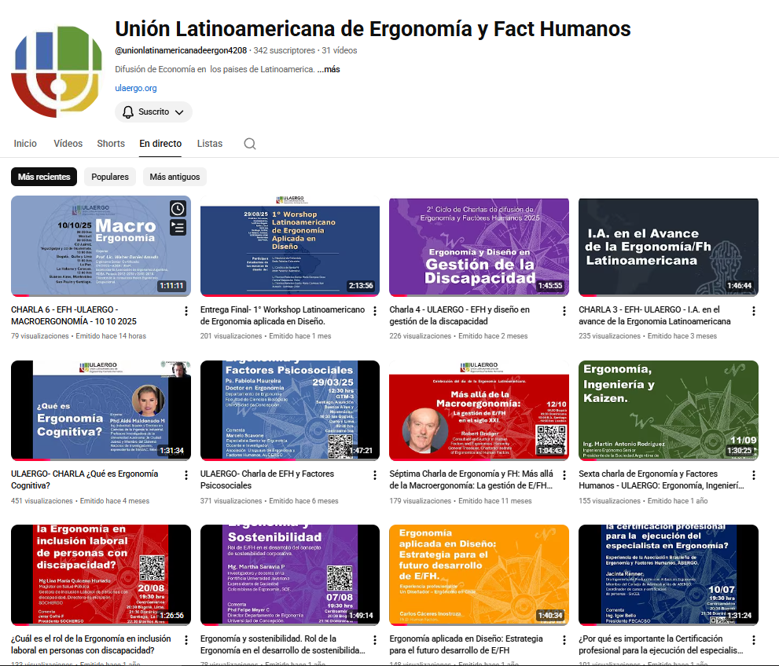
Continuous
The cycle of free talks of the specialty
Through the participation of an Ulaergo association

Slide 9
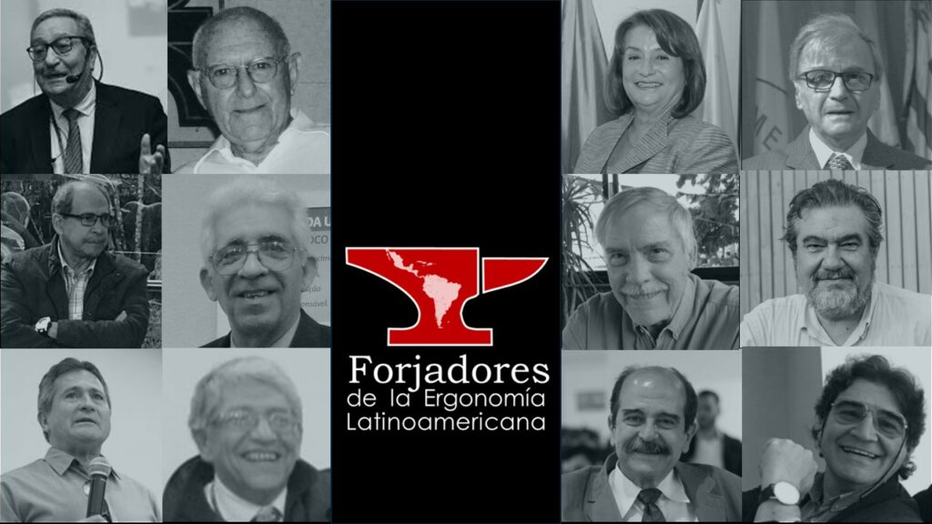
A series of interviews with the first generation of ergonomics specialists in Latin America
"Forgers of Latin American ergonomics“:
Recognition of those who were the first generation of ergonomics specialists

Slide 10
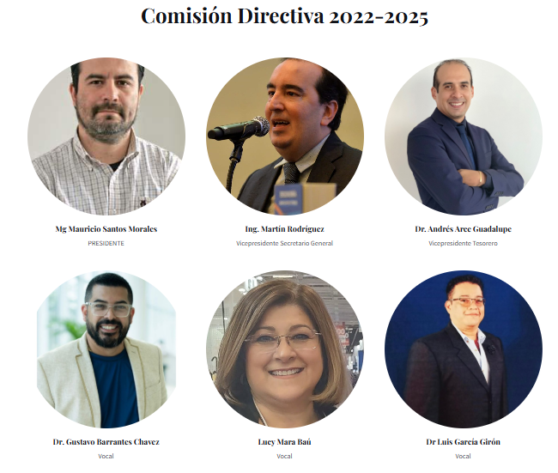
November 5 ends this
ULAERGO board of directors.
Thank you to all the members of the board

Slide 11
Special thanks
Paolo Bandeo, president and Marcela Pellegrino member of the board of directors of the Association of Ergonomics and Human Factors of Argentina (ADEA), Lucy Mara Baú president and Patricia Rossafa Branco member of the Association of Ergonomics and Human Factors of Brazil, (ABERGO), Nelson Chávez president of the Association of Ergonomics and Human Factors of Bolivia (ASERFHU), Jeisy Jofré F. president, Gabriel Portal, director and Daniel Lizama, member of the Chilean Society of Ergonomics and Human Factors (SOCHERGO), Gustavo Barrantes, president and Marco García, vice president of the Costa Rican Association of Ergonomics (ACERGO), Liliana Joaqui, president of the Colombian Society of Ergonomics (SCE), Iván López, president of the Ecuadorian Scientific Society of Ergonomics (SOCEERGO), Ivone Soto, president of the Dominican Society of Ergonomics (SODOERGO), Luis García G, President of the Ergonomics Association of Guatemala (ASERGUA), Mario Sabillón President of the Honduran Association of Ergonomics (ASOHERGO), Carlos Navarro President, Carlos Espejo former President and Jean Paul Becker member of the Society of Ergonomists of Mexico (SEMAC), Javier Córdoba President of the National Association of Ergonomics of Panama (ANAERGO), Marta Centurión President of the Paraguayan Association of Ergonomics (APE), Andrés Arce G, President of the Peruvian Society of Ergonomics (SOPERGO), Silvia Díaz, President, Federico Ferreira, Vice President and Marcelo Scavone, Treasurer of the Uruguayan Association of Ergonomics and Human Factors (AUDERGO), Erick Vega (Puerto Rico) and Joaquín García and Juan Lázaro Acosta of CUBA. Special thanks to Paulina Hernández Albrecht, former president of SOCHERGO and former president of ULAERGO.

