Slide 1
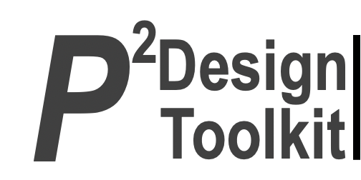
Main projects of CPR committee
Social Media Platforms
Improve Communications
Event calendar
“It is about dreaming” - Andrew Thatcher
EC meeting: October 2025
Presenter: Martin Rodriguez

Slide 2
IEA Social Media Platforms
Value-add
Alignment with IEA Goals
Promote and enhance the IEA’s presence on and use of social media platforms to promote events and activities of the IEA and its stakeholders to demonstrate the value add of the IEA and its internal stakeholders (federated societies, networks and committees).
To develop more effective communication with and collaboration between federated societies.
To advance the science and practice of HFE at an international level.
To enhance the contribution of the HFE discipline to global society
[or 7 strategic policies]
Stakeholder Needs to be met
Project outline including status
Co Chair: Barry Kirby.
Chair IEA 2027 Ben Peachey
Elements; milestones in Progress
Notes:
P^2DT is a process for helping systematic HFE project design. Various HFE methods or tools can be integrated into P^DT to conduct specific steps of the process.
P^2DT assumes participatory design approaches. The benefits of adopting participatory approaches are discussed later.
P^2DT is designed to be applicable to any HFE-related projects in various work places such as healthcare, office work space and environment, process plant, aviation,…

Slide 3
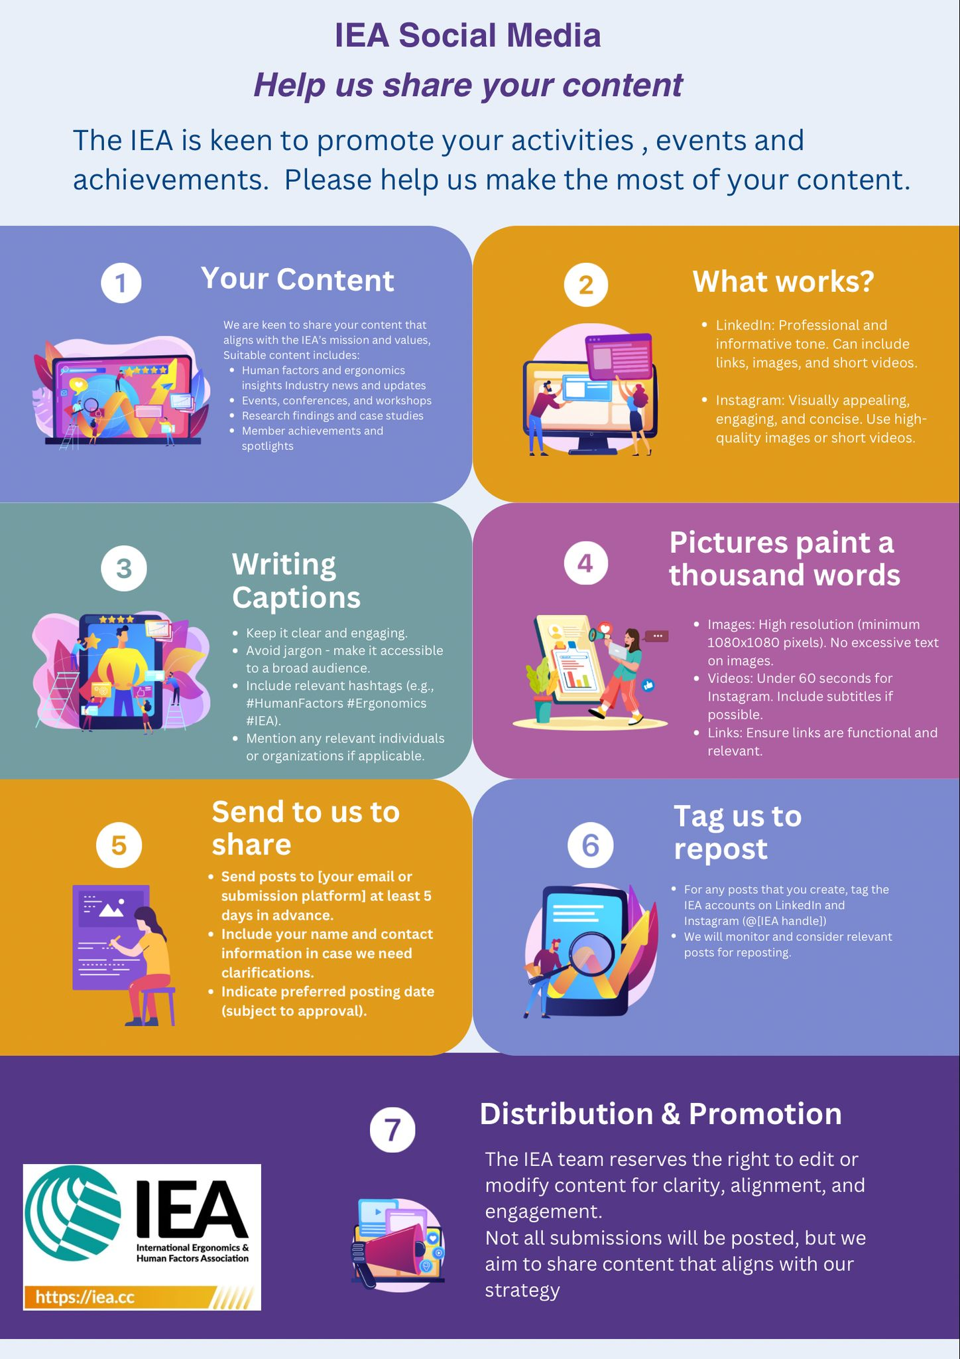



Slide 7
Barry.Kirby@KSharp.co.uk

Slide 9
Improve Communications
Value-add
Alignment with IEA Goals
Promotion activities/focus areas for internal stakeholders (negotiated with relevant stakeholders):
Promotion of IEA publications in collaboration with IEA executive (ILO/IEA Checkpoints; Checkpoints on Agriculture; Healthcare; history
Promotion of IEA technical committees, their activities, publications and events in collaboration with STP chair. Webinars will form an important part of this point.
Profile and promote IEA networks and Societies, their activities, publications and events in collaboration with Chairs of International Development and Development and Promotion
Promotion of IEA awards (linked to the Congress as it draws closer)
To develop more effective communication with and collaboration between federated societies.
To advance the science and practice of HFE at an international level.
To enhance the contribution of the HFE discipline to global society
[or 7 strategic policies]
Stakeholder Needs to be met
Project outline including status
Technical Committee Chairs
IEA EC
Milestones in Progress. Development of new Comms strategy policiy.
Notes:
P^2DT is a process for helping systematic HFE project design. Various HFE methods or tools can be integrated into P^DT to conduct specific steps of the process.
P^2DT assumes participatory design approaches. The benefits of adopting participatory approaches are discussed later.
P^2DT is designed to be applicable to any HFE-related projects in various work places such as healthcare, office work space and environment, process plant, aviation,…

Slide 10
Event Calendar
Value-add
Alignment with IEA Goals
Promotion activities/focus areas for internal stakeholders (negotiated with relevant stakeholders):
Promotion of IEA publications in collaboration with IEA executive (ILO/IEA Checkpoints; Checkpoints on Agriculture; Healthcare; history
Promotion of IEA technical committees, their activities, publications and events in collaboration with STP chair. Webinars will form an important part of this point.
Profile and promote IEA networks and Societies, their activities, publications and events in collaboration with Chairs of International Development and Development and Promotion
Promotion of IEA awards (linked to the Congress as it draws closer)
To develop more effective communication of events in the website page
To advance the science and practice of HFE at an international level.
To enhance the contribution of the HFE discipline to global society
[or 7 strategic policies]
Stakeholder Needs to be met
Project outline including status
Technical Committee Chairs
IEA EC
Elements; milestones in Progress
Notes:
P^2DT is a process for helping systematic HFE project design. Various HFE methods or tools can be integrated into P^DT to conduct specific steps of the process.
P^2DT assumes participatory design approaches. The benefits of adopting participatory approaches are discussed later.
P^2DT is designed to be applicable to any HFE-related projects in various work places such as healthcare, office work space and environment, process plant, aviation,…

Slide 11
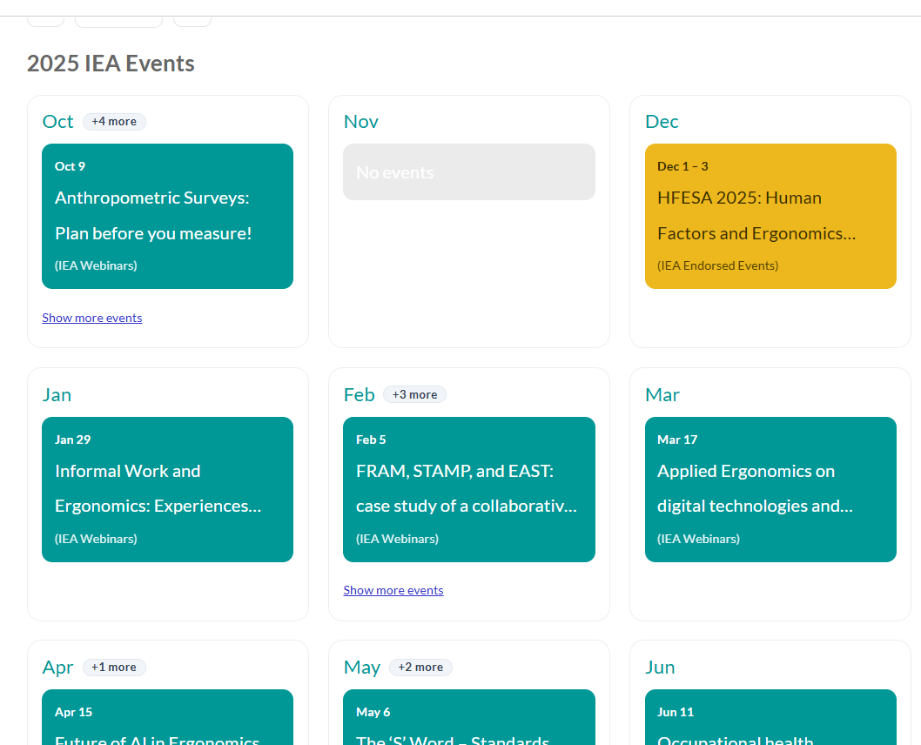
New Website Event Calendar

Slide 12
Thank You!
For sharing, plase send to this email:

