Slide 1
IEA2027 update
Ben Peachey
October 2025

Slide 2
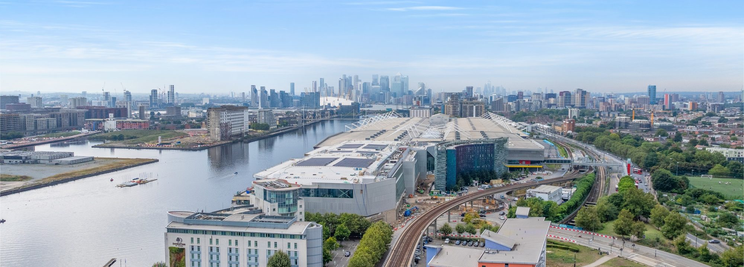

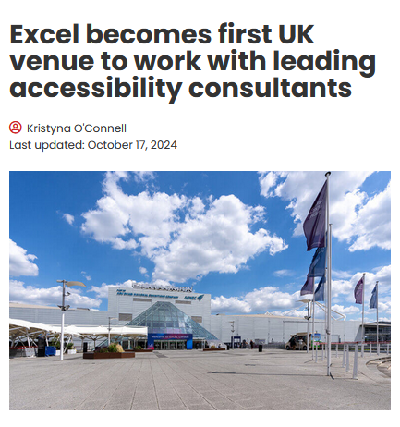
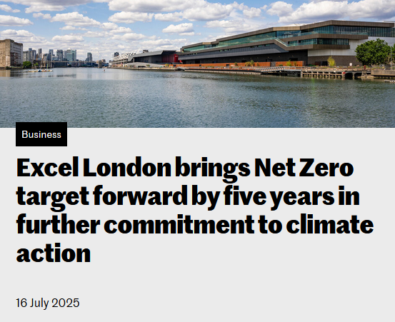


IEA2027
23-25 August
Capital Suite

Slide 3
Progress to date – October 2025
Event administration
MOU signed with IEA and seed funding received
Budget developed and approved by IEA Officers
IEA2027 Community Interest Company set-up (UK legal entity)
Bank account opened
Event company appointed
Venue contract signed
Content preparation
Event ambition document reviewed by CIEHF and IEA leadership
Survey sent to Technical Committee Chairs in September 2025
Dialogue with HEPS organisers for Healthcare day
Marketing
> 400 IEA2024 delegates signed up to marketing list
Date announcement in October 2025 (email, social media, IEA Newsbriefs, web page)
Next priorities
Work on sponsor packages
Sponsor engagement
Partner engagement – INCOSE; ISO TC159; others?
AV specification
Create branding
Create promotional video
Create marketing plan
Unique booking links for IEA member societies

Slide 4
Partner engagement
IEA MOUs:
  INCOSE, IsQUA, FPE, ICOH, and IOHA
International organisation relationships:
  WHO, ILO, ISO (currently liaising re hosting ISO TC159 meeting)
Sustaining members
To discuss:
1) Who owns each relationship?
2) How should we engage them for IEA2027?

Slide 5
Input requested from IEA Council members
Target audiences / sponsors / partners
  Are all key stakeholder audiences covered?
  Do you have contacts/leads in organisations that we should engage?
  Do you want to know if your members are coming to IEA2027?
Event format
  Feedback on content formats (see next slide)

Slide 6
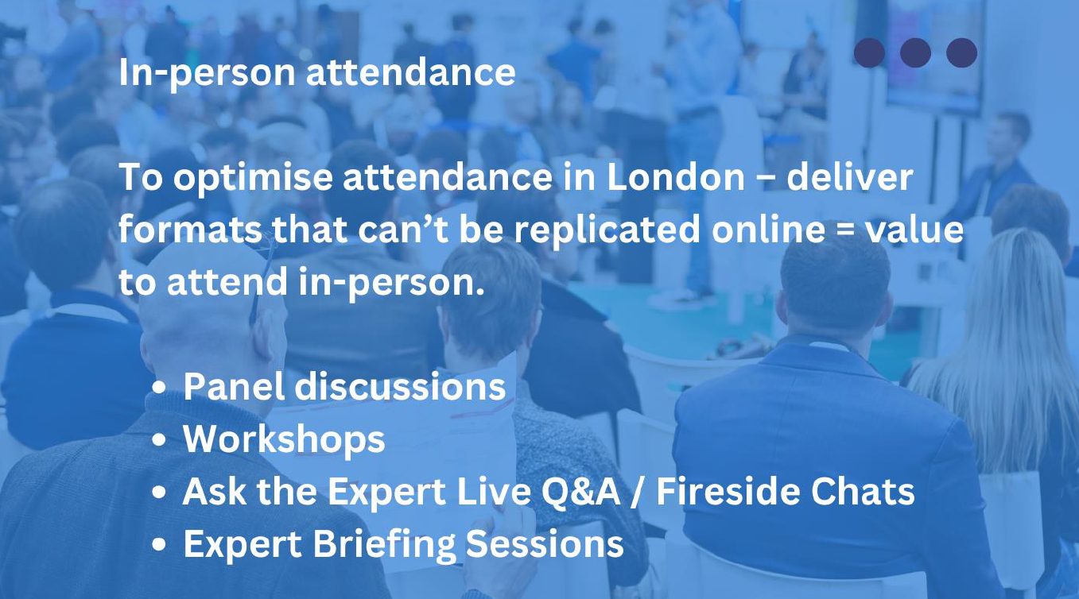
Content formats

Slide 7
Delegate Experience
Before the Event
  Clear understanding of the overall programme and what’s on offer
  Ease of registration and payment
  Confirmation of registration sent promptly
  Queries answered promptly by email
  Choice of self-bookable, discounted accommodation
  Choice of add-on activities e.g. drinks receptions, family attractions
  Comprehensive and accessible joining instructions

Slide 8
Delegate Experience
At the Event
  Welcoming and friendly atmosphere
  Self registration to print delegate badge – speeds up delegate transitions
  ‘Here to Help’ delegate supporters wearing bright t-shirts
Promote community (inclusive, relevant topics, every opinion counts)
  Topics appeal across the range of delegates
  Opportunity to give feedback throughout the event via QR code

Slide 9
Presentation Formats - Opportunities
Plenary Presentation. Format: speakers are up front on stage to whole audience
Interactive Workshops. Format: Facilitated sessions focused on hands-on learning or skill development.
Panel Discussions. Format: A moderated conversation among 3-5 experts representing diverse perspectives on a single topic.
Fireside Chats. Format: Intimate, one-on-one or two-person conversations, often involving a moderator and a guest speaker.
Roundtable Discussions. Format: Small-group discussions facilitated by a moderator, with participants sitting around a table.
Lightning Talks. Format: Short, focused presentations of 5-10 minutes on a specific topic or idea.

Slide 10
Presentation Formats - Opportunities
Interactive Demonstrations. Format: Live or recorded demonstrations showcasing tools, technologies or workflows, often with audience participation.
Debates. Format: Structured debates where opposing viewpoints are presented on controversial or emerging topics.
Peer-Led Discussions. Format: Informal sessions where attendees lead discussions on topics of mutual interest.
Poster Presentations. Format: Academic or research posters displayed digitally or physically, with scheduled time for authors to present.
Think Tanks. Format: Small groups collaborate to solve a real-world challenge or develop actionable strategies.

Slide 11
Ticket sales for your members
Marketing
Unique discount code provided to member societies to share with their members (on request)
Sales
Your members book (and buy ticket) with your discount code
Verification
You can check if individual is a member or not
We provide you with the member contact details
If no, you have their details to encourage membership
If they are not a member of your society, please inform us so we can charge full price ticket
On-site engagement
Ask us if you want help booking a room/venue for an on-site meet-up/social for your members

Slide 12

CIEHF annual conference

Slide 13
Thank you
28-29 October 2025

