Slide 1
PSE Objectives
The Professional Standards and Education (PS&E) Committee aims to advance global human factors/ergonomics (HFE) by improving education standards, expanding certification access, and engaging the next generation of professionals.
Over the next three years, our focus will center on two key objectives:
strengthening global HFE education and certification, and
(2) attracting and developing young professionals.
These objectives will be pursued in collaboration with the International Development (ID) Committee to ensure a broad international impact, particularly in developing regions.

Slide 2
Main projects of the
Professional Standards & Education Committee (PSE)
Activities 2024-2026
Promoting accessible certification
Repository of educational tools
Mentorship Programs & other activities to promote young members
EC meeting: April 2026
Presenter: Verena Nitsch

Slide 3
PSE Members
PSE Co-Chairs:
  Liang Ma (CHN)
  Rob Becker (UK)
  Andrew Todd (ZAF)
  Daniel Braatz (BRA) - since July 2025
Subcommittee Certification
  Valerie O‘Keefe (AUS)
  Stephven Kolose (NZ)

Slide 4
Projects
1. Promoting accessible certification that complies with IEA standards
  Reviews for Certification Endorsement
  Compiling best practice curricula that address IEA core competencies
2. Repository educational tools: provide a centralized, accessible overview of educational resources for HFE
3. Promoting young members (e.g. through international mentorship)

Slide 5
Promoting Certification
Value-add
Alignment with IEA Goals
Strengthens professional standards and recognition of HFE specialists globally. Encourages mutual recognition and standardization.
In partnership with the IDC, we will expand access to low-cost, regionally tailored certification programs, ensuring that more professionals in resource-constrained regions can attain HFE credentials and grow in their careers.
(4)Identify the Roles of IEA in Promoting Education, Certification and Professional Standards
Stakeholder Needs to be met
Project outline including status
Standardization of certification processes
Greater accessibility to certification
Improved professional credibility
Collect „best practice“ curricula from different countries/perspectives (China, UK, France, etc.),check w.r.t. IEA core competencies, identify need to expand competencies (e.g. w.r.t. practioners‘ requirements, new work trends, UX methods). On-going: Endorsement of Certification Processes
Notes:
P^2DT is a process for helping systematic HFE project design. Various HFE methods or tools can be integrated into P^DT to conduct specific steps of the process.
P^2DT assumes participatory design approaches. The benefits of adopting participatory approaches are discussed later.
P^2DT is designed to be applicable to any HFE-related projects in various work places such as healthcare, office work space and environment, process plant, aviation,…

Slide 6
Main stakeholders and their relationship to each other
From To | IEA PSE Chair & Co-Chairs | Certifying Bodies & Course Providers
IEA PSE Chair & Co-Chairs | Project oversight | Collection of best practices, Application for Endorsement
Certifying Bodies & Course Providers | Outreach, provide access to curricula
Notes:
Coupled with the understanding of stakeholder benefits (Step 6), the understanding the relations among stakeholders is critically important for developing promotional strategies.
It will form a basis for specifying subprojects: The underlying consideration is to develop a set of projects which do not conflict in each project. For instance, develop a science-oriented HFE project and a more application-oriented HFE project: The science-oriented HFE project is designed to contribute to the development of HFE science, while the application-oriented HFE project is designed to provide practical benefits. They together achieve a high-quality HFE project. Others may include promotion projects for influential stakeholders (i.e., system influencers).

Slide 7
What stakeholders are involved in project & how?
Group | Group’s role within Project + category* | Group benefit | Individual | Individual’s role within project | Individual benefit
IEA PSE | Project oversight Ensure alignment with core competencies (D) | Standardization | IEA PSE Chair | Coordinate activities, outreach to certifying bodies & course providers (I, E, D) | Expertise development & networking growth
Certifying bodies/course providers | Apply for endorsement Provide & access best practice curricula (E) | Credibility boost | PSE Co-Chairs | outreach to certifying bodies & course providers (E, D) | Expertise development & networking growth
 |  |  | Subcommittee Co-Chairs | advise on certification process, prepare suggestions for endorsements (E, D) | Expertise development & networking growth
 |  |  | Contact person Certifying bodies/course providers | provide documentation for certification endorsement provide best practice curricula (I, E) | Visibility increase, Expertise development
*Categories are indicated by letters: Actor/ Expert/ Decider/ Influencer

Slide 8
Educational Repository
Value-add
Alignment with IEA Goals
A centralized overview of open-access educational materials, including case studies, webinars, and instructional methods. This cost-effective solution will provide faculty and professionals with resources to enhance ergonomics education globally, without requiring significant new course development.
(4)Identify the Roles of IEA in Promoting Education, Certification and Professional Standards
Stakeholder Needs to be met
Project outline including status
Easier access to quality educational tools
Better knowledge dissemination
Resource sharing amongst societies
Survey regarding educational resources & mentorship
Publish overview with collection of links on website;
Annual Update
Notes:
P^2DT is a process for helping systematic HFE project design. Various HFE methods or tools can be integrated into P^DT to conduct specific steps of the process.
P^2DT assumes participatory design approaches. The benefits of adopting participatory approaches are discussed later.
P^2DT is designed to be applicable to any HFE-related projects in various work places such as healthcare, office work space and environment, process plant, aviation,…

Slide 9
What stakeholders are involved in project & how?
Group | Group’s role within Project + category* | Group benefit | Individual | Individual’s role within project | Individual benefit
IEA PSE | Project oversight Ensure diversity and accessibility of material (D) | Knowledge sharing Global impact | IEA PSE Chair | Coordinate activities, survey existing material, compile collection, disseminate to societies (I, E, D) | Expertise development & networking growth
Federated Societies, Course Providers | Provide links to & disseminate educational material (E, I) | Resource visibility Collaboration boos | PSE Co-Chairs | outreach to societies & providers to collect links (E, D) | Expertise development & networking growth
 |  |  | Contact person Societies /course providers | provide links to free, accessible educational material, contact & encourage members to contribute (I, E) | Expertise development & networking growth
*Categories are indicated by letters: Actor/ Expert/ Decider/ Influencer

Slide 10
Main stakeholders and their relationship to each other
From To | IEA PSE Chair & Co-Chairs | Federated Societies, Course Providers
IEA PSE Chair & Co-Chairs | Project oversight | provide links to free, accessible educational material,
Federated Societies | Outreach, disseminate course material | Encourage society members to contribute
Notes:
Coupled with the understanding of stakeholder benefits (Step 6), the understanding the relations among stakeholders is critically important for developing promotional strategies.
It will form a basis for specifying subprojects: The underlying consideration is to develop a set of projects which do not conflict in each project. For instance, develop a science-oriented HFE project and a more application-oriented HFE project: The science-oriented HFE project is designed to contribute to the development of HFE science, while the application-oriented HFE project is designed to provide practical benefits. They together achieve a high-quality HFE project. Others may include promotion projects for influential stakeholders (i.e., system influencers).

Slide 11
Mentorship Programs
Value-add
Alignment with IEA Goals
Encourages next-generation participation in HFE. Supports career development and knowledge transfer.
A virtual mentorship program will connect students with experienced professionals for career guidance, fostering professional growth through short-term, cost-effective engagements.
(7) Maintain a future focus for HF/E
Stakeholder Needs to be met
Project outline including status
Attracts young professionals, provides structured international mentorship, fosters career & competence development
Survey regarding educational resources & mentorship, Mentorship Program Launch
Notes:
P^2DT is a process for helping systematic HFE project design. Various HFE methods or tools can be integrated into P^DT to conduct specific steps of the process.
P^2DT assumes participatory design approaches. The benefits of adopting participatory approaches are discussed later.
P^2DT is designed to be applicable to any HFE-related projects in various work places such as healthcare, office work space and environment, process plant, aviation,…

Slide 12
What stakeholders are involved in project & how?
Group | Group’s role within Project + category* | Group benefit | Individual | Individual’s role within project | Individual benefit
IEA PSE | Project oversight Setup & coordinate mentorship program (D) | Talent development Community growth | IEA PSE Chair | Coordinate activities, setup & coordinate mentorship program (I, E, D) | Network Expansion
Federated Societies | Support mentorship program: acquire mentors & mentees Collect further ideas on promoting young members (E,I) | Member engagement Reputation boost | PSE Co-Chairs | outreach to societies, collect ideas on promoting young members, support mentorship program coordination in different regions (E, D) | Network Expansion
 |  |  | IEA Council Members | take part in survey, acquire mentors & mentees (I, E) | Relationship building
*Categories are indicated by letters: Actor/ Expert/ Decider/ Influencer

Slide 13
Main stakeholders and their relationship to each other
From To | IEA PSE Chair & Co-Chairs | Federated Societies
IEA PSE Chair & Co-Chairs | Project oversight | Take part in survey, name interested mentors & mentees
Federated Societies | Outreach, coordinate international mentorship programm | Encourage society members to contribute
Notes:
Coupled with the understanding of stakeholder benefits (Step 6), the understanding the relations among stakeholders is critically important for developing promotional strategies.
It will form a basis for specifying subprojects: The underlying consideration is to develop a set of projects which do not conflict in each project. For instance, develop a science-oriented HFE project and a more application-oriented HFE project: The science-oriented HFE project is designed to contribute to the development of HFE science, while the application-oriented HFE project is designed to provide practical benefits. They together achieve a high-quality HFE project. Others may include promotion projects for influential stakeholders (i.e., system influencers).

Slide 14
Update
a) establish an international mentoring programme (starting with connecting existing ones from different societies),
  Data collected with survey
  Next Step: Contact and connect the societies that have a mentoring programme and indicated that they wished to collaborate. (->Farzan Sasangohar, HFES)?
b) facilitating the shared use of HFE educational resources,
  Data collected with survey
  Next Step: Contact and connect the societies that have educational resources and indicated that they are open to sharing them with others. (->Liang Ma)
c) collecting best practice HFE curricula from around the world to provide guidance for those who wish to establish new courses in their countries,
  We have compiled a sizable collection of courses and are currently checking each curriculum w.r.t. IEA core competencies and other assessment criteria (currently Europe) (->Denizsu Topkaya)
  Next Step: Replace Global Map with Table? Ask Co-Chairs to continue with their respective regions

Slide 15
Certification
d) guiding certification bodies through the endorsement and re-endorsement process
Guided the HFE Society of Malaysia (HFEM) through the endorsement process
Organized a meeting with certification bodies and started collaborating on topics such as mutual recognition and developing a centralised professional registry
Stephven has compiled two documents providing an overview of different certification systems and their history
Next Step: Re-endorsement process with a number of certification bodies, starting with CREE (->Stephven)
We need active volunteers!

Slide 16
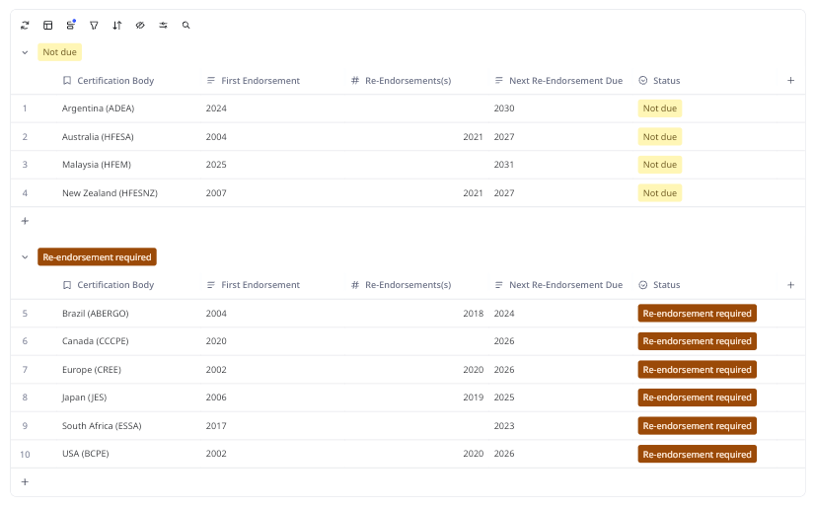
Re-Endorsement

Slide 18
Survey
Section 1: General Information
What is the name of your Human Factors and Ergonomics (HFE) society? (Open-ended)
In which country or region does your society operate? (Open-ended)
How many members does your society currently have? (Multiple choice)
  Fewer than 50
  50–100
  101–500
  501–1,000
  More than 1,000
Section 2: Challenges and Concerns
What are the biggest concerns for your society? (Select all that apply) (Multiple choice)
  Recruiting and retaining young members
  Membership growth
  Funding or financial stability
  Access to professional resources
  Networking and collaboration opportunities
  Other (please specify): (Open-ended)
On a scale of 1 to 5, how significant is the challenge of recruiting young members? (Likert scale: 1 = Not a challenge, 5 = Very significant challenge)
What activities or strategies does your society use to attract young members? (Open-ended)
Section 3: Educational Resources
Does your society currently offer any of the following educational resources? (Select all that apply) (Multiple choice)
  Webinars
  Tutorials
  Workshops
  Checklists or guidelines
  Online courses
  Other (please specify): (Open-ended)
  None
If your society offers educational resources, are they primarily:
  Developed internally by your society
  Sourced from external providers
  A mix of both
Would your society be interested in sharing its educational resources with other societies? (Yes/No/Maybe)
Would your society be interested in utilizing educational resources shared by other societies? (Yes/No/Maybe)
Section 4: Mentorship and Support
Does your society have a mentorship program? (Yes/No)
If yes, what does your mentorship program include? (Select all that apply) (Multiple choice)
  One-on-one mentoring
  Group mentoring
  Career development workshops
  Peer-to-peer mentoring
  Other (please specify): (Open-ended)
Would your society be interested in collaborating on an international mentorship program? (Yes/No/Maybe)
Section 5: Future Collaboration and Needs
What additional resources or support would help your society meet its goals? (Open-ended)
How open is your society to collaborating with other HFE societies on: (Select all that apply) (Multiple choice)
  Joint webinars or events
  Educational content development
  Member exchange programs
  Mentorship programs
  Advocacy and policy initiatives
  Other (please specify): (Open-ended)
Are there any specific topics or areas where your society would benefit from additional resources or expertise? (Open-ended)
Section 6: Final Thoughts
What do you see as the most pressing challenge for the global HFE community in the coming years? (Open-ended)
Do you have any other comments or suggestions for the International Ergonomics and Human Factors Association? (Open-ended)

Slide 19
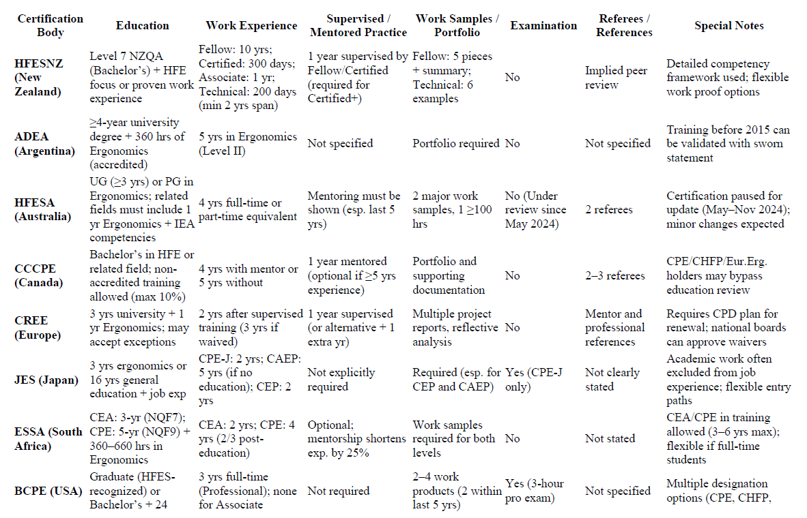
Survey

