Slide 1
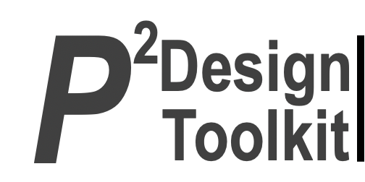
Main projects of Vice-President Secretary General
Improve IEA internal stakeholder communications
Improve External stakeholder communications
Improve process efficiency
Enhance operating procedures (OPs)
EC meeting: April 24-25, 2026 Nottingham UK
Presenter: Nancy Black

Slide 2
Improve IEA internal stakeholder communications
Value-add
Alignment with IEA Goals
Involvement
+ Perceived value
To develop more effective communication with MS & collaboration between MS.
1. Engage Stakeholders
Project outline including status
Stakeholder Needs to be met
Virtual council gatherings:
2025 (1);
2026 (3): Mar - ILO; May; Aug
Invitations to Sustaining Members
Value … + Networking
Information sharing
Notes:
P^2DT is a process for helping systematic HFE project design. Various HFE methods or tools can be integrated into P^DT to conduct specific steps of the process.
P^2DT assumes participatory design approaches. The benefits of adopting participatory approaches are discussed later.
P^2DT is designed to be applicable to any HFE-related projects in various work places such as healthcare, office work space and environment, process plant, aviation,…

Slide 3
Improve IEA internal stakeholder communications Who, involved & how?
Group |  |  | Individual
Category | Role* | Benefit | Title | Role* | Benefit
IEA Council | Participants, idea generation, sharing (A) | Enhance bonds; learning | IEA President | Chair (E) | Value-creation
IEA Officers | Create opportunities (D) | Value creation | VPSG | Scheduler (I) | Commun-ication
Executive Committee | Facilitators (A /I) | Succession | Admini-strator | Communicator (group lists) | Database
Sustaining Members | Participants, Sharing (A) | Involve-ment
*Categories: Actor/ Expert/ Decider/ Influencer

Slide 4
Enhance communications: stakeholders and their relationships
From To | Officers | EC | Council | Sustaining Members | Non-council
Officers | Discuss | Test-population | Requests | Suggestion opportunity | Needs Practices
EC | Present. Propose. | Discuss at EC meetings | Feedback-suggest. |  | TC Input
Council | Propose opportunities | Support | Discuss needs | Suggest (interested) | Needs to be met
Sustaining Members | Invited | Listen. Learn | Network |  | Historical, business interests
Non-council | Communicate |  |  |  | Platforms
Notes:
Coupled with the understanding of stakeholder benefits (Step 6), the understanding the relations among stakeholders is critically important for developing promotional strategies.
It will form a basis for specifying subprojects: The underlying consideration is to develop a set of projects which do not conflict in each project. For instance, develop a science-oriented HFE project and a more application-oriented HFE project: The science-oriented HFE project is designed to contribute to the development of HFE science, while the application-oriented HFE project is designed to provide practical benefits. They together achieve a high-quality HFE project. Others may include promotion projects for influential stakeholders (i.e., system influencers).

Slide 5
Improve external stakeholder communications
Value-add
Alignment with IEA Goals
IEA Macro-value
5. Strengthen relationships with external partners
Stakeholder Needs to be met
Project outline including status
Support from IEA to WHO, ILO, GOSH
Information sharing
Participation in gobal networks
GOSH8 – panel (2026)
WHO non-state actor status renewed (3 years)
Notes:
P^2DT is a process for helping systematic HFE project design. Various HFE methods or tools can be integrated into P^DT to conduct specific steps of the process.
P^2DT assumes participatory design approaches. The benefits of adopting participatory approaches are discussed later.
P^2DT is designed to be applicable to any HFE-related projects in various work places such as healthcare, office work space and environment, process plant, aviation,…

Slide 6
Improve external stakeholder communications
Who, involved & how?
Group |  |  | Individual
Category | Role* | Benefit | Title | Role* | Benefit
IEA Council | Idea generation, sharing (A) | Enhance MS visibility | IEA President | Attendee; signatory (A/E/I) | Value-creation
IEA Officers | Attendance (A) | Value creation | VPSG | Representative | Commun-ication
Executive Committee | Facilitators (A /I) | Succession | VP Treas | Representative | Commun-ication
External partners | MOU | Mutually enhanced visibility | Admini-strator | Communicator (group lists) | Database
*Categories: Actor/ Expert/ Decider/ Influencer

Slide 7
Improve process efficiency
Value-add
Alignment with IEA Goals
Limited secretariat and volunteer hours available
6. Reinforce the infrastructure of the Association
7. Maintain future focus
Stakeholder Needs to be met
Project outline including status
Timely, transparent, value-added supports
Triennial report preparation
Ambassador reports compilation, reporting to come
Automated certificates (prog) ?
Streamline communications ?
Notes:
P^2DT is a process for helping systematic HFE project design. Various HFE methods or tools can be integrated into P^DT to conduct specific steps of the process.
P^2DT assumes participatory design approaches. The benefits of adopting participatory approaches are discussed later.
P^2DT is designed to be applicable to any HFE-related projects in various work places such as healthcare, office work space and environment, process plant, aviation,…

Slide 8
Improve processes - stakeholders involved & how?
Group |  |  | Individual
Category | Role* | Benefit | Title | Role* | Benefit
IEA Council | Suggest (I, D) | Value | President | Chair (E) | Value-creation
IEA Officers | Create supports; facilitate (A, I) | Value creation | VPSG | Scheduler (I) | Communic-ation
Executive Committee | Suggest (A, E) | Efficiency | VPTreas | Budget oversight (I)
Admin support! | Implement; quality control (A,E) | Efficiency | Administra-tor | Communicator (group lists) A,E | Database
*Categories: Actor/ Expert/ Decider/ Influencer
!Administrator, ICT Chair, Programmer

Slide 9
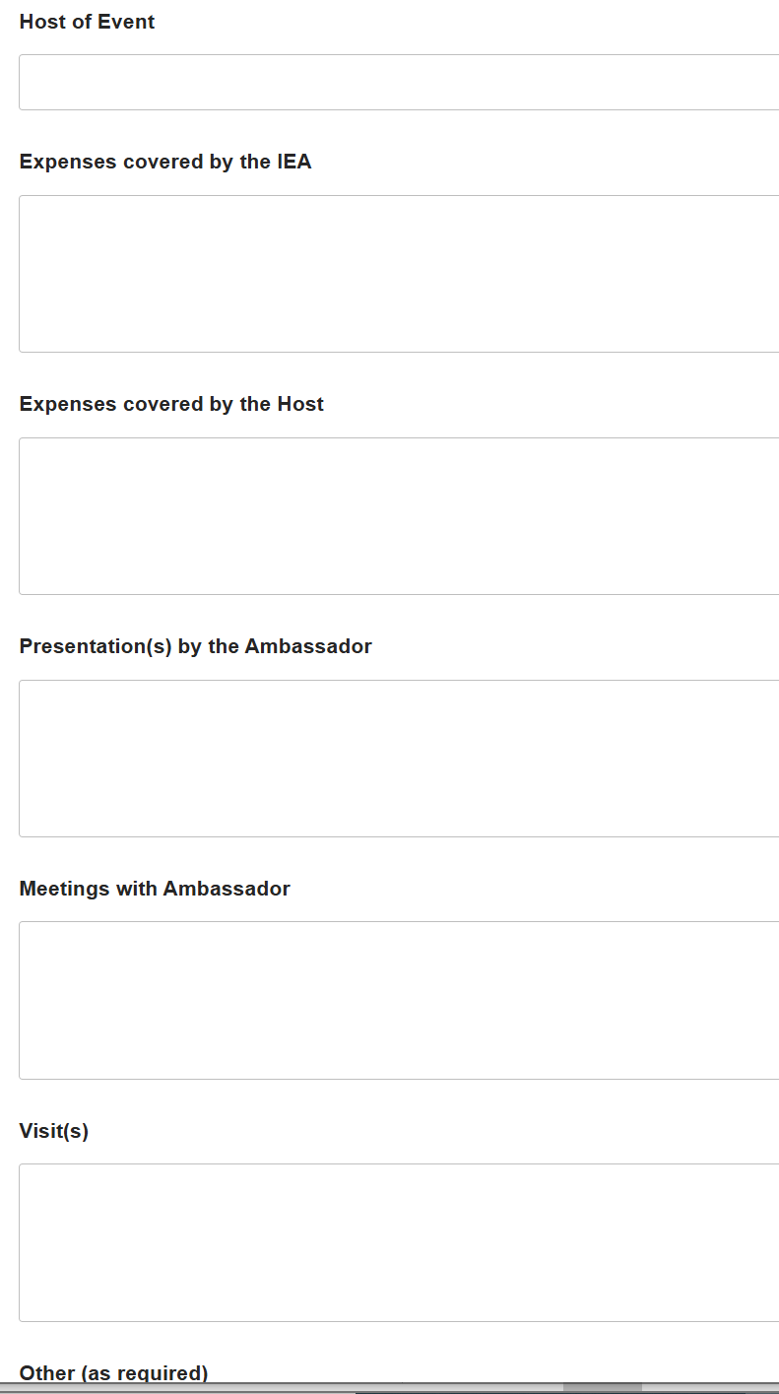
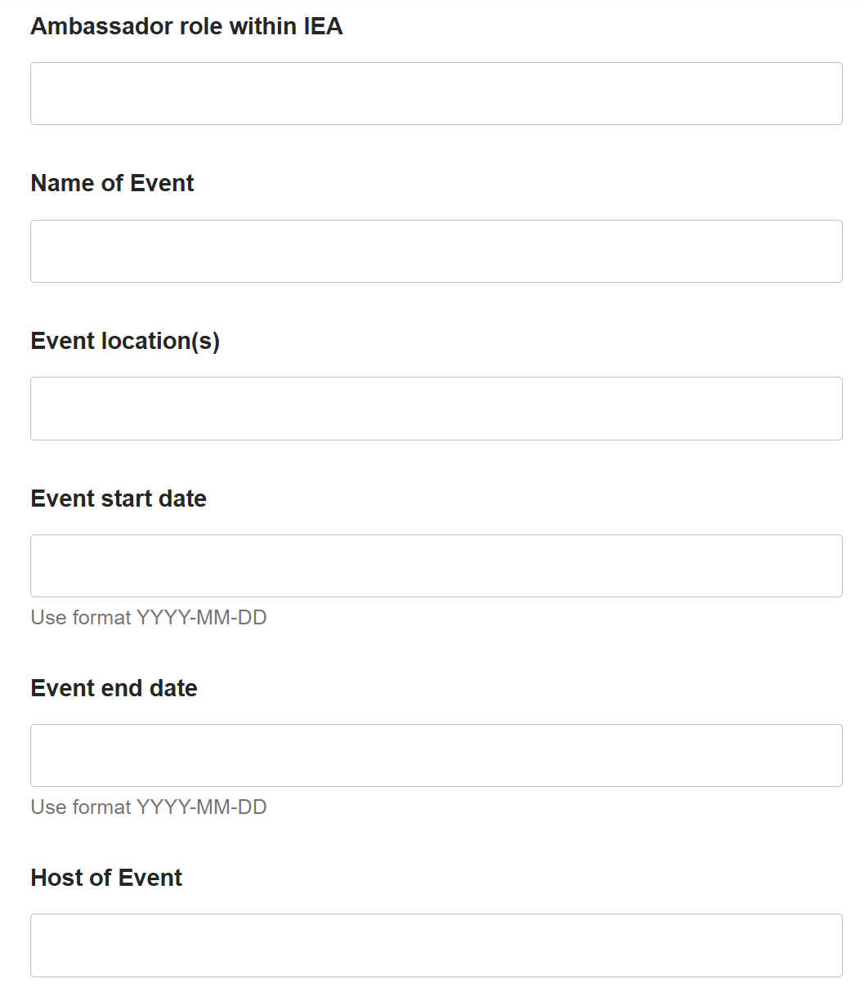
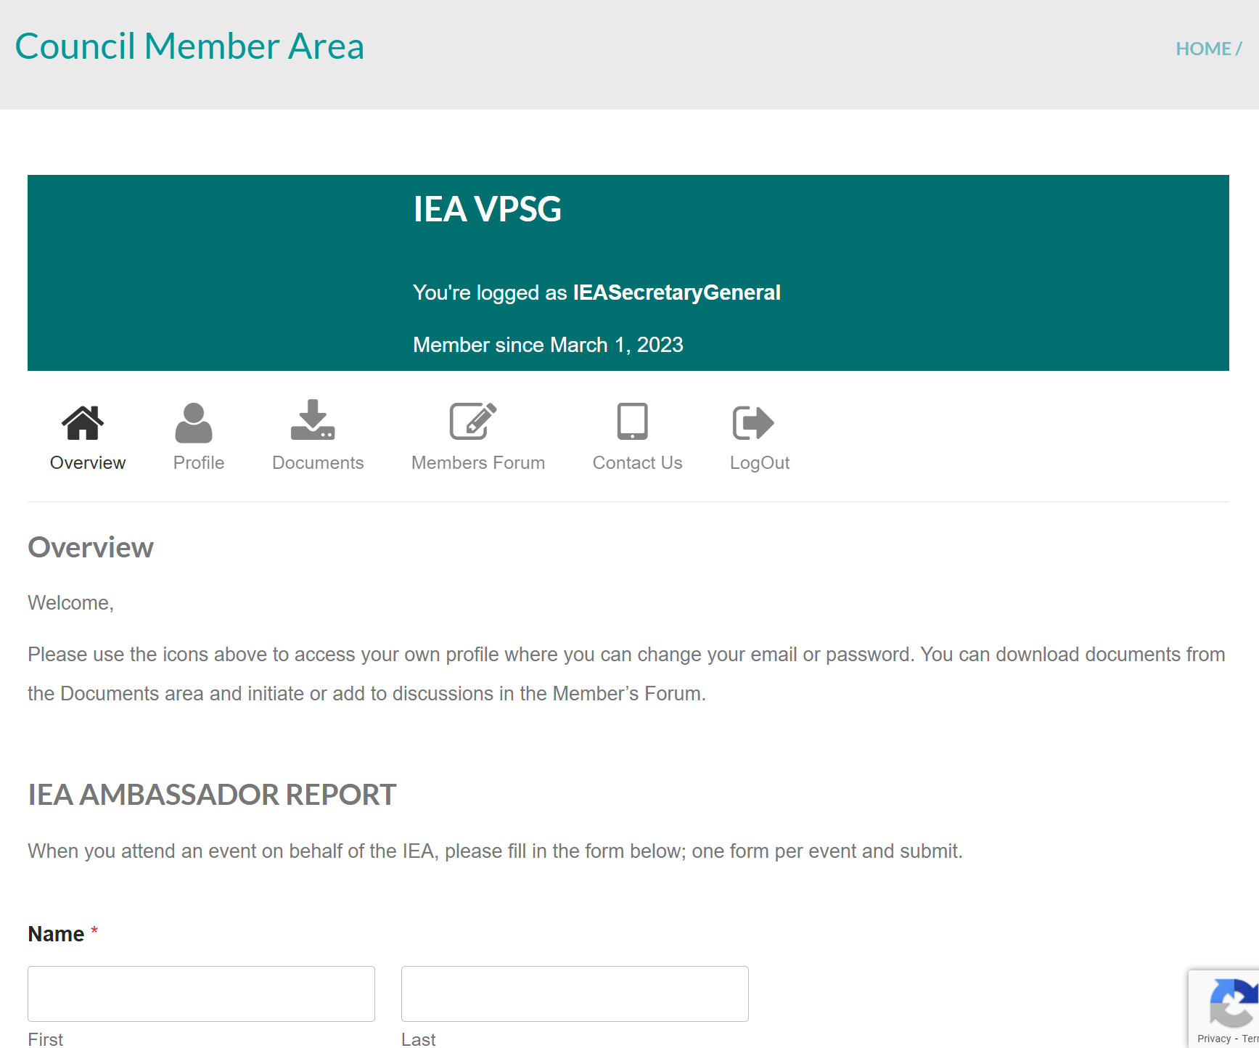
Ambassador report: iea.cc → Member area
Improve processes

Slide 10
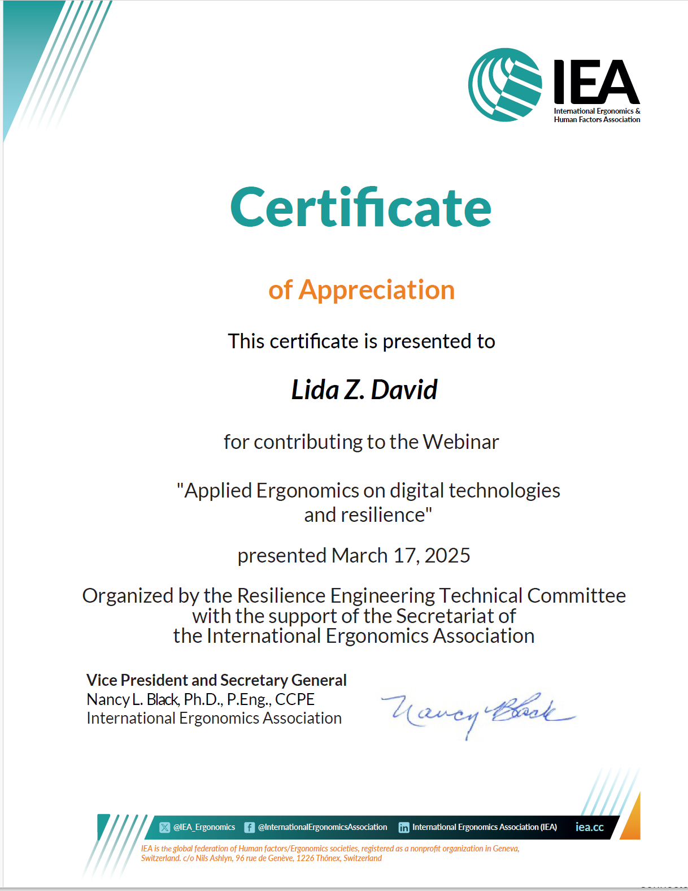
Webinar Certificate Production
Improve processes
Programmed support
https://ergengresearch.shinyapps.io/hfe_certificates_demo/
Variable fields
  TC recognition
    TC members as organizers
Value-added of IEA hosting
  Hosting time limitations

Slide 11
Process efficiency stakeholder relationships
From To | VPSG | Admin. | Officers | Executive Committee | Other (external) groups
VPSP | Reflect | Suggest | Suggest | Suggest | Suggest
Admin | Consult | Reflect | Suggest | Suggest | Suggest
Officers | Suggest | Discuss | Discuss | Suggest | Discuss
Executive Committee | Discuss | Inform | Discuss | Reflect | Discuss
Other (external) groups | Discuss | Discuss | Discuss | Discuss | Share best practices
Notes:
Coupled with the understanding of stakeholder benefits (Step 6), the understanding the relations among stakeholders is critically important for developing promotional strategies.
It will form a basis for specifying subprojects: The underlying consideration is to develop a set of projects which do not conflict in each project. For instance, develop a science-oriented HFE project and a more application-oriented HFE project: The science-oriented HFE project is designed to contribute to the development of HFE science, while the application-oriented HFE project is designed to provide practical benefits. They together achieve a high-quality HFE project. Others may include promotion projects for influential stakeholders (i.e., system influencers).

Slide 12
Enhance Operating Procedures
Value-add
Alignment with IEA Goals
Facilitate value-added elements
…effective communication with and collaboration between FS.
Engage Stakeholders
Reinforce Association infrastructure
Maintain future focus
Stakeholder Needs to be met
Succession support;
Responsible resources use
Project outline including status
Policy: Financial support for IEA Presentations (non-officer) - done
OP21: Code of conduct – IEA Events – EC aware; 2026 Council agenda
Notes:
P^2DT is a process for helping systematic HFE project design. Various HFE methods or tools can be integrated into P^DT to conduct specific steps of the process.
P^2DT assumes participatory design approaches. The benefits of adopting participatory approaches are discussed later.
P^2DT is designed to be applicable to any HFE-related projects in various work places such as healthcare, office work space and environment, process plant, aviation,…

Slide 13
Operating Procedure - stakeholders involved & how?
Group | Group’s role* | Group benefit | Individual | Individual’s role* | Individual benefit
IEA Officers | Propose, Oversee, Review (A,E,I) | Value-add | VPSG | Propose (A,E) | Responsive value
 |  |  | President | Strategic alignment (E) | Value-add
Executive Committee | Preliminary approval (A,I) | Value-add | VP Treasurer | Financial sustainability (E) | Value-add
IEA Council | Debate, Final approval (D,I) | Value-add | Admin. | Compilation, publishing (A) | Efficiency
*Categories: Actor/ Expert/ Decider/ Influencer

Slide 14
New Policy:
Financial support of IEA presentations (non-officer)
Objectives | Asked to present at conferences / gatherings Normally represented by elected officer but… Limited support available
2. Procedures | 2.1 Event / Organisation requests IEA presentation
 | 2.2 Communicate request to IEA officers for decision
 | 2.3 Deliberation
 | 2.3 Decision to support
3. Terms of Reference for Funds | Support travel … volunteer.... Follow IEA Guidelines for travel expenses (2019)

Slide 15
OP21: Code of Conduct – IEA Events
(2025-12-18)
1. Objectives | The IEA organizes and endorses events, communications and gatherings (hereafter called “events”) supporting professional development and networking related to its mission. These may be in-person or online, in real-time or off-line. All attendees of all IEA events must be ensured of a safe, positive, respectful, and inclusive environment that facilitates open exchange and mutual support at all times, whatever the format. This document aims at proactively ensuring acceptable behaviour by all at IEA events.
2. Principles | As a federation representing ergonomics and human factors societies around the world, IEA recognizes that perceptions and social norms may vary across its constituents. However, all IEA activities recognize the inherent worth of every participant, and every effort will be made to ensure its events are free of discrimination and harassment, including that associated with gender, gender identity and expression, age, sexual orientation, disability, physical appearance, body size, race, ethnicity, or religious affiliation. Organizers and participants do not tolerate harassment of participants or staff in any form, including verbal abuse, intimidation, or discrimination in any form. The above standards apply uniformly to all events and participants.
3. Procedures | Attendees | Organizers | Reporting
4. Terms of Reference | Protection of complainant | Consequences | Communication to Member Society | Maintenance of information

Slide 16
Operating Procedures stakeholder relationships
From To | Officers | Executive Committee | Council | External stakeholders
Officers | Discuss, revise | Suggest | Suggest | Suggest
Executive Committee | Propose, discuss (revise) | Discuss | Suggest | Suggest
Council | Propose, discuss, vote |  | Discuss | Suggest
External stakeholders | Inform | Inform | Inform
Notes:
Coupled with the understanding of stakeholder benefits (Step 6), the understanding the relations among stakeholders is critically important for developing promotional strategies.
It will form a basis for specifying subprojects: The underlying consideration is to develop a set of projects which do not conflict in each project. For instance, develop a science-oriented HFE project and a more application-oriented HFE project: The science-oriented HFE project is designed to contribute to the development of HFE science, while the application-oriented HFE project is designed to provide practical benefits. They together achieve a high-quality HFE project. Others may include promotion projects for influential stakeholders (i.e., system influencers).

Slide 17
Discussion
VPSG@iea.cc

