Slide 1

IEA
Executive Committee
SWOT analysis
April 2027
Prof. Andrew Thatcher, IEA President (2024-2027)

Slide 2

Strengths, Weaknesses, Opportunities, Threats (SWOT)
A SWOT analysis give a high-level idea of where the association is headed both internally and externally. While just a SWOT analysis on its own will not help you to identify a precise problem to solve, it will provide you with valuable context. Performing a SWOT analysis gives you detailed insight into the association and its position globally.

Slide 3
Short-term themes

Slide 4
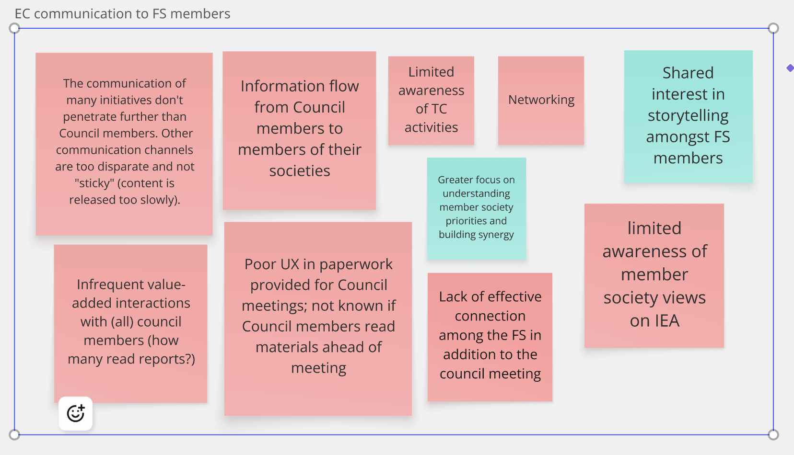

Slide 5
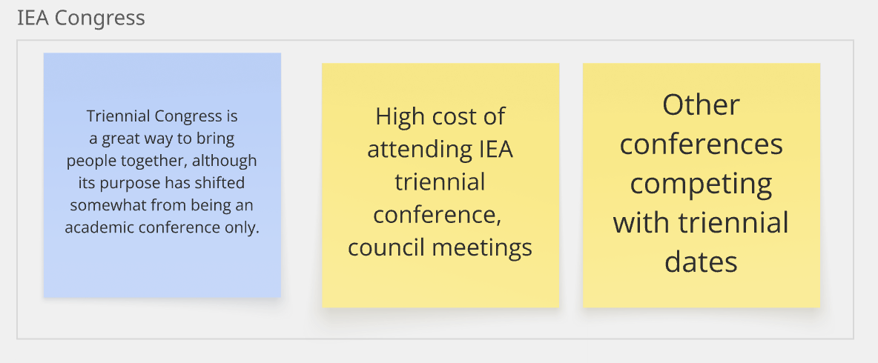

Slide 6
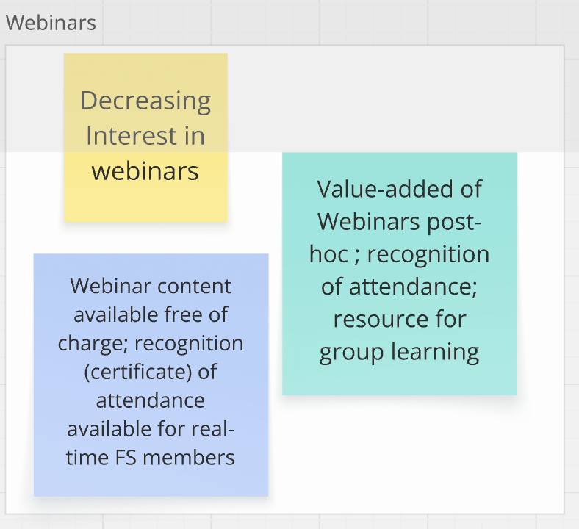

Slide 7
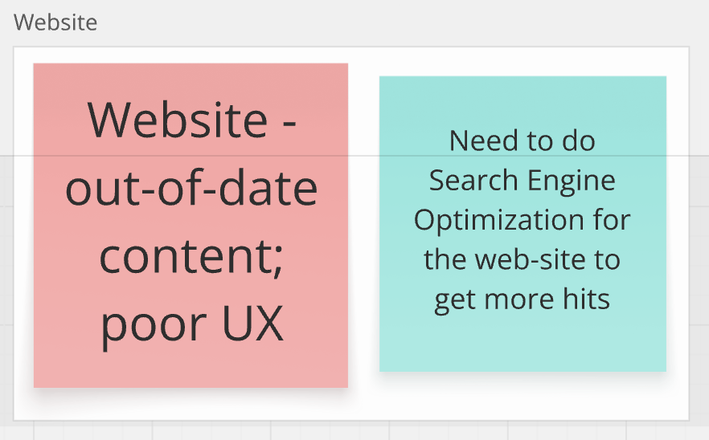

Slide 8
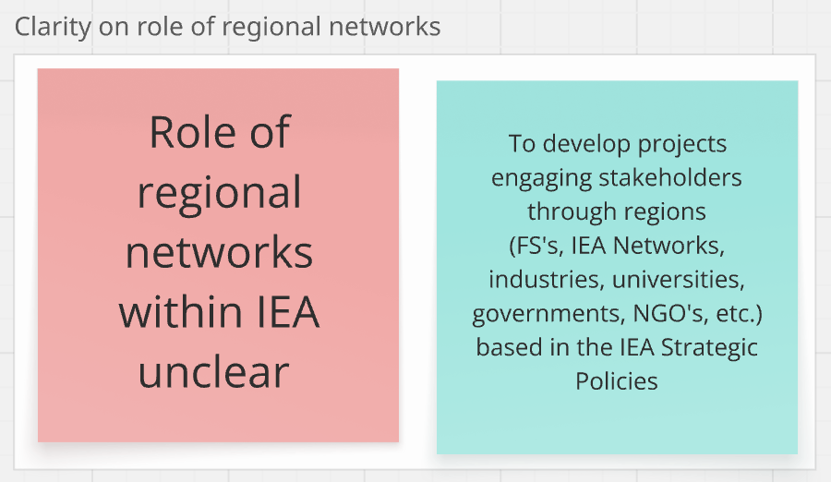

Slide 9
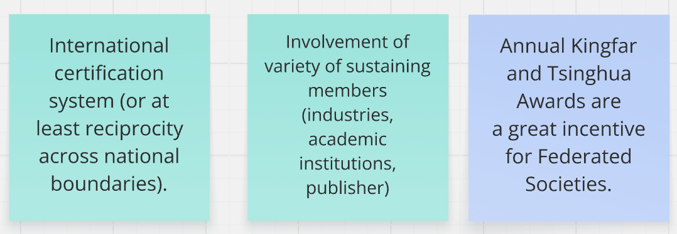
Issues which weren’t possible to put into themes

Slide 10
Long-term themes

Slide 11
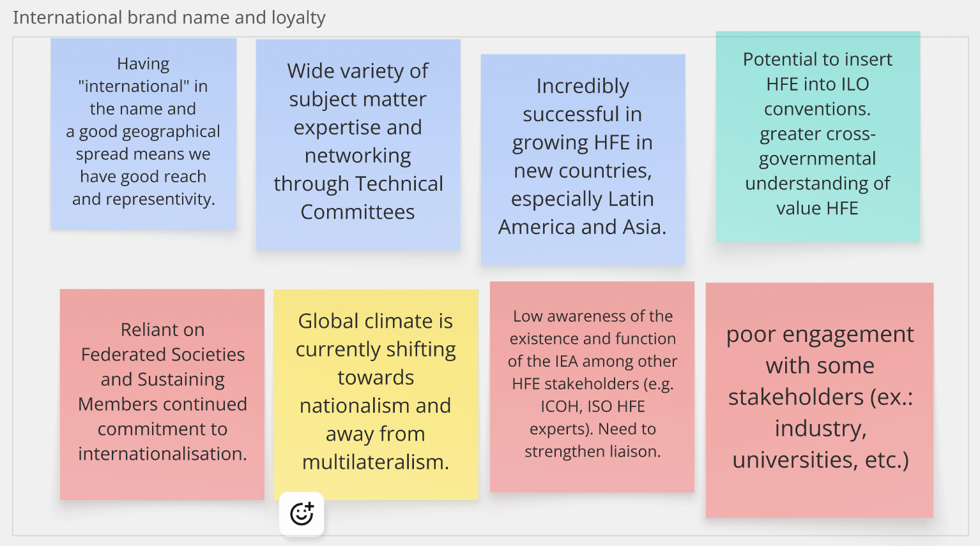

Slide 12
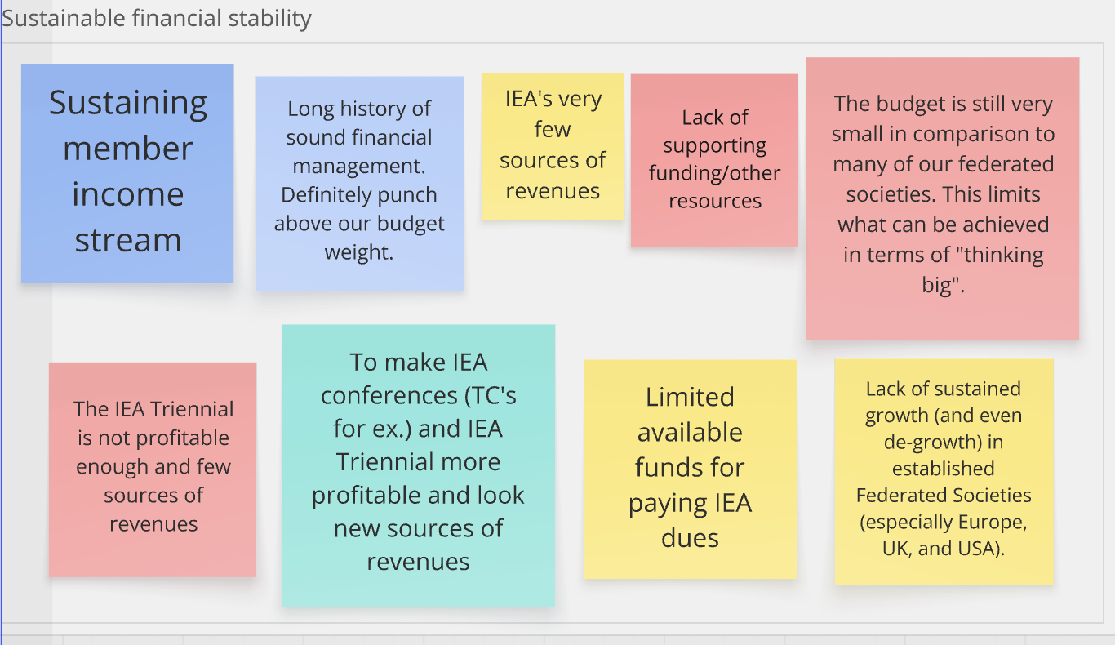

Slide 13
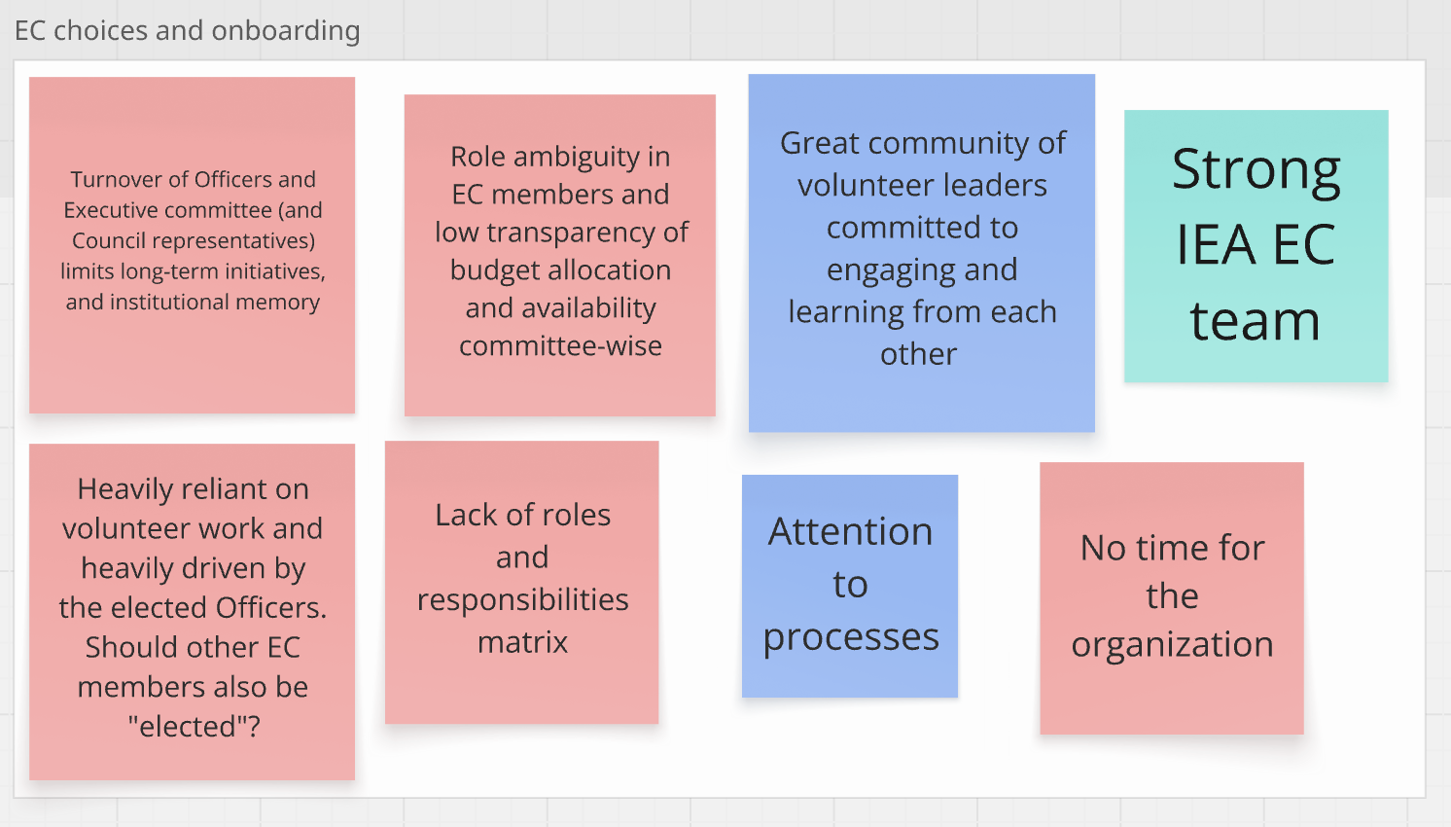

Slide 14
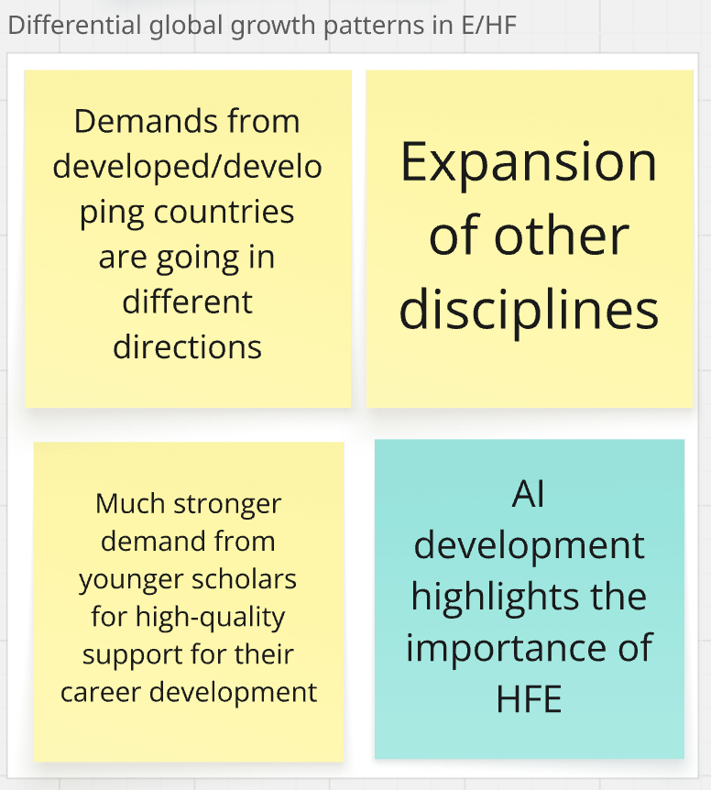

Slide 15
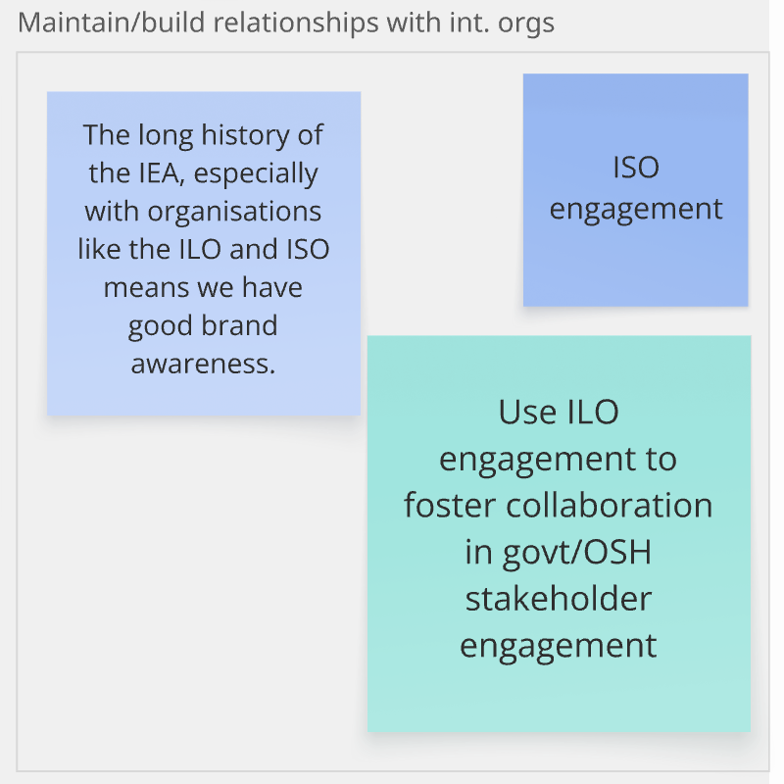

Slide 16
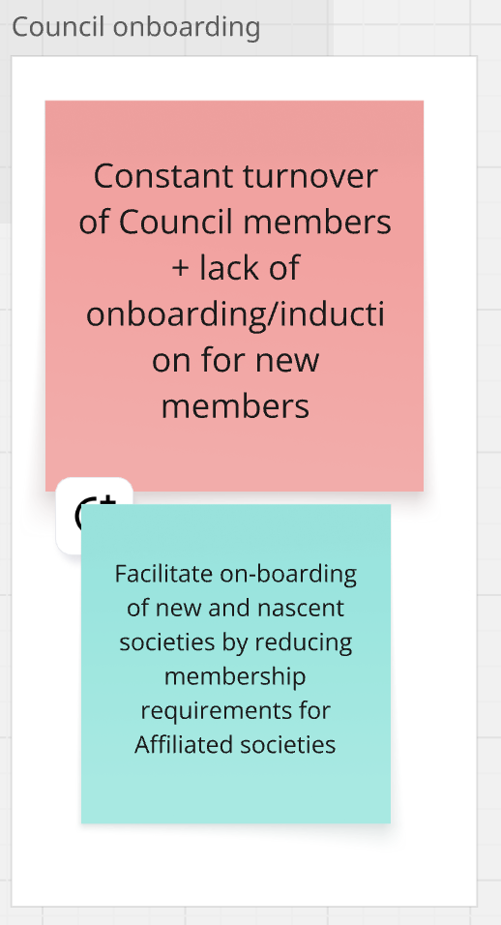

Slide 17
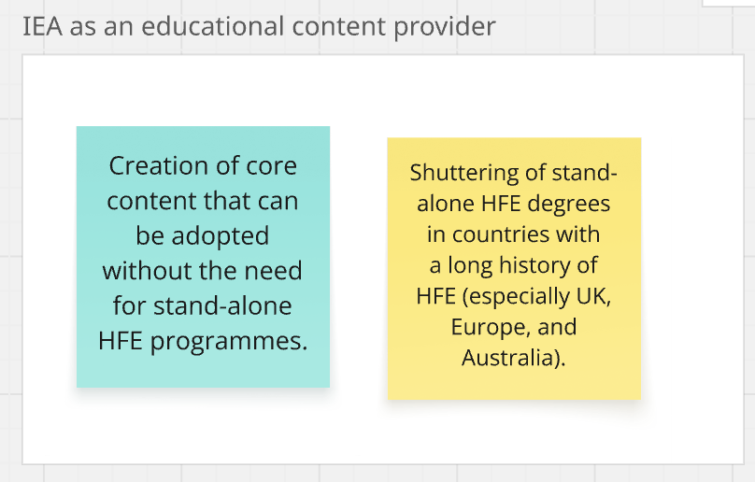

Slide 18
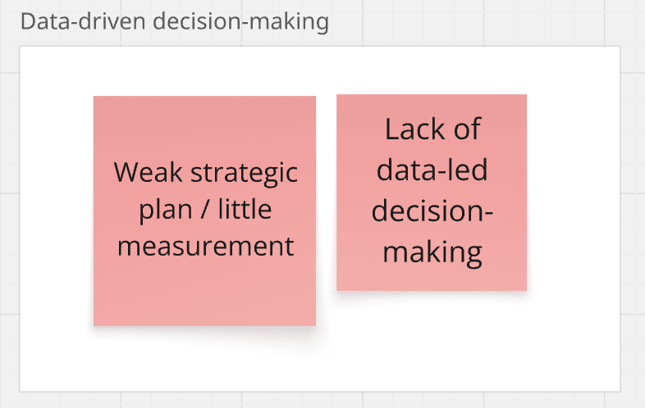

Slide 19
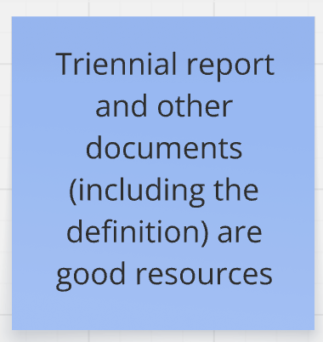
Issue which wasn’t possible to put into a theme

