Slide 1
Main projects of Vice-President Secretary General
Improve IEA stakeholder communications
  Internal: Sustaining Member value - Newsbriefs
  External: Strategic Social Media direction
    EBSCO agreement
Improve process efficiency
  Ambassador reports (summary)
  Certificate production
  Membership application
Enhance operating procedures (OPs)
  Code of conduct at IEA events
Council meeting: 2-3 November 2026 Florianopolis, Brazil
Presenter: Nancy Black

Slide 2
Improve IEA internal stakeholder communications
Value-add
Alignment with IEA Goals
Involvement - Networking
+ Perceived value
To develop more effective communication with FS & collaboration between FS.
1. Engage Stakeholders
Project outline including status
Stakeholder Needs to be met
3 Virtual council gatherings: Feb–May-Aug✓
Calendar on IEA.cc ✓
Improve online exchanges ➔ Support for social media communication strategy definition; Social for Good (Sept. – Oct)
Value … + Networking
Information sharing
Notes:
P^2DT is a process for helping systematic HFE project design. Various HFE methods or tools can be integrated into P^DT to conduct specific steps of the process.
P^2DT assumes participatory design approaches. The benefits of adopting participatory approaches are discussed later.
P^2DT is designed to be applicable to any HFE-related projects in various work places such as healthcare, office work space and environment, process plant, aviation,…

Slide 3
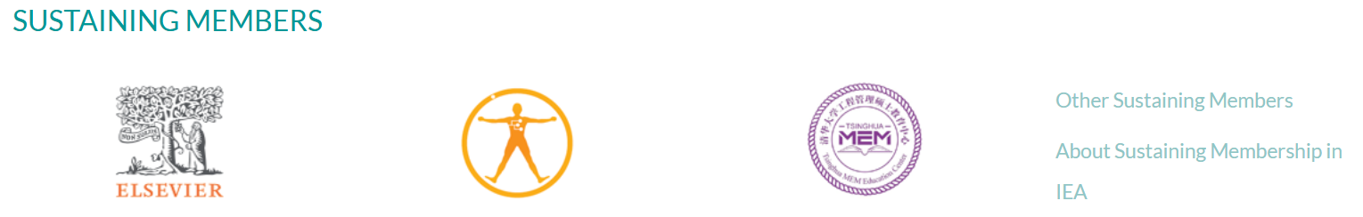
Sustaining Member value
Diamond level
Gold level
Universidad del Valle/Facultad de Salud (College of Health)
HUANUO
TeamScape LLC
BAuA
Minicute
VUBPnet
Individual Sustaining Members
Supporters: David Caple
Contributors: Pascale Carayon; Peter Hoonnaker; Andrew S. Imada; Kazutaka Kogi; Ernst Koningsveld; Johan Molenbroek; David Rempel

Slide 4
Improve process efficiency
Value-add
Alignment with IEA Goals
Limited secretariat and volunteer hours available
6. Reinforce the infrastructure of the Association
7. Maintain future focus
Stakeholder Needs to be met
Project outline including status
Timely, transparent, value-added supports
Ambassador reports ✓
Automated certificates (prog) ✓
Streamline communications
- platforms; exchange
Notes:
P^2DT is a process for helping systematic HFE project design. Various HFE methods or tools can be integrated into P^DT to conduct specific steps of the process.
P^2DT assumes participatory design approaches. The benefits of adopting participatory approaches are discussed later.
P^2DT is designed to be applicable to any HFE-related projects in various work places such as healthcare, office work space and environment, process plant, aviation,…

Slide 5
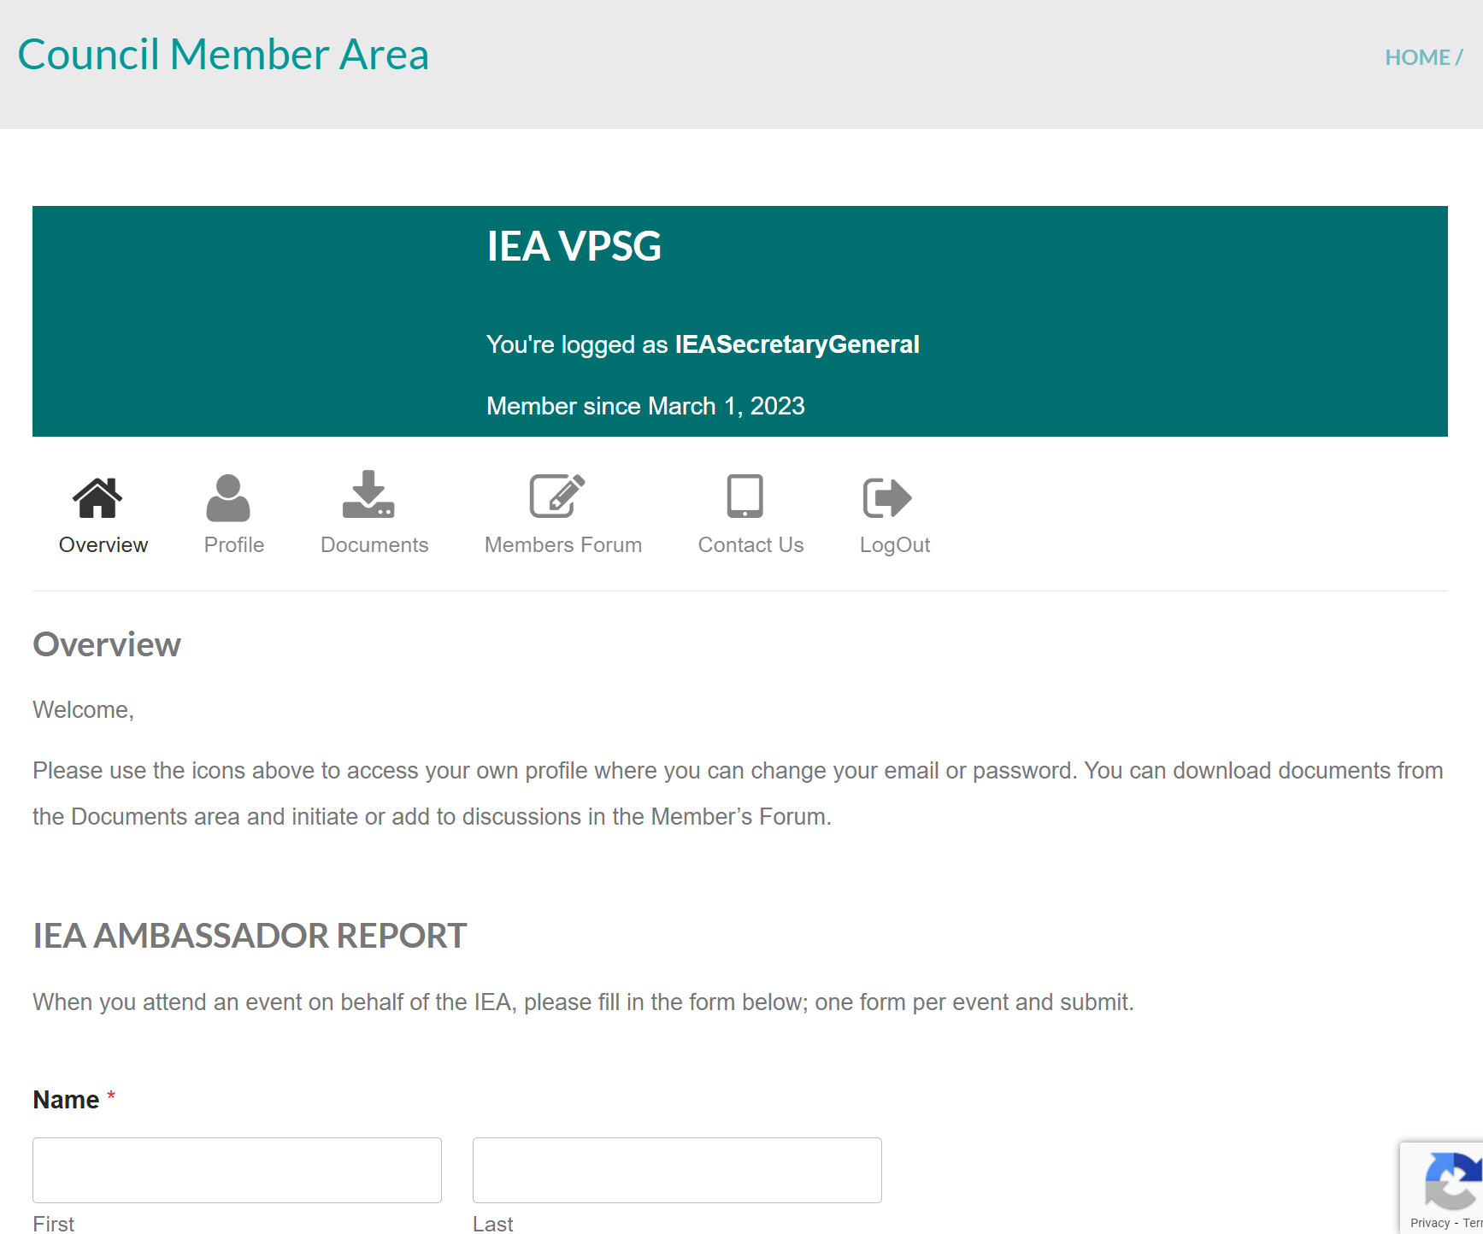
Ambassador report:
Improve processes
iea.cc → Member Login
Summary in NewsBriefs & Triennial report
2025-2026
Andrew Thatcher
Thomas Alexander
Nancy Black

Slide 6
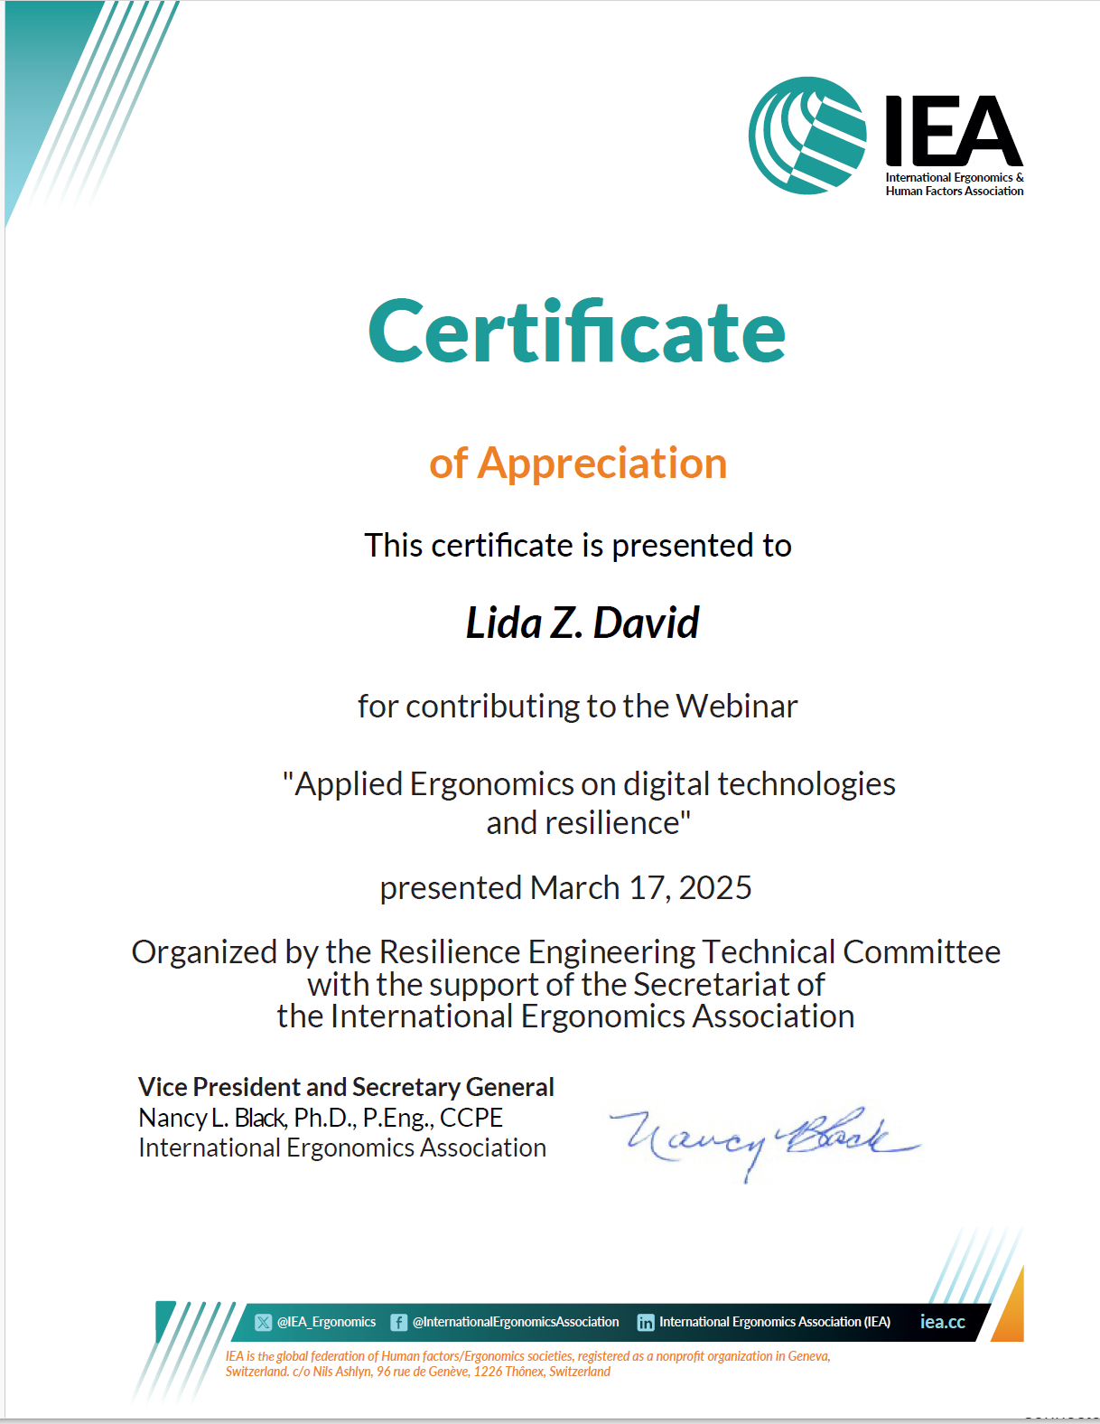
Webinar Certificate Production
Improve processes
Programmed in PPT
Variable fields
  TC recognition
    TC members as organizers
Value-added of IEA hosting
  Hosting time limitations

Slide 7
Enhance Operating Procedures
Value-add
Alignment with IEA Goals
Facilitate value-added elements
…effective communication with and collaboration between FS.
Engage Stakeholders
Reinforce the infrastructure
Maintain future focus
Stakeholder Needs to be met
Project outline including status
Succession support;
Responsible resources use
Proposed OP 21: ✓
Notes:
P^2DT is a process for helping systematic HFE project design. Various HFE methods or tools can be integrated into P^DT to conduct specific steps of the process.
P^2DT assumes participatory design approaches. The benefits of adopting participatory approaches are discussed later.
P^2DT is designed to be applicable to any HFE-related projects in various work places such as healthcare, office work space and environment, process plant, aviation,…

Slide 8
Operating Procedure 21 proposed:
Code of Conduct at IEA Events
Objectives | - Events, communications and gatherings in-person or other formats. - Safe, positive, respectful, and inclusive environment facilitating open exchange and mutual support. Proactive.
2. Principles | Events free of discrimination and harassment. Zero tolerance of harassment of participants or staff …verbal abuse, intimidation, or discrimination in any form.
3. Procedures | 3.1 For attendees
 | 3.2 For organizers
 | 3.3 Reporting of misconduct
4. Terms of Reference | 4.1 Confidentiality and privacy;
 | 4.2 Protection of complainant
 | 4.3 Consequences following complaint
 | 4.4 Communication to Member Society
 | 4.5 Maintenance of information

Slide 9
Applications for new Society Membership
New societies
Proposed revision to Application format
Ergonomi och Human Factors Sällskapet Sverige (EHSS)
  Ergonomics and Human Factors Society of Sweden
  1994-
  170 as per 12 August 2026
  https://www.ehss.se/
Suomen Ergonomia Yhdistys (SEY)
  Finnish Ergonomics Society
Clarification of payment amount (100$ for place-holder)
Communication to Treasurer

Slide 10
Discussion
VPSG@iea.cc

