Slide 1


Professional Standards &
Education Committee
Progress report on four projects
IEA Council Meeting · November 2026 · Florianópolis, Brazil
Verena Nitsch, Chair PSE

Slide 2

PROFESSIONAL STANDARDS & EDUCATION
Our mission and team
We advance global HFE by improving education standards, expanding certification access and engaging the next generation of professionals.
PSE CO-CHAIRS
Liang Ma CHN
Rob Becker UK
1
Strengthen global HFE education and certification
Andrew Todd ZAF
Daniel Braatz BRA
Farzan Sasangohar USA
NEW
2
Attract and develop young professionals
CERTIFICATION SUBCOMMITTEE
Stephven Kolose NZ
Valerie O'Keefe AUS
In collaboration with the International Development Committee, with a focus on developing regions.
Rose Figueroa USA
NEW
Thank you to Yining Ye and Denizsu Topkaya for their supporting work.
PSE Committee · IEA Council Meeting 2026 2

Slide 3




OVERVIEW
Four projects at a glance
A
B
C
D
International Mentoring Network
Shared HFE Educational Resources
HFE Curricula & Programme Database
Certification (Re-)Endorsement
Connect existing society-led mentoring programmes
A governed platform for open learning resources
Best-practice curricula and a searchable programme overview
Guide certification bodies through (re-)endorsement
Survey sent to all Federated Societies
Interactive prototype ready for review
303 HFE programmes in the new database
CREE & ESSA scored by three assessors
IN PROGRESS
IN PROGRESS
IN PROGRESS
IN PROGRESS
PSE Committee · IEA Council Meeting 2026 3

Slide 4
PROJECT A · INTERNATIONAL MENTORING NETWORK
Lead: Farzan Sasangohar (HFES)
Connecting mentoring programmes across societies
Goal Make society-led mentoring visible, identify collaboration opportunities and let IEA facilitate connections
Discussions with HFES & IFPE
Survey developed & sent to all societies
Data collection & follow-up
Inventory of mentoring activities
Recommendations for IEA coordination
Completed
Completed
In progress
Next
Next
WHAT WE LEARNED
PLANNED OUTCOMES
Mentoring takes very different forms across societies: formal committees (e.g. HFES), mentor matching, student mentoring, conference programming and leadership mentoring.
Inventory of mentorship activities
Good practices and shareable resources
Unmet needs & map of collaboration interest
Recommendations: cross-promotion, joint virtual activities, mentor referral
PSE Committee · IEA Council Meeting 2026 4

Slide 5




PROJECT B · SHARED HFE EDUCATIONAL RESOURCES
Lead: Liang Ma · with Yining Ye
A governed platform for open HFE learning resources
BENCHMARK OF FIVE PLATFORMS
TWO-STAGE REVIEW
Coursera
edX
FutureLearn
OpenLearn
OER Commons
Submission
DESIGN PRIORITIES
Creator selects licence, confirms rights, flags third-party material
Easy to find
Provenance & licence
▼
1 · HFE content review
Search, topic entry points and course cards
Licence and third-party material as mandatory fields
Professional relevance, classification, completeness
▼
2 · IEA final review
Clear review roles
Complete records
Copyright, privacy, conditions for public release
Professional and compliance review separated
Versions, review outcomes and access status kept
▼
Publication
Version control, link checks, complaint handling
PSE Committee · IEA Council Meeting 2026 5

Slide 6
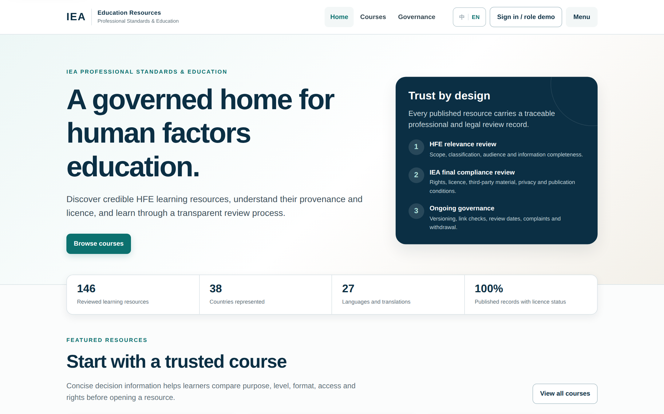
PROJECT B · SHARED HFE EDUCATIONAL RESOURCES
Interaction prototype of the IEA platform
01
Trust by design
Every published resource carries a traceable professional and legal review record.
02
Built on the research
Translates platform structure, user roles and key workflows into an interactive interface.
03
Next step
Review and discussion of the prototype with PSE and EC; decision on implementation and hosting.
Figures shown in the prototype are placeholder demo data.
PSE Committee · IEA Council Meeting 2026 6

Slide 7

PROJECT C · HFE CURRICULA & PROGRAMME DATABASE
From the Global Map to a searchable programme database
BEFORE · GOOGLE GLOBAL MAP
NOW · CENTRAL EXCEL DATABASE
303
Double work: data in Google Drive and Google Earth
Shared Google account caused login conflicts
Multi-step updates and coordination meetings
One central file – no shared account needed
Two layers: filter tab and main database tab
New programmes added as a simple new row
HFE programmes in the database to date
records migrated from the previous IEA database
BEST-PRACTICE HFE CURRICULA
A collection of HFE curricula with an overview of covered subjects has been compiled to guide those who wish to establish new courses. The overview is shared with Council members – further curricula are welcome.
PSE Committee · IEA Council Meeting 2026 7

Slide 8
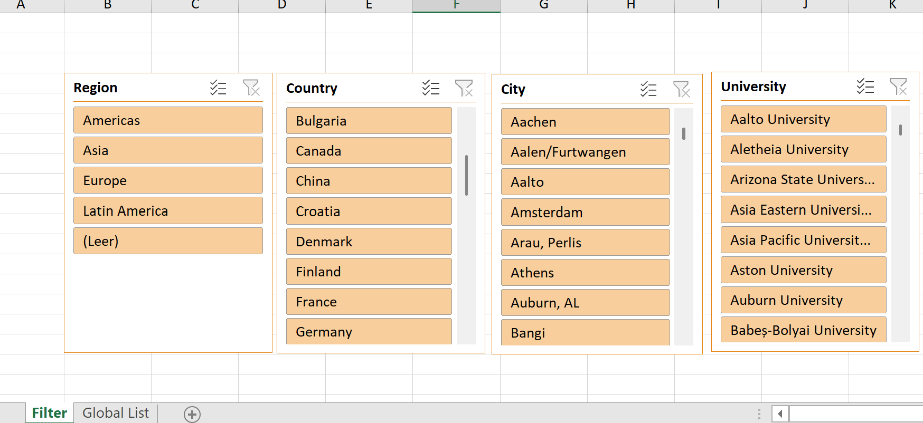
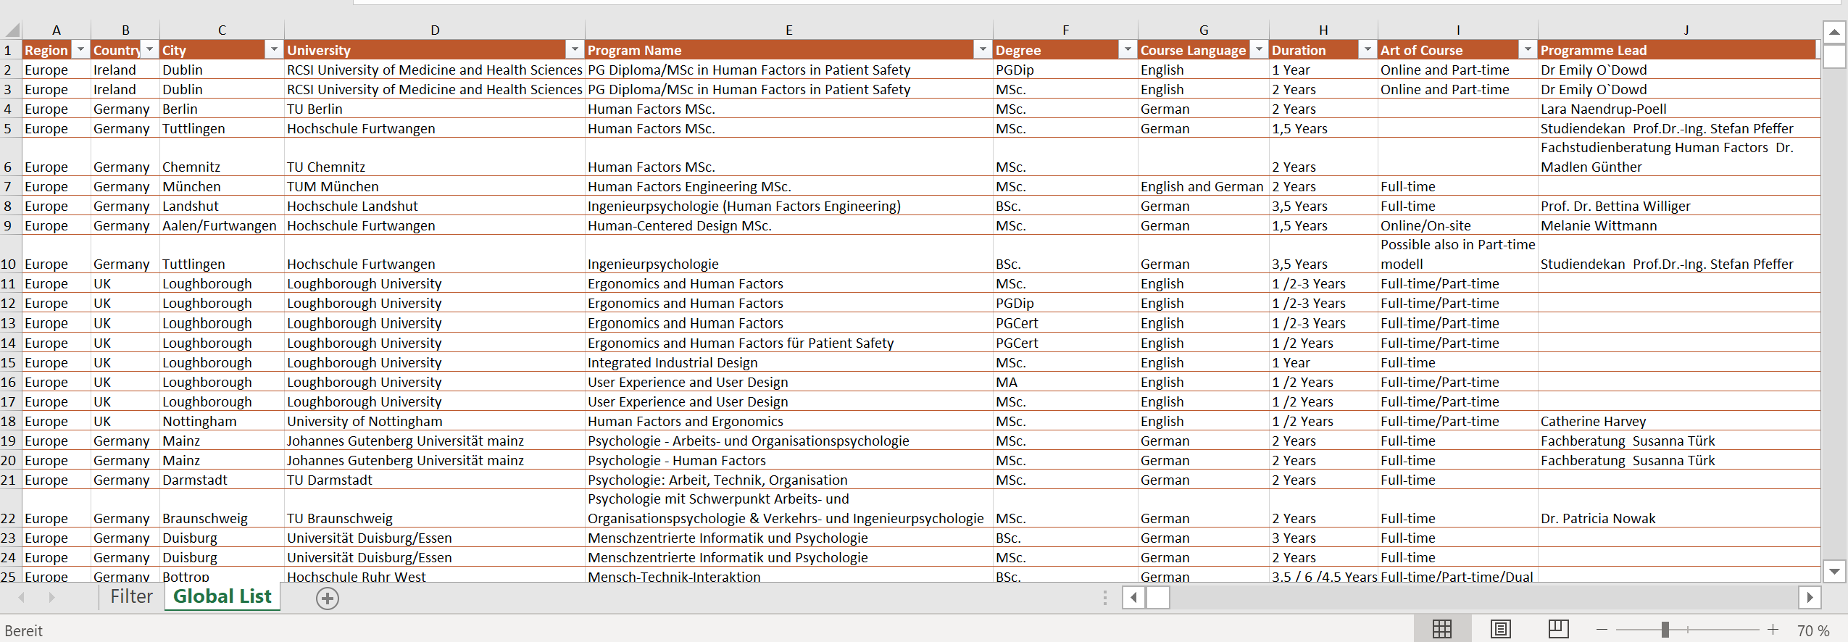


PROJECT C · HFE CURRICULA & PROGRAMME DATABASE
The new database in practice
Sheet 1 · Filter
Search tool: filter programmes by region, country, city and university
Sheet 2 · Database
Single source: programme, degree, language, duration, contacts and links
NEXT STEPS
Share with initial users for feedback on usability and search
Regional contacts verify, add and update programmes
Add reporting features (pivot tables, formatting)
PSE Committee · IEA Council Meeting 2026 8

Slide 9


PROJECT D · CERTIFICATION (RE-)ENDORSEMENT
Certification Subcommittee: S. Kolose, V. O'Keefe, R. Figueroa
Building a shared knowledge base on certification
History of the IEA Certification Endorsement System
Overview and comparison of certification criteria
S. Kolose · January 2026 · foundational resource for the Subcommittee
Circulated to certification bodies for review
9
certification bodies compared
7
dimensions per system
1961
2000
2001
2010s
2020s
IEA mandate: science into practice
Quality Assurance Committee; endorsement criteria
IEA Core Competencies
Alignment with ISO/IEC 17024
Hybrid exam + portfolio models
Education · work experience · supervised practice · portfolio · examination · referees · special notes
KEY OBSERVATIONS
CHALLENGES IDENTIFIED
All systems rely on work experience and work samples / portfolios
Only 2 of 9 use a written examination (BCPE, JES)
Endorsement so far focuses on process rather than content
Language barriers in applications and assessment
Loss of institutional memory between committee cycles
Shrinking pool of volunteer assessors
PSE Committee · IEA Council Meeting 2026 9

Slide 10
PROJECT D · CERTIFICATION (RE-)ENDORSEMENT
Rubric IEA-CSC-RUB-01
A rubric to standardise re-endorsement scoring
35 CRITERIA IN 7 WEIGHTED DOMAINS
MULTI-REVIEWER PROCESS
Core competency alignment
25%
8
Lead reviewer
Co-reviewer
Divergences
Result
Professional behaviour & ethics
25%
4
scores + justification
scores independently
flagged for discussion
recommendation by fixed rules
Assessment methodology & rigour
20%
6
Optional third reviewer · final decision remains with the Subcommittee
Governance & independence
15%
5
DECISION THRESHOLDS
Continuing professional development
7.5%
4
Weighted score
Critical Reds
Total Reds
Certification lifecycle management
5%
4
Full
≥ 85%
0
≤ 1
Conditional
≥ 40%
≤ 4
≤ 6
Transparency & documentation
2.5%
4
Non-endorsement
< 40%
≥ 5
≥ 7
■ critical domain ■ non-critical · right column: number of criteria
Non-endorsement if weighted score < 40% or either Red trigger is reached.
0–3 SCALE PER CRITERION
Tested on the CREE and ESSA applications, scored independently by three assessors.
3
Fully
2
Substantially
1
Partial
0
Gap
PSE Committee · IEA Council Meeting 2026 10

Slide 11
PROJECT D · CERTIFICATION (RE-)ENDORSEMENT
Re-endorsement schedule
Certification body | First endorsement | Last re-endorsement | Next due | Status
Argentina (ADEA) | 2024 | – | 2030 | Not due
Australia (HFESA) | prob. 2007 | 2021 | 2027 | Not due
Brazil (ABERGO) | 2018 | – | 2024 | Re-endorsement required
Canada (CCCPE) | 2020 | – | 2026 | Expected Jan 2027
Europe (CREE) | before 2009 | 2020 | 2026 | Submitted – scored
Japan (JES) | 2006 | 2019 | 2025 | Re-endorsement required
Malaysia (HFEM) | 2025 | – | 2031 | Not due
New Zealand (HFESNZ) | 2007 | 2021 | 2027 | Not due
South Africa (ESSA) | before 2022 | – | 2023–2027 | Submitted – scored
USA (BCPE) | before 2009 | 2020 | 2026 | Due
Mexico has not applied, but maintains long-standing communication with IEA about its established system. Source: PSE re-endorsement overview, Sept 2026.
PSE Committee · IEA Council Meeting 2026 11

Slide 12





HOW COUNCIL MEMBERS CAN HELP
Your contribution makes these projects work
Mentorship survey
Complete the mentorship survey
Send HFE curricula
Share your society's mentoring activities and interest in collaboration.
Add curricula from your country to the best-practice collection.
Verify programme data
Volunteer
IEA Mentorship Activities and Coordination Survey – scan to respond
Check and complete the HFE programmes listed for your region.
We need active contributors, e.g. as assessors for re-endorsements.
PSE Committee · IEA Council Meeting 2026 12

Slide 13

Thank you
Questions and discussion
Verena Nitsch
Chair, Professional Standards & Education Committee
iea.cc

