Slide 1
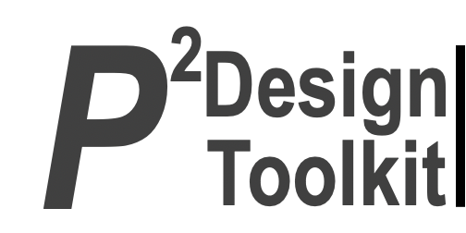
Main projects of Science, Technology, and Practice Committee
Webinar Project
Ergonomics in a Nutshell for Children
TC member recruitment update
Organizing new and old TCs
IEA 2027 Organizing Committee
EC meeting: November 2026
Presenter: Rosemary Seva STP Chair

Slide 2
IEA Webinar Project
Value-add
Alignment with IEA Goals
Facilitate sharing of knowledge about HFE in the ergonomics community
To develop more effective communication with and collaboration between federated societies.
To advance the science and practice of HFE at an international level.
Stakeholder Needs to be met
Project outline including status
Update on the trends in HFE practice
Networking
77 videos uploaded in the IEA website
52 came from TCs
Notes:
P^2DT is a process for helping systematic HFE project design. Various HFE methods or tools can be integrated into P^DT to conduct specific steps of the process.
P^2DT assumes participatory design approaches. The benefits of adopting participatory approaches are discussed later.
P^2DT is designed to be applicable to any HFE-related projects in various work places such as healthcare, office work space and environment, process plant, aviation,…

Slide 3
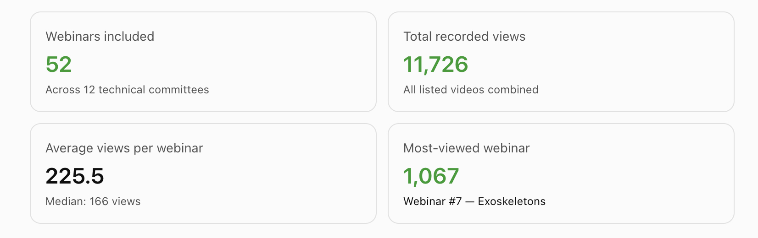
IEA Webinar Statistics
Notes:
P^2DT is a process for helping systematic HFE project design. Various HFE methods or tools can be integrated into P^DT to conduct specific steps of the process.
P^2DT assumes participatory design approaches. The benefits of adopting participatory approaches are discussed later.
P^2DT is designed to be applicable to any HFE-related projects in various work places such as healthcare, office work space and environment, process plant, aviation,…

Slide 4
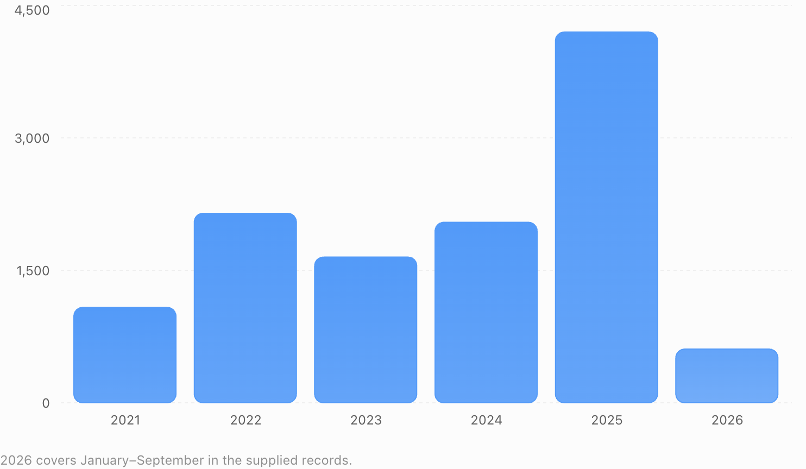
IEA Webinar Statistics
Notes:
P^2DT is a process for helping systematic HFE project design. Various HFE methods or tools can be integrated into P^DT to conduct specific steps of the process.
P^2DT assumes participatory design approaches. The benefits of adopting participatory approaches are discussed later.
P^2DT is designed to be applicable to any HFE-related projects in various work places such as healthcare, office work space and environment, process plant, aviation,…

Slide 5
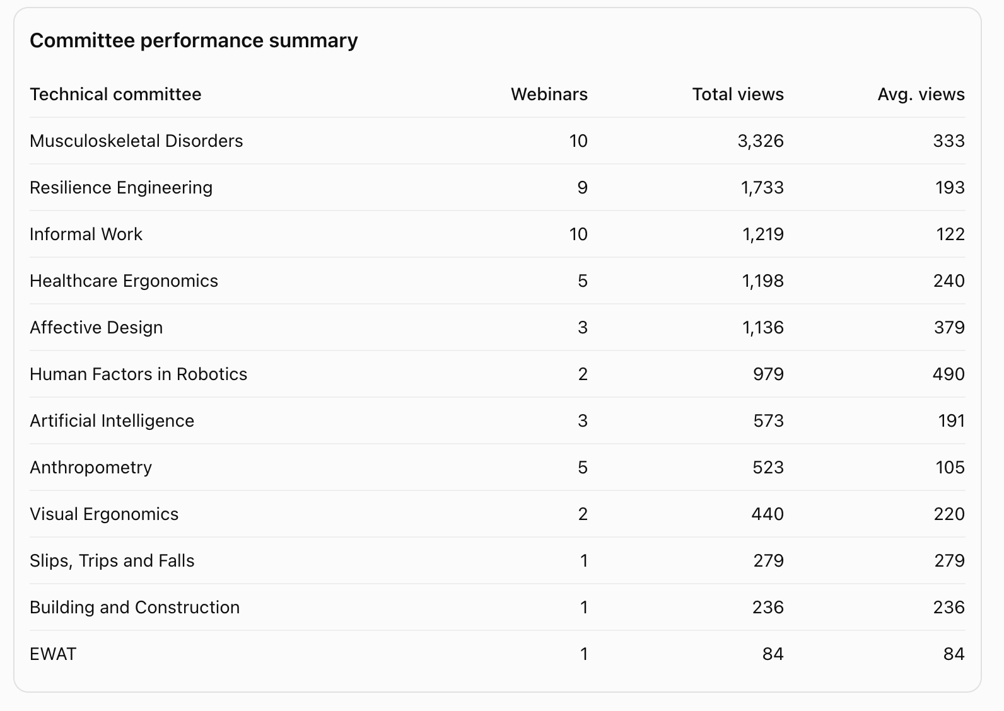
IEA Webinar Statistics
Notes:
P^2DT is a process for helping systematic HFE project design. Various HFE methods or tools can be integrated into P^DT to conduct specific steps of the process.
P^2DT assumes participatory design approaches. The benefits of adopting participatory approaches are discussed later.
P^2DT is designed to be applicable to any HFE-related projects in various work places such as healthcare, office work space and environment, process plant, aviation,…

Slide 6
What stakeholders are involved in project & how?
Group | Group’s role within Project + category* | Group benefit | Individual | Individual’s role within project | Individual benefit
Technical Committees | Organize the webinars (A) | Knowledge dissemination Networking opportunity | TC Chair (I) | Invite speaker (A) | Work fulfilment
VPSG | Provide technical and marketing support (I) |  | IEA VPSG(A) | Create Zoom Link and facilitate promotion (A) | Work fulfilment
IEA SCC | Provide marketing support (A) |  | A. Du Plessis (A) | Include webinar information in the Newsbrief (A) | Work fulfilment
IEA Federated Society Members | Attendees (A) | Knowledge acquisition Networking opportunity
*Categories are indicated by letters: Actor/ Expert/ Decider/ Influencer

Slide 7
Ergonomics in a Nutshell for Children
Value-add
Alignment with IEA Goals
Promotion of ergonomics and human factors to specific groups
Enhancing knowledge in HFE
To advance the science and practice of HFE at an international level.
To enhance the contribution of the HFE discipline to global society
Stakeholder Needs to be met
Project outline including status
- Ergonomics insights, compellingly presented for a targeted group.
In the conceptualization stage
Notes:
P^2DT is a process for helping systematic HFE project design. Various HFE methods or tools can be integrated into P^DT to conduct specific steps of the process.
P^2DT assumes participatory design approaches. The benefits of adopting participatory approaches are discussed later.
P^2DT is designed to be applicable to any HFE-related projects in various work places such as healthcare, office work space and environment, process plant, aviation,…

Slide 8
What stakeholders are involved in project & how?
Group | Group’s role within Project + category* | Group benefit | Individual | Individual’s role within project | Individual benefit
IE Executive Committee | Project oversight (I) | Knowledge for reporting | IEA President | Looking for writers and funding (A) | Work fulfilment
 |  |  | IEA VPSG | Looking for writers (A) | Work fulfilment
STP Committee | Project oversight (I) | Knowledge for reporting | STP Chair | Organize meetings (I) | Work fulfilment
Writers | Provide content (A) | Knowledge sharing Publication | A. Gamper/K. Jacobs | Project leader (I) | Publication
*Categories are indicated by letters: Actor/ Expert/ Decider/ Influencer

Slide 9
TC Member Recruitment
Value-add
Alignment with IEA Goals
Sharing of HFE knowledge in the ergonomics community
To advance the science and practice of HFE at an international level.
Engage stakeholders
Promote HFE science, technology, and practice
Stakeholder Needs to be met
Project outline including status
Update on the trends in HFE practice
Networking opportunity
Sign-up announcement featured in Newsbrief
132 signed up for TC membership
List of new members sent to TC Chairs to contact
Notes:
P^2DT is a process for helping systematic HFE project design. Various HFE methods or tools can be integrated into P^DT to conduct specific steps of the process.
P^2DT assumes participatory design approaches. The benefits of adopting participatory approaches are discussed later.
P^2DT is designed to be applicable to any HFE-related projects in various work places such as healthcare, office work space and environment, process plant, aviation,…

Slide 10
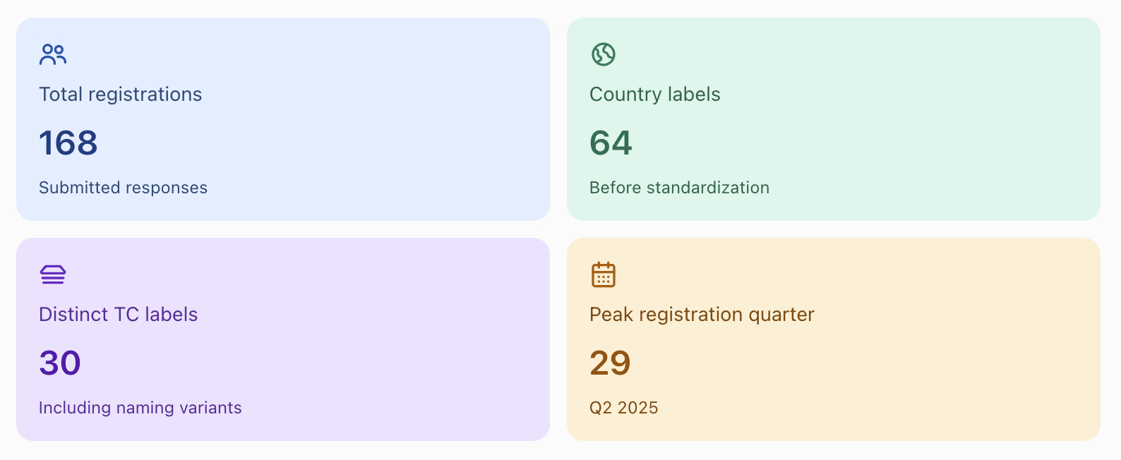
TC Member Recruitment Summary
Notes:
P^2DT is a process for helping systematic HFE project design. Various HFE methods or tools can be integrated into P^DT to conduct specific steps of the process.
P^2DT assumes participatory design approaches. The benefits of adopting participatory approaches are discussed later.
P^2DT is designed to be applicable to any HFE-related projects in various work places such as healthcare, office work space and environment, process plant, aviation,…

Slide 11
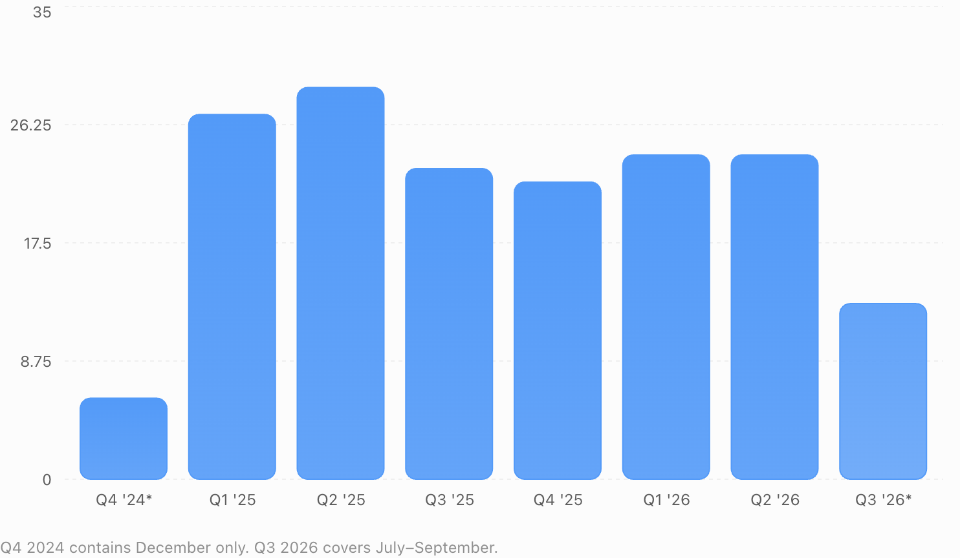
TC Member Recruitment Summary
Notes:
P^2DT is a process for helping systematic HFE project design. Various HFE methods or tools can be integrated into P^DT to conduct specific steps of the process.
P^2DT assumes participatory design approaches. The benefits of adopting participatory approaches are discussed later.
P^2DT is designed to be applicable to any HFE-related projects in various work places such as healthcare, office work space and environment, process plant, aviation,…

Slide 12
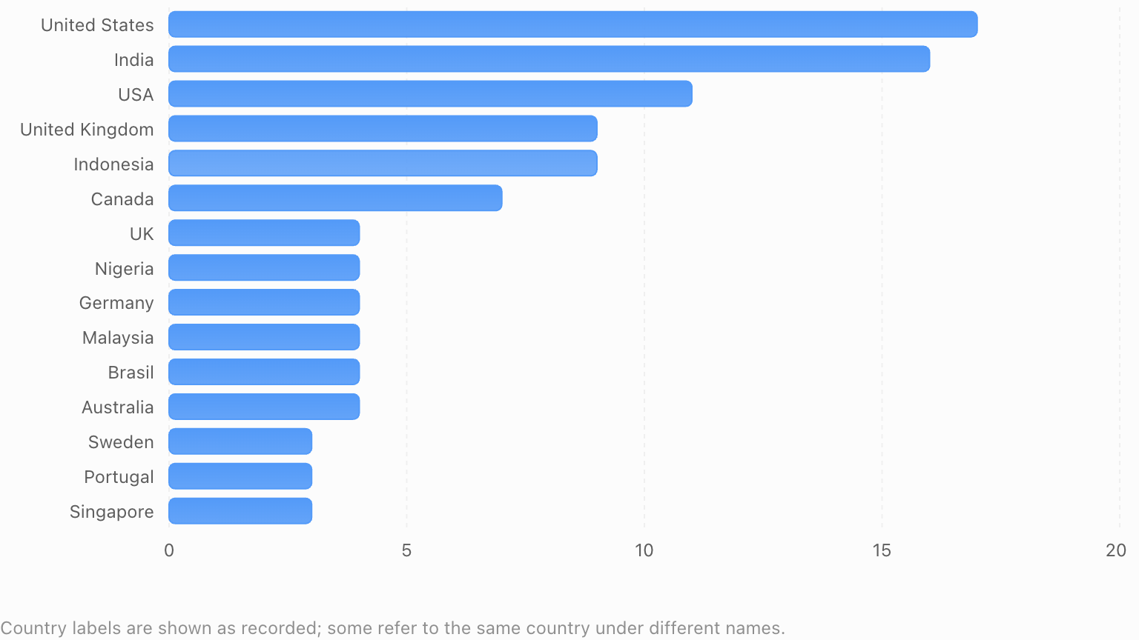
TC Member Recruitment Summary
Notes:
P^2DT is a process for helping systematic HFE project design. Various HFE methods or tools can be integrated into P^DT to conduct specific steps of the process.
P^2DT assumes participatory design approaches. The benefits of adopting participatory approaches are discussed later.
P^2DT is designed to be applicable to any HFE-related projects in various work places such as healthcare, office work space and environment, process plant, aviation,…

Slide 13
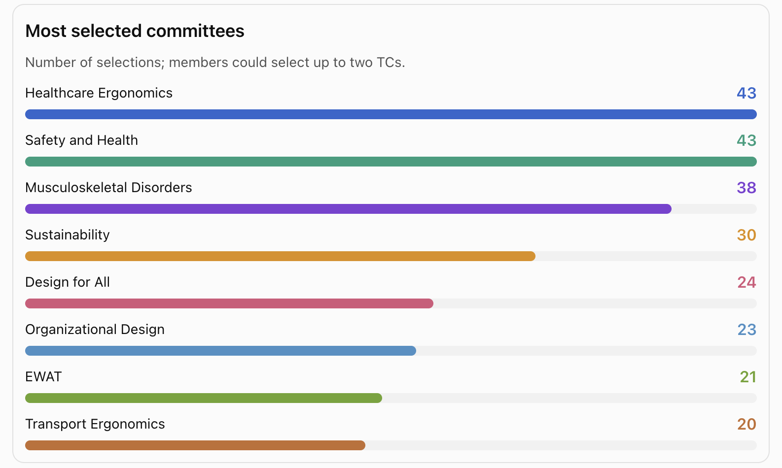
Most Selected TCs
Notes:
P^2DT is a process for helping systematic HFE project design. Various HFE methods or tools can be integrated into P^DT to conduct specific steps of the process.
P^2DT assumes participatory design approaches. The benefits of adopting participatory approaches are discussed later.
P^2DT is designed to be applicable to any HFE-related projects in various work places such as healthcare, office work space and environment, process plant, aviation,…

Slide 14
What stakeholders are involved in project & how?
Group | Group’s role within Project + category* | Group benefit | Individual | Individual’s role within project | Individual benefit
Information Technology Committee | Technical support (E) | Work fulfilment | IT Chair | Update the website (A) | Work fulfilment
STP Committee | Content provider (A) | Increase in TC membership | STP Chair | Provide google sign-up form (A) | Work fulfilment
 | Dissemination of information to TCs (A) |  | STP Chair | Send email to TC chairs (A) | Work fulfilment
*Categories are indicated by letters: Actor/ Expert/ Decider/ Influencer

Slide 15
Reorganizing Old TCs
Value-add
Alignment with IEA Goals
Better TC organization
To advance the science and practice of HFE at an international level.
Engage stakeholders
Project outline including status
26 TCs at present
New TC Collaboration & Design Activities Through Technology
Proposed TC Ergonomics and Human Factors in Sport
Stakeholder Needs to be met
Timely response on queries
Notes:
P^2DT is a process for helping systematic HFE project design. Various HFE methods or tools can be integrated into P^DT to conduct specific steps of the process.
P^2DT assumes participatory design approaches. The benefits of adopting participatory approaches are discussed later.
P^2DT is designed to be applicable to any HFE-related projects in various work places such as healthcare, office work space and environment, process plant, aviation,…

Slide 16
What stakeholders are involved in project & how?
Group | Group’s role within Project + category* | Group benefit | Individual | Individual’s role within project | Individual benefit
STP Committee | Identify TCs to be organized and revived | Work fulfilment | STP Chair (I) | Identify TCs to be organized and revived | Work fulfilment
IEA Executive Committee | Decide on new TCs to organize | Work fulfilment | IEA VPSG(D) | Decision maker | Work fulfilment
*Categories are indicated by letters: Actor/ Expert/ Decider/ Influencer

Slide 17
Support IEA 2027 Organizing Committee
Value-add
Alignment with IEA Goals
Smooth coordination of the IEA2027 program
To develop more effective communication with and collaboration between federated societies
To advance the science and practice of HFE at an international level.
Project outline including status
STP Annual meeting last June 2026 where B. Charles was invited
TC meeting in Beijing
Stakeholder Needs to be met
Good conference organization
Notes:
P^2DT is a process for helping systematic HFE project design. Various HFE methods or tools can be integrated into P^DT to conduct specific steps of the process.
P^2DT assumes participatory design approaches. The benefits of adopting participatory approaches are discussed later.
P^2DT is designed to be applicable to any HFE-related projects in various work places such as healthcare, office work space and environment, process plant, aviation,…

Slide 18
What stakeholders are involved in project & how?
Group | Group’s role within Project + category* | Group benefit | Individual | Individual’s role within project | Individual benefit
Technical Committees | Organize sessions (A) | Knowledge sharing TC Promotion | TC Chair (A) | Organizer | Promotion of TC
STP Committee | Project oversight (I) | Work fulfilment | STP Chair (I) | Program coordinator | Work fulfilment
IEA 2027 Committee | Main organizer (I) | Promotion Sharing of HFE practice Networking | B. Peachey (I) | Conference Chair | Promotion
*Categories are indicated by letters: Actor/ Expert/ Decider/ Influencer

Slide 19
Attendees in Beijing
Attendee | TC
Aleksandar Zunjic | Safety and Health
Christelle Casse | Gender and Work
Karen Jacobs | AI and Work
Melissa Baysari (Tomiczek on passport) | Healthcare
Rich Mcilroy | Transport Ergonomics and Human Factors
Rosemary Seva | STP
Sofia Scataglini | Digital Human Modelling
Yakir Yaniv | Human Systems Integration
Yue Li | Slips, Trips, and Falls

