Slide 1
Main projects of the
Professional Standards & Education Committee (PSE)
Activities 2024–2027
a) International Mentoring Network
b) Shared Use of HFE Educational Resources
c) Best-Practice HFE Curricula & Global Programme Database
d) Certification Endorsement & Re-Endorsement
IEA Council Meeting: November 2026, Florianópolis, Brazil
Presenter: Verena Nitsch

Slide 2
PSE Objectives
The Professional Standards and Education (PS&E) Committee aims to advance global human factors/ergonomics (HFE) by improving education standards, expanding certification access, and engaging the next generation of professionals.
Over the 2024–2027 term, our focus centres on two key objectives:
(1) strengthening global HFE education and certification, and
(2) attracting and developing young professionals.
These objectives are pursued in collaboration with the International Development (ID) Committee to ensure broad international impact, particularly in developing regions.

Slide 3
PSE Members
PSE Co-Chairs
Liang Ma (CHN) – Liaison to the International Development Committee; lead, educational resources platform
Rob Becker (UK) – Young members
Andrew Todd (ZAF) – Young members, expert interviews
Daniel Braatz (BRA) – Young members
Farzan Sasangohar (USA, HFES) – Lead, international mentoring network (new)
Certification Subcommittee
Stephven Kolose (NZ) – overview documents, re-endorsement scoring rubric, assessor
Valerie O'Keefe (AUS) – assessor
Rose Figueroa – assessor (new)
Thank you to Yining Ye (educational resources platform research & prototype) and Denizsu Topkaya (curricula collection, HFE programme database, certification bodies meeting) for their supporting work.

Slide 4
a) International Mentoring Network
Value-add
Alignment with IEA Goals
Makes existing society-led mentoring activities visible and connects them, instead of creating a parallel IEA programme
Increases access to mentoring for students and early-career professionals, especially in societies/regions with a limited pool of mentors
Goal: Coordination and information sharing across IEA Federated Societies – not standardisation of existing programmes
SP 7 – Maintain a future focus for HFE
SP 1 – Engage stakeholders
SP 2 – Collaborate with and reinforce IEA networks
Source: iea.cc – IEA strategic policies
Stakeholder Needs to be met
Project outline including status
Access to mentoring for students & early-career professionals
Visibility of existing mentoring offers across societies
Sharing of mentor/mentee guidance, templates and training resources
Council survey; results presented at virtual Council meeting (May 2026) completed
Initial discussions with HFES and IFPE completed
Mentorship Activities & Coordination Survey developed and distributed to Federated Societies completed
Data collection, response monitoring & targeted follow-up in progress
Inventory matrix of mentorship activities to start
Follow-up discussions with selected societies to start
Recommendations to the PSE Committee to start
Notes:
P^2DT is a process for helping systematic HFE project design. Various HFE methods or tools can be integrated into P^DT to conduct specific steps of the process.
P^2DT assumes participatory design approaches. The benefits of adopting participatory approaches are discussed later.
P^2DT is designed to be applicable to any HFE-related projects in various work places such as healthcare, office work space and environment, process plant, aviation,…

Slide 5
What stakeholders are involved in project & how?
Group | Group’s role within Project + category* | Group benefit | Individual | Individual’s role within project | Individual benefit
IEA PSE Committee | Project oversight; Survey design, outreach & analysis; Recommendations for coordination (D, E) | Coordination role, visibility | Verena Nitsch – PSE Chair | Coordinate activities, report to EC and Council (I, D) | Network expansion
IEA Federated Societies (leadership, secretariats, education contacts) | Respond to survey; Share mentoring activities & resources; Open activities to members of other societies (A, E) | Visibility, access to mentors & materials | Farzan Sasangohar (HFES) – PSE Co-Chair | Lead the initiative: discussions, survey, outreach, analysis, recommendations (E, A) | Leadership, international network
Society mentoring committees (e.g. HFES Mentorship Committee, IFPE) | Provide insight into established programmes; Serve as potential models / partners (E, I) | Exchange of good practice | Rob Becker, Andrew Todd – PSE Co-Chairs | Support outreach with focus on young members (E) | Engagement of young members
Students & early-career professionals | Mentees and main beneficiaries (A) | Access to mentoring & networks | Contact persons of Federated Societies | Complete survey, provide programme contacts and resources (A, E) | Visibility of own programmes
*Categories are indicated by letters: Actor / Expert / Decider / Influencer

Slide 6
Main stakeholders and their relationship to each other
From ↓ To → | PSE Chair & Co-Chairs | Federated Societies & their mentoring programmes
PSE Chair & Co-Chairs | Project oversight | Survey, follow-up discussions, coordination proposals
Federated Societies & their mentoring programmes | Survey responses, programme information, shareable resources
Students & early-career professionals |  | Participation as mentees
Notes:
Coupled with the understanding of stakeholder benefits (Step 6), the understanding the relations among stakeholders is critically important for developing promotional strategies.
It will form a basis for specifying subprojects: The underlying consideration is to develop a set of projects which do not conflict in each project. For instance, develop a science-oriented HFE project and a more application-oriented HFE project: The science-oriented HFE project is designed to contribute to the development of HFE science, while the application-oriented HFE project is designed to provide practical benefits. They together achieve a high-quality HFE project. Others may include promotion projects for influential stakeholders (i.e., system influencers).

Slide 7
Update: a) International Mentoring Network
Work completed
Initial discussions with HFES and IFPE: mentoring takes very different forms (formal committees, mentor matching, student mentoring, conference programming, leadership mentoring)
Mentorship Activities & Coordination Survey developed and sent to all Federated Societies
Clear message: coordination & information sharing – not standardisation
Current phase
Data collection and response monitoring
Next steps
Inventory of mentorship activities
Identify coordination opportunities & unmet needs
Follow-up discussions and recommendations

Slide 8
b) Shared HFE Educational Resources
Value-add
Alignment with IEA Goals
A governed, central platform for open HFE learning resources – cost-effective, without requiring new course development
Learners and educators can find resources quickly and understand provider, audience, provenance and licensing
Goal: Establish an IEA Online Education Resources Platform with a transparent two-stage review
SP 4 – Promote HFE education, certification and professional standards
SP 3 – Promote HFE science, technology and practice
SP 2 – Collaborate with and reinforce IEA networks
Source: iea.cc – IEA strategic policies
Stakeholder Needs to be met
Project outline including status
Easier access to quality-reviewed HFE educational resources
Transparency on provenance, versions and licensing
Resource sharing among societies; legal certainty for IEA
Survey on educational resources among societies completed
Benchmark of 5 platforms (Coursera, edX, FutureLearn, OpenLearn, OER Commons) completed
Design research report; user roles & workflow report completed
Interactive prototype of the platform completed
Review & discussion of the prototype (PSE, EC) in progress
Decision on implementation, hosting and governance roles to start
Pilot with first resources to start
Notes:
P^2DT is a process for helping systematic HFE project design. Various HFE methods or tools can be integrated into P^DT to conduct specific steps of the process.
P^2DT assumes participatory design approaches. The benefits of adopting participatory approaches are discussed later.
P^2DT is designed to be applicable to any HFE-related projects in various work places such as healthcare, office work space and environment, process plant, aviation,…

Slide 9
What stakeholders are involved in project & how?
Group | Group’s role within Project + category* | Group benefit | Individual | Individual’s role within project | Individual benefit
IEA PSE Committee | Project oversight; Define review criteria and responsibilities (D, E) | Knowledge sharing, global impact | Verena Nitsch – PSE Chair | Coordinate activities, present concept to EC/Council (I, D) | Network expansion
IEA Executive Committee | Decision on implementation, hosting and resources (D, I) | Informed decision | Liang Ma – PSE Co-Chair | Lead platform research, design specification and prototype (E, A) | Research & design experience
Federated Societies, universities & course providers | Submit and disseminate open educational resources (A, E) | Resource visibility | Yining Ye | Platform benchmarking, reports and interaction prototype (E, A) | Research & design experience
HFE content reviewers / IEA review administrators (future roles) | Professional review; copyright, privacy and release review (E, D) | Transparent, documented reviews | Contact persons of societies / course providers | Provide links to free, accessible educational material (E, I) | Visibility of own material
Learners, educators, practitioners | Users of the platform (A) | Quality-reviewed resources
*Categories are indicated by letters: Actor / Expert / Decider / Influencer

Slide 10
Main stakeholders and their relationship to each other
From ↓ To → | PSE Chair & Co-Chairs | IEA EC
PSE Chair & Co-Chairs | Project oversight | Platform concept & prototype for decision
IEA EC | Mandate, decision on resources & hosting
Societies & course providers | Submission of open resources incl. licences
Learners & educators | Feedback, complaints, usage
Notes:
Coupled with the understanding of stakeholder benefits (Step 6), the understanding the relations among stakeholders is critically important for developing promotional strategies.
It will form a basis for specifying subprojects: The underlying consideration is to develop a set of projects which do not conflict in each project. For instance, develop a science-oriented HFE project and a more application-oriented HFE project: The science-oriented HFE project is designed to contribute to the development of HFE science, while the application-oriented HFE project is designed to provide practical benefits. They together achieve a high-quality HFE project. Others may include promotion projects for influential stakeholders (i.e., system influencers).

Slide 11
Update: b) Shared HFE Educational Resources
Research (Liang Ma, Yining Ye)
Benchmark of Coursera, edX, FutureLearn, OpenLearn and OER Commons
Priorities: easy to find · provenance & licensing transparent · clearly assigned review roles · complete records
Key design decisions
Governed open-resource repository with metadata, versions, review outcomes and access status
Licence and third-party material as mandatory submission fields
Two-stage review: HFE content reviewers → IEA final compliance review
Next step
Interaction prototype available for review and discussion

Slide 12
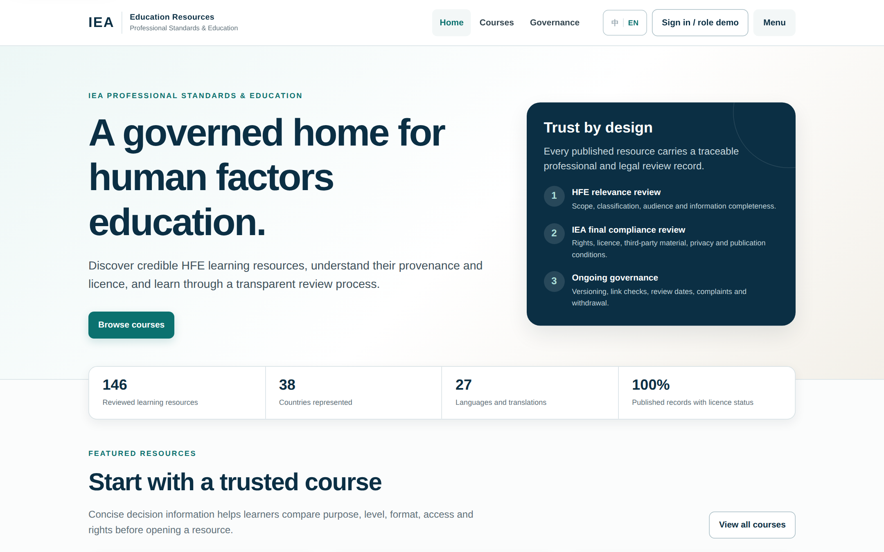
Interaction prototype – IEA Online Education Resources Platform
Prototype by Liang Ma and Yining Ye (September 2026); figures shown are placeholder demo data.

Slide 13
c) HFE Curricula & Programme Database
Value-add
Alignment with IEA Goals
Guidance for those who wish to establish new HFE courses in their countries
Up-to-date, searchable overview of HFE programmes worldwide with far less maintenance effort than the former Global Map
Goal: Curated curricula collection and a central HFE programme database, validated by societies and updated annually
SP 4 – Promote HFE education, certification and professional standards
SP 6 – Reinforce the infrastructure of the Association
SP 2 – Collaborate with and reinforce IEA networks
Source: iea.cc – IEA strategic policies
Stakeholder Needs to be met
Project outline including status
Orientation for institutions developing new HFE programmes
Reliable, current information on HFE programmes
Simple maintenance without shared accounts
Curricula collected; overview of covered subjects compiled completed
Overview shared with Council; invitation to add curricula in progress
Google Global Map discontinued; two-sheet Excel database built (303 programmes) completed
Existing records migrated from previous IEA database completed
User feedback on usability & search to start
Validation and expansion via regional representatives / societies to start
Reporting features (pivot tables, conditional formatting) to start

Slide 14
What stakeholders are involved in project & how?
Group | Group’s role within Project + category* | Group benefit | Individual | Individual’s role within project | Individual benefit
IEA PSE Committee | Project oversight; Compile curricula and maintain database (D, E) | Maintainable data source | Verena Nitsch – PSE Chair | Coordinate activities, outreach to Council (I, D) | Network expansion
IEA Council members / Federated Societies | Contribute curricula; Review and correct programme information (E, A) | Visibility, best-practice orientation | PSE Co-Chairs | Review information for their respective regions (E) | Regional expertise
Universities & programme leads | Provide programme details and curricula (A, E) | International visibility | Denizsu Topkaya – student support | Curricula collection, database migration and structure (A) | Research experience
IEA EC | Decision on replacing the Global Map; publication on IEA website (D, I) | Up-to-date website information | Regional representatives / institutional contacts | Verify and add programme information (E, A) | Visibility of programmes
*Categories are indicated by letters: Actor / Expert / Decider / Influencer

Slide 15
Main stakeholders and their relationship to each other
From ↓ To → | PSE Chair & Co-Chairs | Council members / Federated Societies
PSE Chair & Co-Chairs | Project oversight | Curricula overview, database for review
Council members / Federated Societies | Additional curricula, corrections
Universities & programme leads | Programme details and curricula

Slide 16
Update: c) HFE Curricula & Programme Database
Best-practice curricula
Collection of HFE curricula compiled with an overview of covered subjects
Overview provided to Council members – please send curricula you wish to add
Global Map → HFE programme database
Problem: double maintenance (Google Drive + Google Earth), shared-account login conflicts, high coordination effort
Solution: central two-sheet Excel database (filter + main tab); new entries as simple rows
303 HFE programmes to date; records migrated from previous IEA database
Next steps
User feedback · validation by regional contacts · reporting features

Slide 17
d) Certification (Re-)Endorsement
Value-add
Alignment with IEA Goals
Strengthens professional standards and recognition of HFE specialists globally
Transparent, consistent re-endorsement through a rubric-based scoring system
Exchange among certification bodies on mutual recognition and a centralised professional registry
Goal: All endorsed certification bodies reviewed on schedule; active network of certification bodies
SP 4 – Promote HFE education, certification and professional standards
SP 1 – Engage stakeholders
SP 2 – Collaborate with and reinforce IEA networks
Source: iea.cc – IEA strategic policies
Stakeholder Needs to be met
Project outline including status
Standardised and transparent endorsement processes
Greater accessibility of certification
Improved professional credibility; exchange among certification bodies
Endorsement of HFE Society of Malaysia (HFEM) completed
Meeting of certification bodies (19 Jan 2026) completed
Overview documents on certification systems and their history completed
Rubric-based scoring system for re-endorsement completed
CREE and ESSA applications scored independently by three assessors completed
Finalisation of CREE and ESSA re-endorsement in progress
Further re-endorsements (e.g. BCPE, CCCPE, ABERGO, JES) to start
Mutual recognition / professional registry in progress
Notes:
P^2DT is a process for helping systematic HFE project design. Various HFE methods or tools can be integrated into P^DT to conduct specific steps of the process.
P^2DT assumes participatory design approaches. The benefits of adopting participatory approaches are discussed later.
P^2DT is designed to be applicable to any HFE-related projects in various work places such as healthcare, office work space and environment, process plant, aviation,…

Slide 18
What stakeholders are involved in project & how?
Group | Group’s role within Project + category* | Group benefit | Individual | Individual’s role within project | Individual benefit
IEA PSE Committee & Certification Subcommittee | Project oversight; Assess applications, prepare endorsement recommendations (D, E) | Transparent, documented process | Verena Nitsch – PSE Chair | Coordinate activities, chair certification bodies meeting (I, D) | Network expansion
Certification bodies (e.g. CREE, ESSA, BCPE, CCCPE, CIEHF, ACE, HFEM) | Apply for (re-)endorsement; Collaborate on mutual recognition and registry (A, E) | Recognition, exchange, feedback | Stephven Kolose – Certification Subcommittee | Overview documents, scoring rubric, assessor (E, D) | Expertise development
IEA EC / Council | Decision on endorsement (D) | Informed decisions | Valerie O'Keefe – Certification Subcommittee | Assessor (E, D) | Expertise development
 |  |  | Rose Figueroa – Certification Subcommittee | Assessor (new) (E, D) | Expertise development
 |  |  | Contact persons of certification bodies | Provide documentation for (re-)endorsement (A, E) | Credibility boost
*Categories are indicated by letters: Actor / Expert / Decider / Influencer

Slide 19
Main stakeholders and their relationship to each other
From ↓ To → | PSE Chair & Certification Subcommittee | Certification bodies
PSE Chair & Certification Subcommittee | Project oversight | Guidance, assessment & feedback; network meetings
Certification bodies | Applications & documentation; input on criteria | Exchange on mutual recognition
IEA EC / Council | Decision on endorsement
Notes:
Coupled with the understanding of stakeholder benefits (Step 6), the understanding the relations among stakeholders is critically important for developing promotional strategies.
It will form a basis for specifying subprojects: The underlying consideration is to develop a set of projects which do not conflict in each project. For instance, develop a science-oriented HFE project and a more application-oriented HFE project: The science-oriented HFE project is designed to contribute to the development of HFE science, while the application-oriented HFE project is designed to provide practical benefits. They together achieve a high-quality HFE project. Others may include promotion projects for influential stakeholders (i.e., system influencers).

Slide 20
Update: d) Certification (Re-)Endorsement
Endorsement
Successfully guided the HFE Society of Malaysia (HFEM) through the endorsement process
Network of certification bodies
Meeting with certification bodies; collaboration on mutual recognition and a centralised professional registry
Two overview documents on certification systems and their history (S. Kolose)
Re-endorsement
New rubric-based scoring system
CREE and ESSA applications scored independently by three assessors
Rose Figueroa joined S. Kolose and V. O'Keefe as assessor

Slide 21
Re-endorsement schedule
Certification body | First endorsement | Last re-endorsement | Next due | Status
Argentina (ADEA) | 2024 | – | 2030 | Not due
Australia (HFESA) | prob. 2007 | 2021 | 2027 | Not due
Brazil (ABERGO) | 2018 | – | 2024 | Re-endorsement required
Canada (CCCPE) | 2020 | – | 2026 | Expected Jan 2027
Europe (CREE) | before 2009 | 2020 | 2026 | Submitted 2026 – scored
Japan (JES) | 2006 | 2019 | 2025 | Re-endorsement required
Malaysia (HFEM) | 2025 | – | 2031 | Not due
New Zealand (HFESNZ) | 2007 | 2021 | 2027 | Not due
South Africa (ESSA) | before 2022 | – | 2023–2027 | Submitted 2026 – scored
USA (BCPE) | before 2009 | 2020 | 2026 | Due
Source: PSE re-endorsement overview (Sept 2026). Mexico has never applied but maintains long-standing communication with IEA about its established system.

